Slide 1


Slide 2
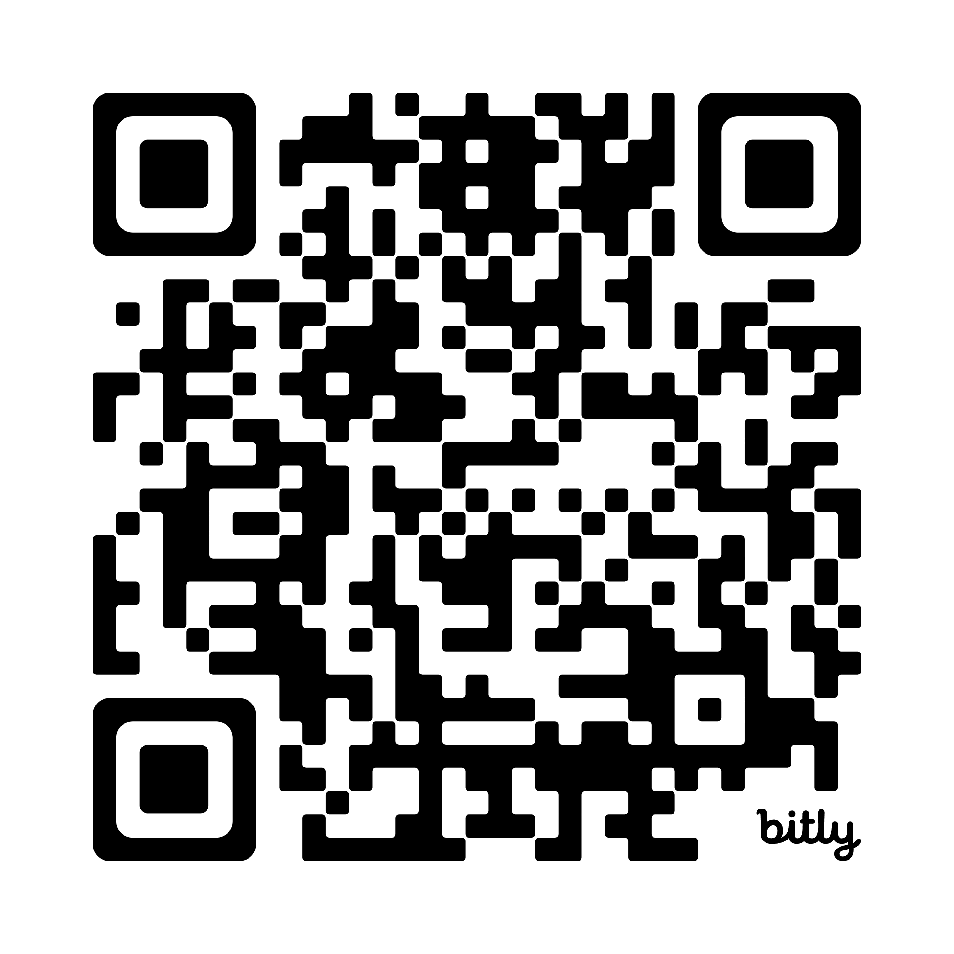
Please Sign-in
Network: Blue Oaks
Password: 7139KollCenter

Slide 3


Seunen Paschengink Contacts
https://yerbabuena.goldengatescouting.org/
Andrew Gaddis
andrew_gaddis@yahoo.com
Chapter Chief
Shannon Carroll
shannoncarrollggac@gmail.com Chapter Advisor
***please remember to use YPT protocol when communicating with youth members***

Slide 4

Twin Valley Roundtable
March 5, 2026

Slide 5

Welcome to Roundtable
Tonight’s slides will be available online at:
https://twinvalley.ggacbsa.org/

Slide 6
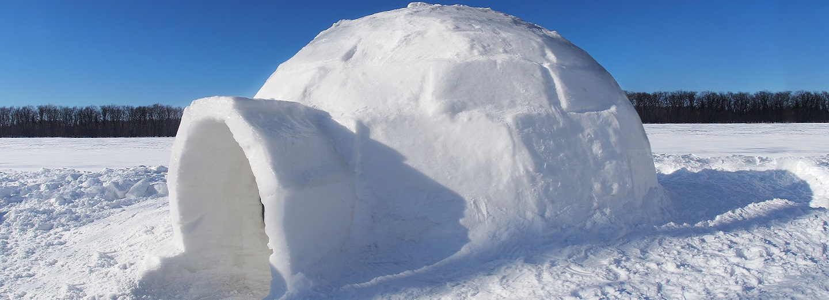
Safety Moment:
Cold Weather Preparedness
C = Clean: Insulation is only effective when the insulating layers are kept clean and fluffy.
O = Overheating: Avoid overheating by adjusting the layers of your clothing to keep from sweating during warmer temperatures. Stay hydrated by drinking plenty of water. Avoid energy drinks (sports drinks are OK).
L = Loose layers: Wear several loosely fitting layers of clothing and footwear that will allow maximum insulation without blocking your circulation. Having clothing that is brightly colored (orange or red) is also a good idea, so hunters and sportsmen can see you in snowy conditions. Always wear a hat.
D = Dry: Sweaty, damp clothing and skin can cause your body to cool very quickly, possibly leading to frostbite and/or hypothermia. Keep dry by avoiding clothes that absorb moisture. Always brush snow off your clothes before you enter a heated area.
For more information visit: https://www.scouting.org/health-and-safety/safety-moments/winter-activity/

Slide 7


Safety Moment
https://www.avalancheaware.com/

Slide 8

District Updates
Twin Valley District Roundtable
March 5, 2026
Fil de Cal - District Executive, Twin Valley
Golden Gate Area Council

Slide 9
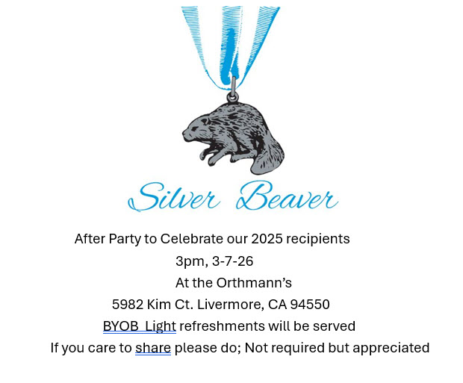
A word from Dr. Weiss
Silver Beaver
District Awards

Slide 10


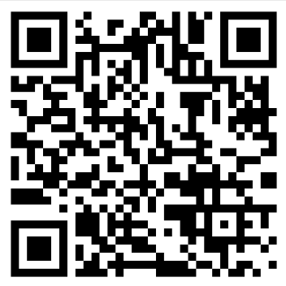
More Council Events:
Clayton Carroll
Greg Dyson
Terri Dyson
Robert Nuddleman

Slide 11
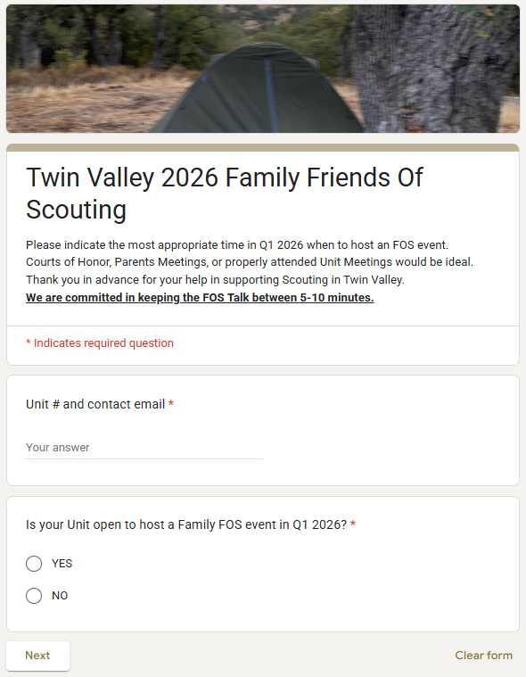
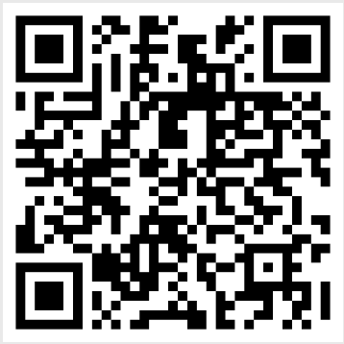
2026 FOS Planning
2026 Campaign starts in January
Best venue: CoH or dedicated Unit meetings (e.g. parents night)
Google Form is out for sign-ups
Missing details from:
Packs 546, 901, 912, 914, 916, 943, 948, 950, 951, 969, 981
Troops 904, 908, 916, 924, 939, 941, 947, 948, 981, 998, 999, 2904, 2981

Slide 12

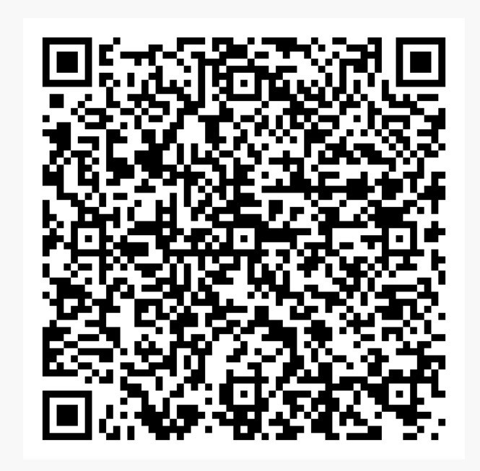
2026 Popcorn Campaign
Registration is LIVE for 2026 commitment. Register your Unit for 2026!
“Work hard for six weeks, enjoy a year of free Scouting adventures!”
In 2025:
$87,000+ in TV Unit rewards
12 Scouts obtained 100% Campership discount
14 obtained 50% discount
48 obtained 25% discount
‘000’s in gift cards

Slide 13
NEW: 2026 Certificates of Insurance
Emailed to Key 3:
Livermore (March 2)
Dublin (March 2)
Pleasanton (March 5)

Slide 14
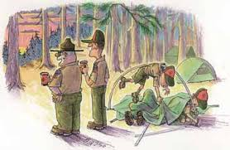
More District Events:
IOLS / BLUE OAKS: April 10-12
65th District Dinner: May 9
Camporee: May 15-17
Cub Scouts Day Camp: June 23-26
Sea Scouts Weekend: September 12-13
Trail To Troop: October 2-4
Ocean to Redwoods Adventure: July 5-11

Slide 15

2026 Council Support
10’x10’ Canopy
Yard Signs
Tablecloth
Kites
Rockets
Bow & Arrow Playset
Invites + Flyers + Posters
Youth and Adult application forms
Directional Signage

Slide 16
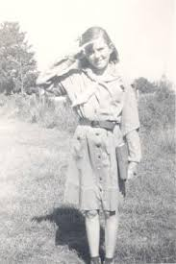

2026 Summer Camps
 | Week 1 | Week 2 | Week 3 | Week 4 | Week 5 | Week 6
Camp Royaneh | 924 | 908, 2981 |  | 2981
Wente Scout Reservation | 900 | 947 | 948, 981 | 939, 941, 998, 2942, 2998 | 905
Camp Wolfeboro | 941, 998, 999, 2942 |  | 911
Bold: multiple weeks booked
Consider Provisional Scout option

Slide 17
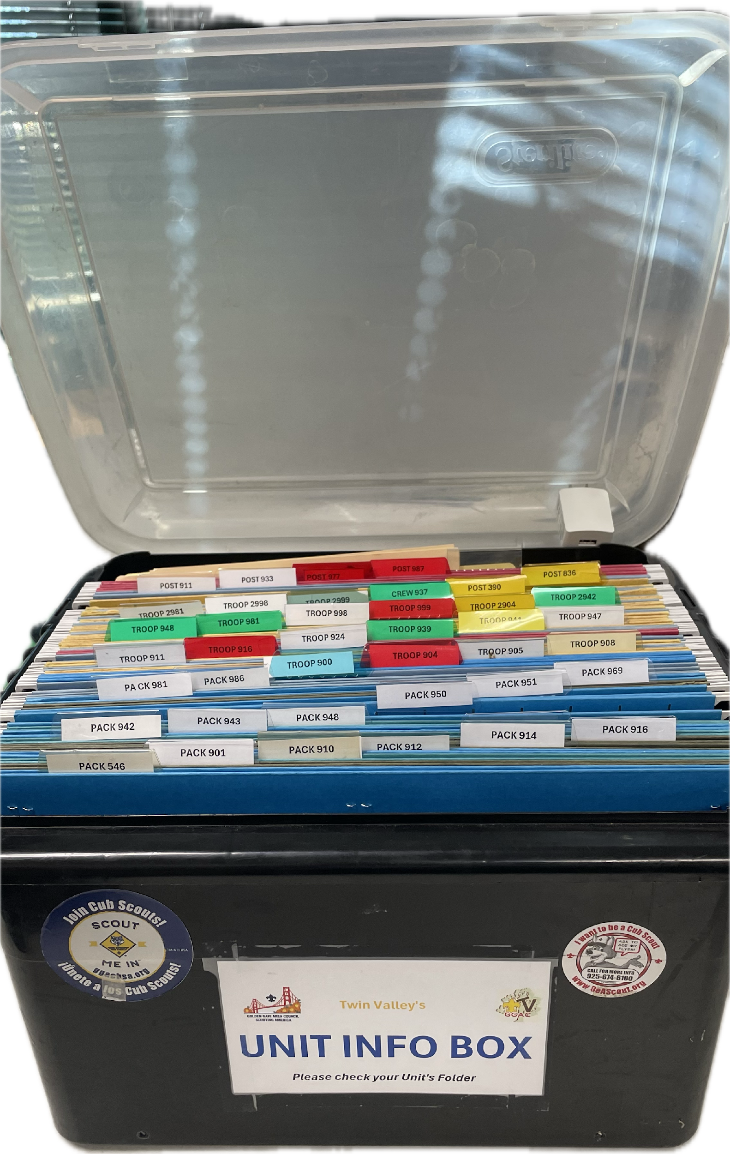
Don’t Forget To Check Your Info Box!
Reminders
Updates
Reports
Certificates
Announcements
EAGLE Kits (T908, T924, T941, T2999)

Slide 18
Next Roundtable:
April 9, 2026

Slide 19
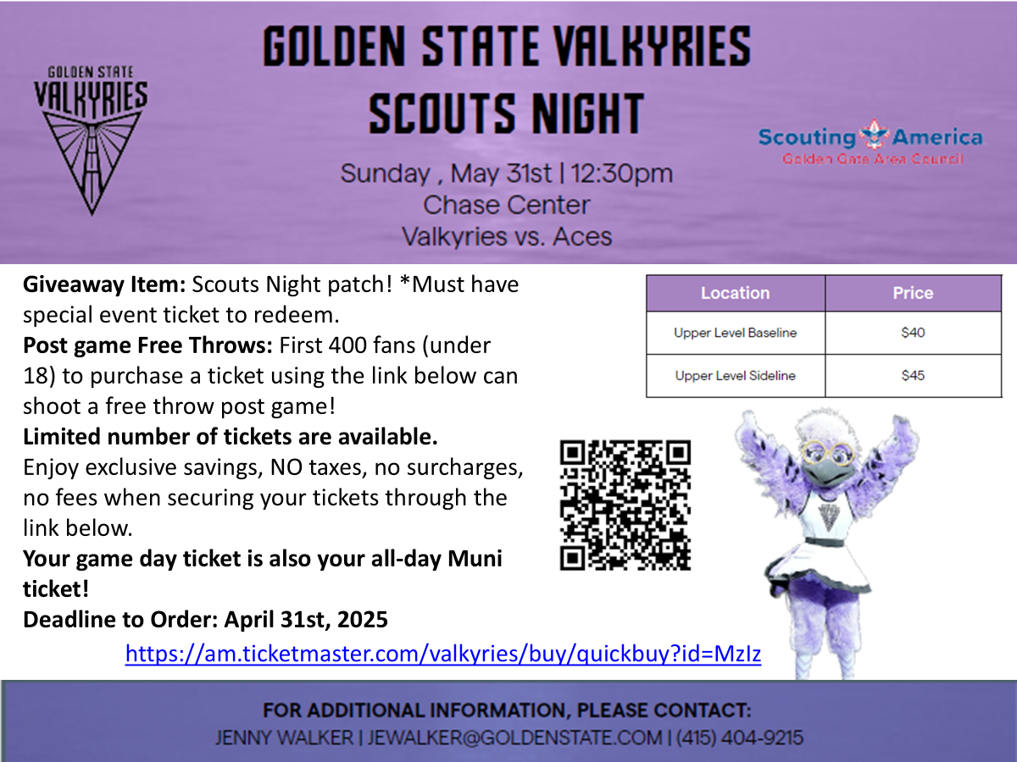
ACTIVITIES AND EVENTS
Really Fun Stuff

Slide 20

T-Shirt Club
Be in the room where it happens
Change into a t-shirt
and see you there!
This month, let’s try…
336 St. Mary Street Pleasanton

Slide 21
Topics for Group Discussion
What is your unit doing?

Slide 22
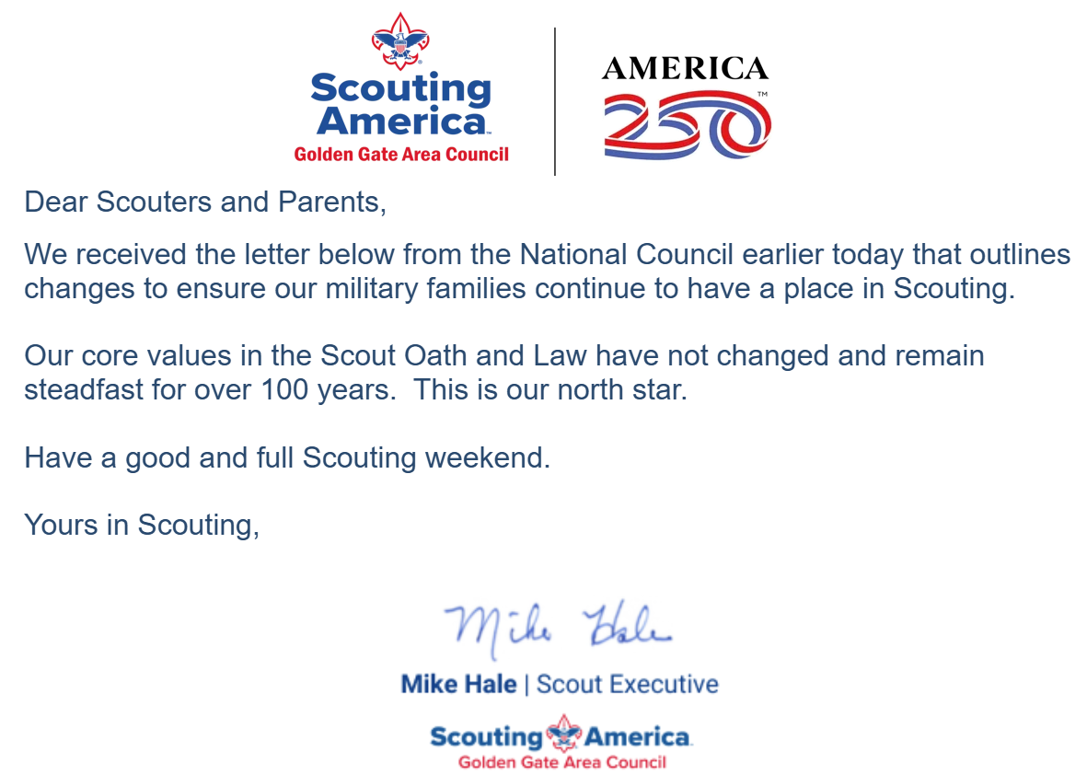
Executive Order 14173
Please direct all questions to Mike Hale - Scout Executive
communications@goldengatescouting.org
Friday, 2/27/2026

Slide 23
Scouting America - Military Announcement
2/27 - Mike Hale sent out an email regarding Executive Order 14173 and Scouting America
Provides Continued support for Scouting on military installations worldwide
Continues ongoing Support for Nation Jamborees
New Benefits for Military family
New Military Service merit Badge

Slide 24
Changes in PUSD
Pleasanton Unified School District has decided to start charging for renting MPRs
A single classroom (up to 30 people) is free
How do units that meet (or met) at schools handle their meeting spaces (non-Pleasanton)?
For those using PUSD facilities, what is your plan? Are you paying or meeting elsewhere?

Slide 25

Breakout
Cub Scouts

Slide 26


“Ging Gang Goolee”
Usually sung in the round…
Ging Gang Goolee, Goolee,
Goolee, Goolee Watcha
Ging Gang Goo Ging Gang Goo
Ging Gang Goolee, Goolee,
Goolee, Goolee Watcha
Ging Gang Goo Ging Gang Goo
Hayla, Hayla Shayla, Hayla Shayla Hayla Ho-o-o!
Hayla, Hayla Shayla Hayla Shayla Hayla Ho-o-o!
Shalawally hallway shalawally shalawally!
Oompah, Oompah, Oompah, Oompah!

Slide 27

2026 Camporee: Registration is OPEN

Slide 28
Cub Scout Recruitment Coordinator
District needs a volunteer from each City (Dublin, Pleasanton, Livermore) to help coordinate and maintain schedule of Pack Recruiting events and opportunities for District Membership Chair.

Slide 29

Getting Parents Involved
Strategies for Recruiting Parents:
Make it Personal
Offer Flexible Options
Set Clear Expectations
Foster a Social Environment
Remove Logistical Barriers
Leverage Technology
Highlight the Impact
Things to Avoid:
Expecting parents to volunteer on their own
Expecting everyone to be a leader
An unwelcoming atmosphere
Titles - Focus on the Tasks
Notes:
Make it Personal: Broad emails are often ignored. Instead, reach out directly to parents via phone, text, or face-to-face conversation at pickup. Parents are more likely to say "yes" when they feel their specific skills are being recognized.
Offer Flexible Options: Many parents work full-time or have young children. Provide "bite-sized" tasks like 30-minute shifts, evening/weekend opportunities, or at-home tasks like cutting out raffle tickets or updating a website.
Set Clear Expectations: Vague requests can be intimidating. Provide a "Volunteer Menu" or clear job descriptions that list the specific duties and the exact time commitment required (e.g., "1 hour a month").
Foster a Social Environment: Encourage parents to sign up in pairs or small groups with friends to make volunteering a social event rather than just a task. Hosting low-pressure meet-and-greets can help new families feel welcomed.
Remove Logistical Barriers: Provide onsite childcare or offer transportation for parents who do not drive to make it easier for them to attend meetings or events.
Leverage Technology: Use online scheduling tools like SignUpGenius or SignUp.com so parents can easily view and select slots from their phones without back-and-forth communication.
Highlight the Impact: Share success stories of how previous volunteer efforts directly benefited the students, such as funding new playground equipment or classroom supplies.

Slide 30
Breakout
BSA Scouts

Slide 31

Camporee!
Register here
$20 until 4/3
$30 after

Slide 32
Summer Camp
It’s time to start thinking about Summer Camp (if you aren’t already)
Cost is $815 per Scout, $500 per adult
Calls to Action:
Start talking about Summer Camp with your Scouts and families
Start collecting deposits for camp ($250 due to council late March)
Let your Scouts and families know that merit badge schedules are being released February 17 (for GGAC camps) - or not :(
Encourage Scouts who may need financial help to apply for Camperships
Encourage older Scouts to apply for staff positions here More information at https://goldengatescouting.org/summer-camp/

Slide 33


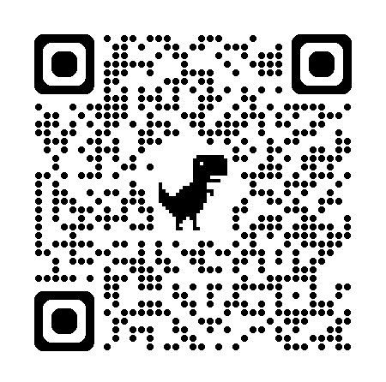
oceantoredwoodadventure
Who: Provisional Scouts, aged 14-20
What: Backpacking, canoeing, COPE,
trail cooking, leadership devo
When: July 5 – July 11
Where: Camp Royaneh
Cost: Same as camp, $815
Discount: Half off for anyone attending a week of camp
Questions: croraadventure@gmail.com
Registration & More Info

Slide 34
Jamboree 2026 - Do you have Scouts going?
Registration is closed
Summit Bechtel Reserve from July 22 to 31, 2026
$4100 (includes airfare)
More information here:
https://jamboree.scouting.org/
https://goldengatescouting.org/jamboree/

Slide 35
Jamboree Alternatives
Bundeslager National Jamboree 2026
30 July - 8 August 2026 in Wolfsburg, Germany
349 Euros + travel ($2940 BWE, $1550 HAJ)
Pupukea Summer Camp in Hawaii
$500 + travel ($600-900)
Does your troop do any Jamboree-type event?

