Slide 1

Twin Valley Roundtable
November 13, 2025

Slide 2
Welcome to Roundtable
Tonight’s slides are available online at:
https://twinvalley.ggacbsa.org/

Slide 3
District Updates
November 13, 2025

Slide 4
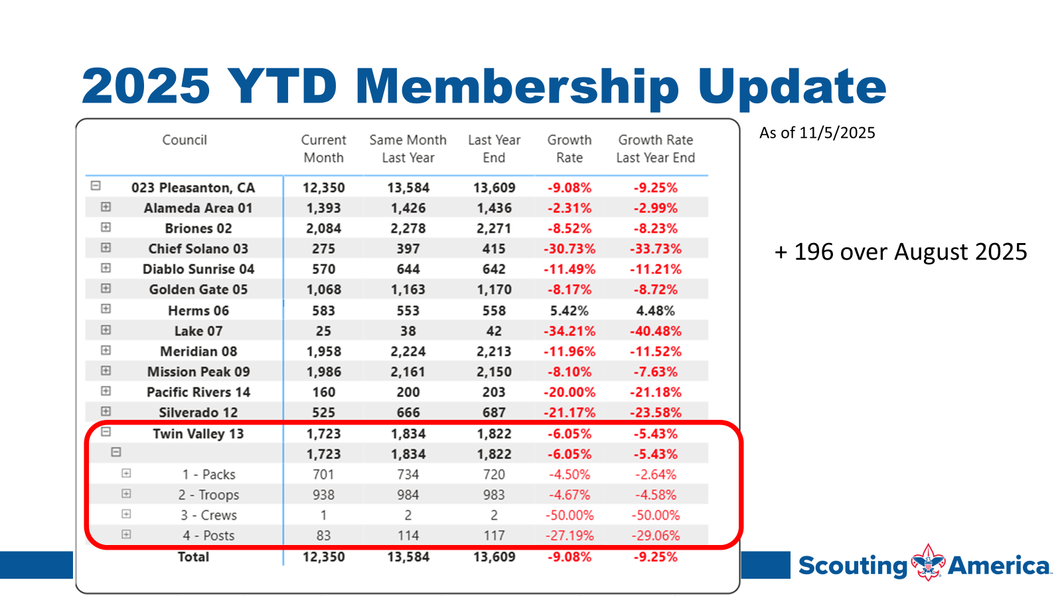

Slide 5
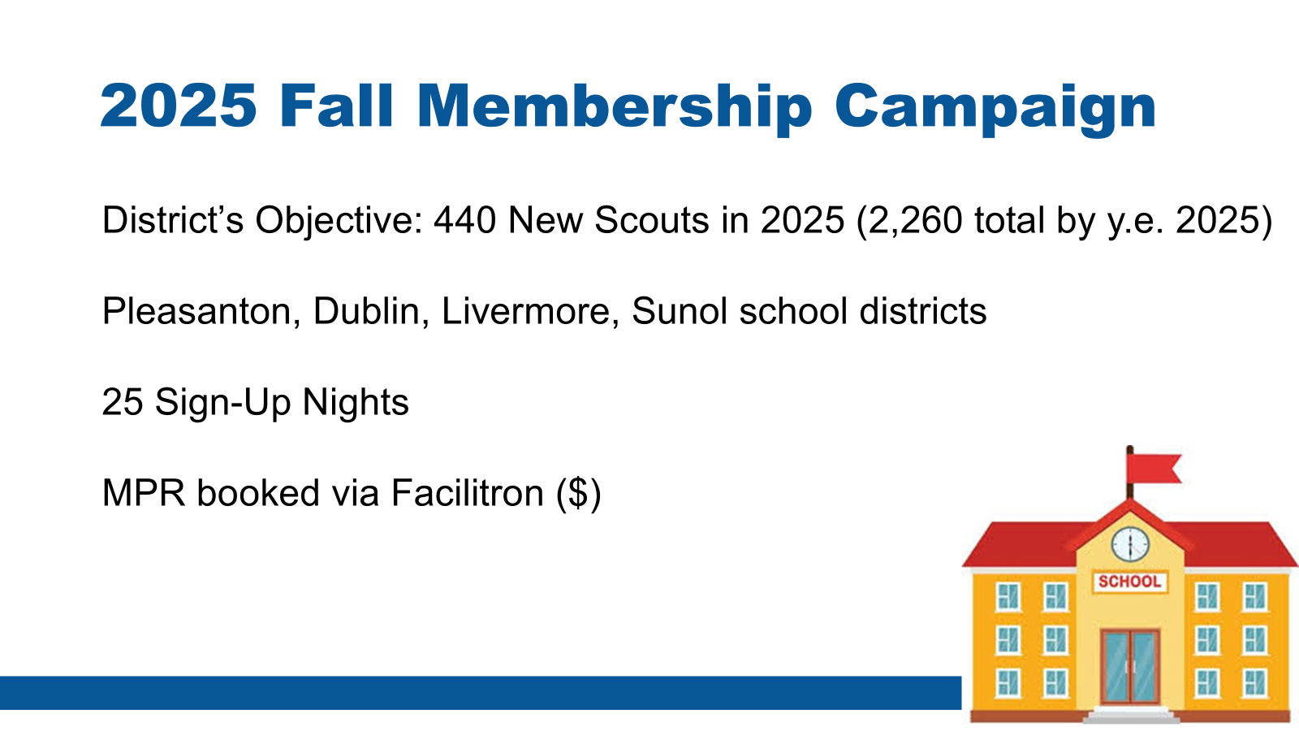

Slide 6
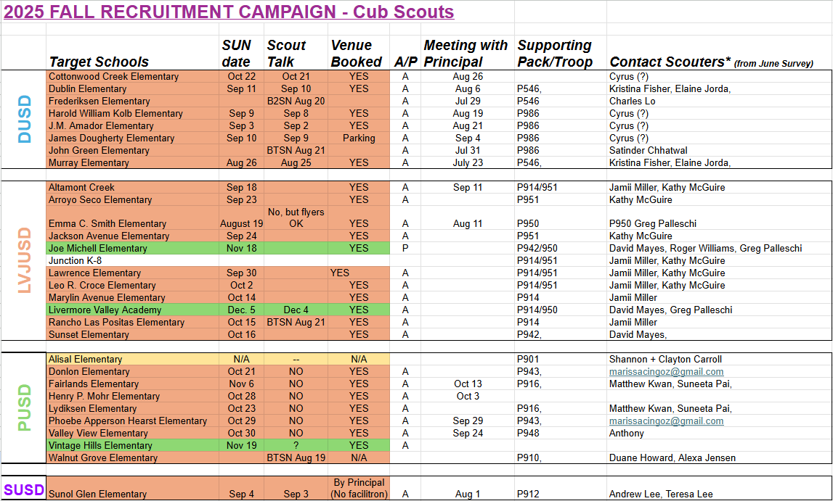

Slide 7

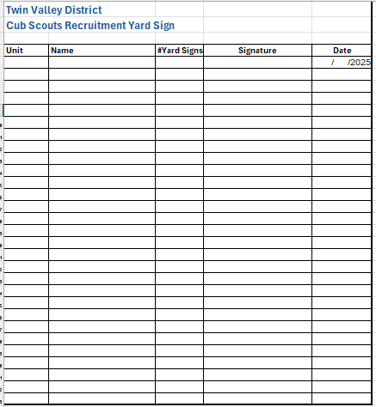
Available for you:
18" x 24" Yard sign
Semi-permanent
Check local restrictions
Schools, neighborhoods, meeting places
Available for pick up tonight
  Fill form

Slide 8
Golden Gate Area Council
Achieving Budget 2026 Discussion on CPF

Slide 9
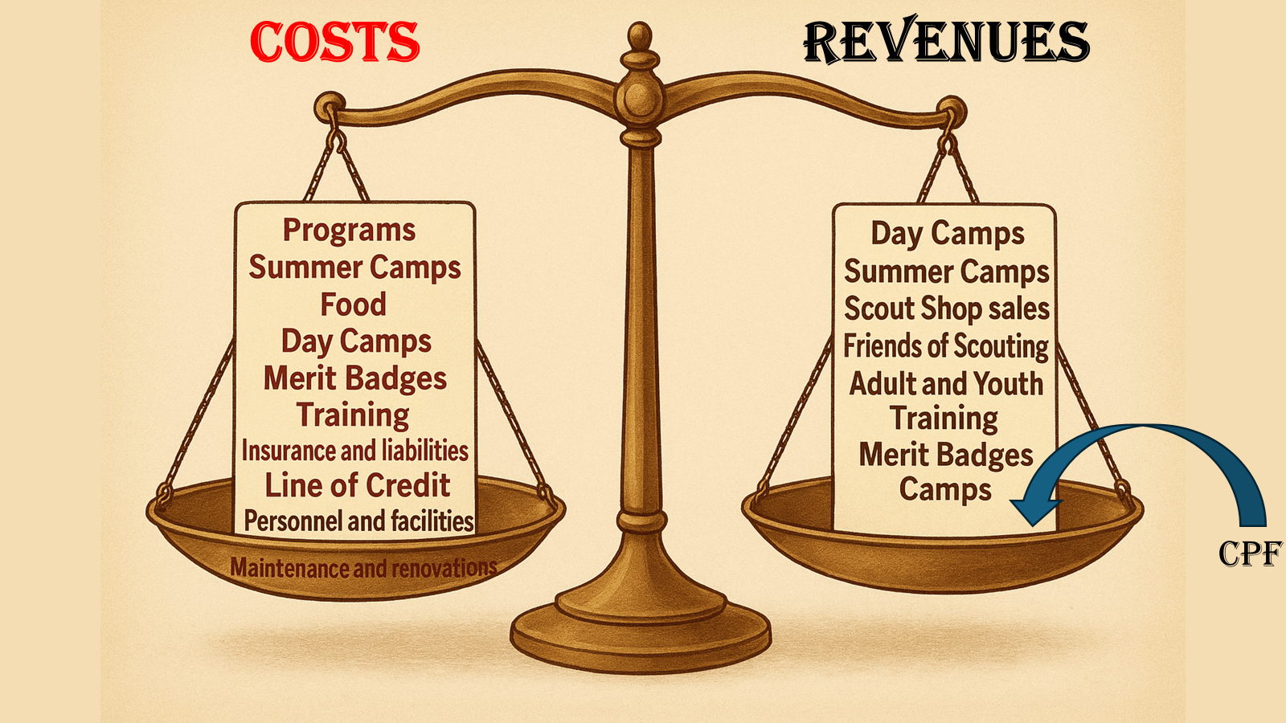

Slide 10
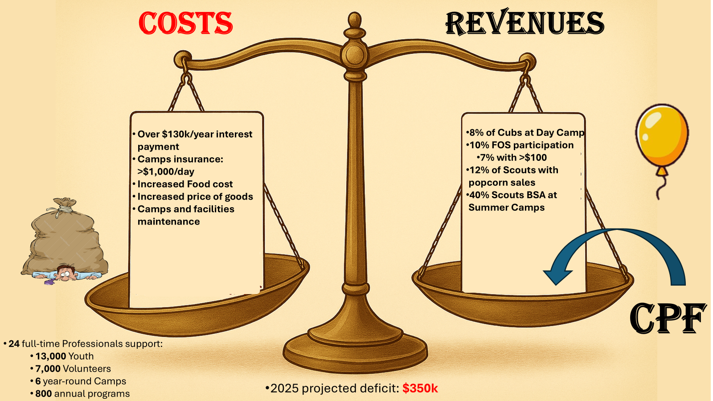

Slide 11
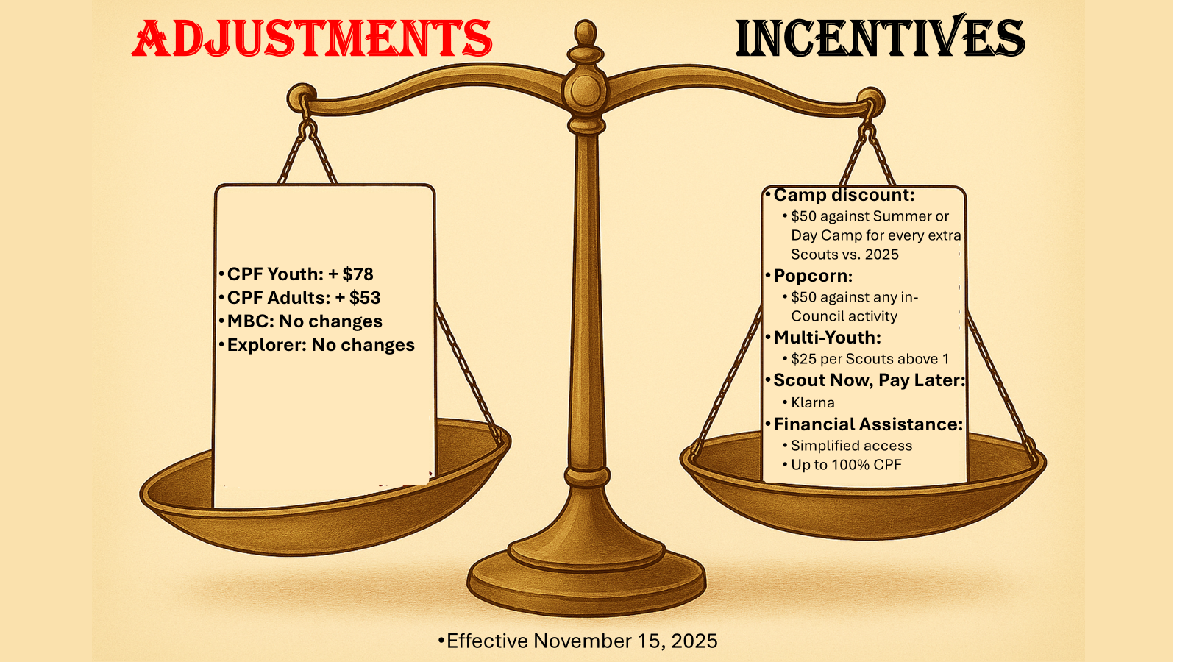
Youth: $234
Adult: $164

Slide 12
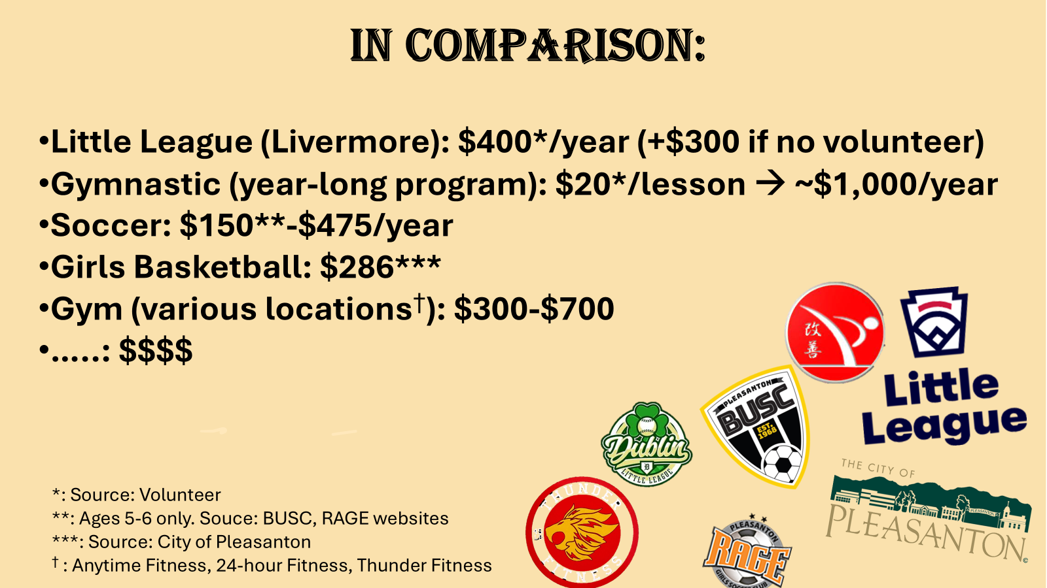

Slide 13
In Conclusion:
Adjustments are needed to keep the Council solvent and in existence
The additional impact on families is $6.50/month or less, and is considerably lower than other available alternatives
Increase youth participation in Scouting instrumental in offsetting costs
Friends of Scouting campaign has been an historically declining buffer (both in participation and contributions)
The impact of Scouting on our youth is priceless

Slide 14
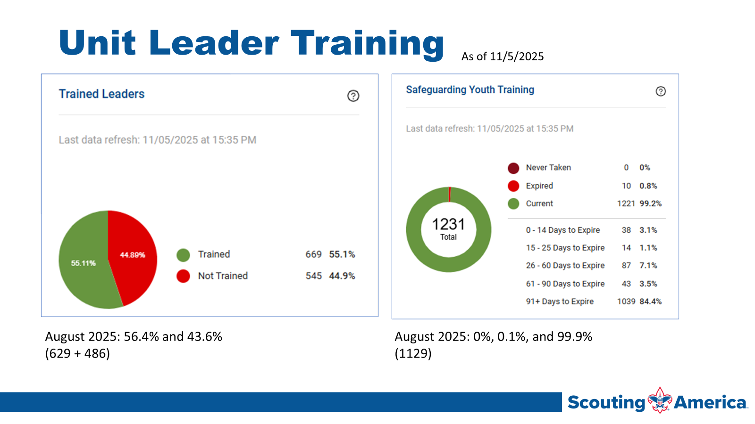

Slide 15
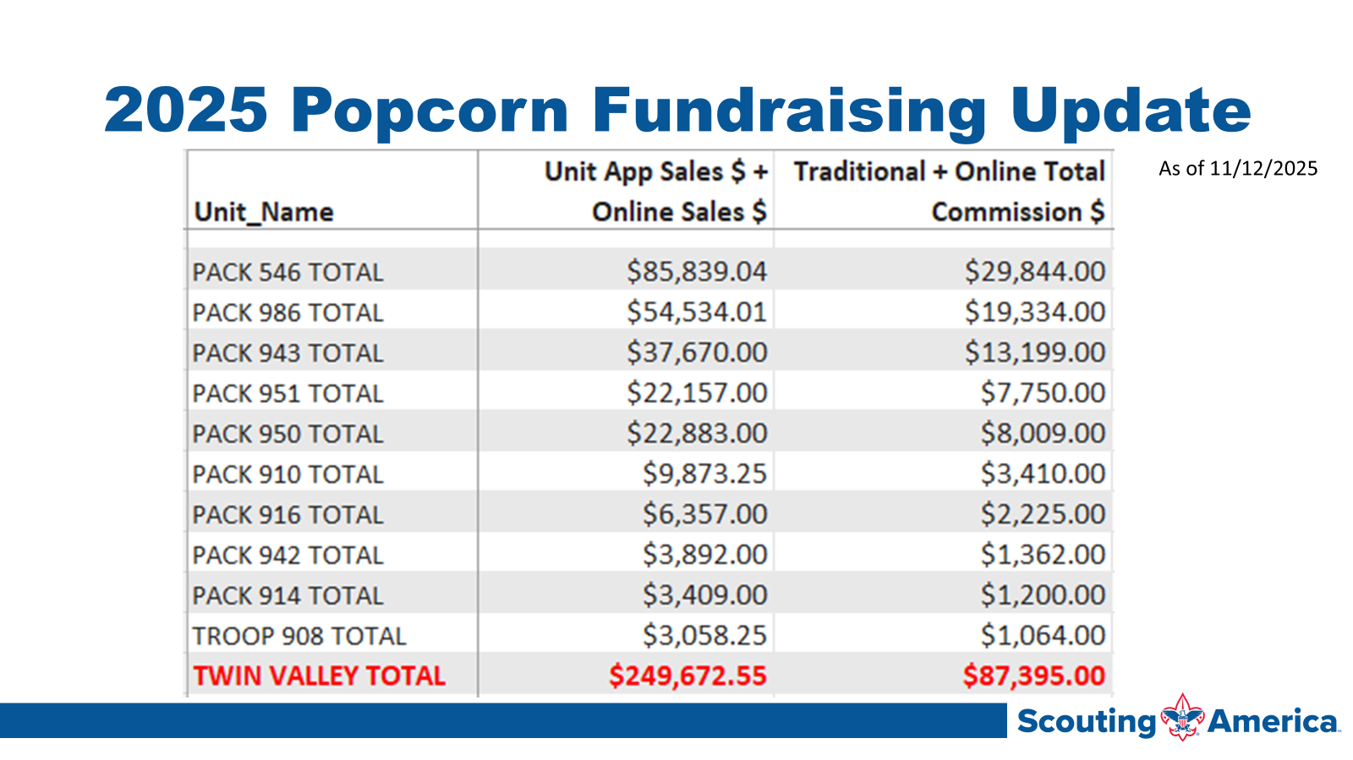

Slide 16
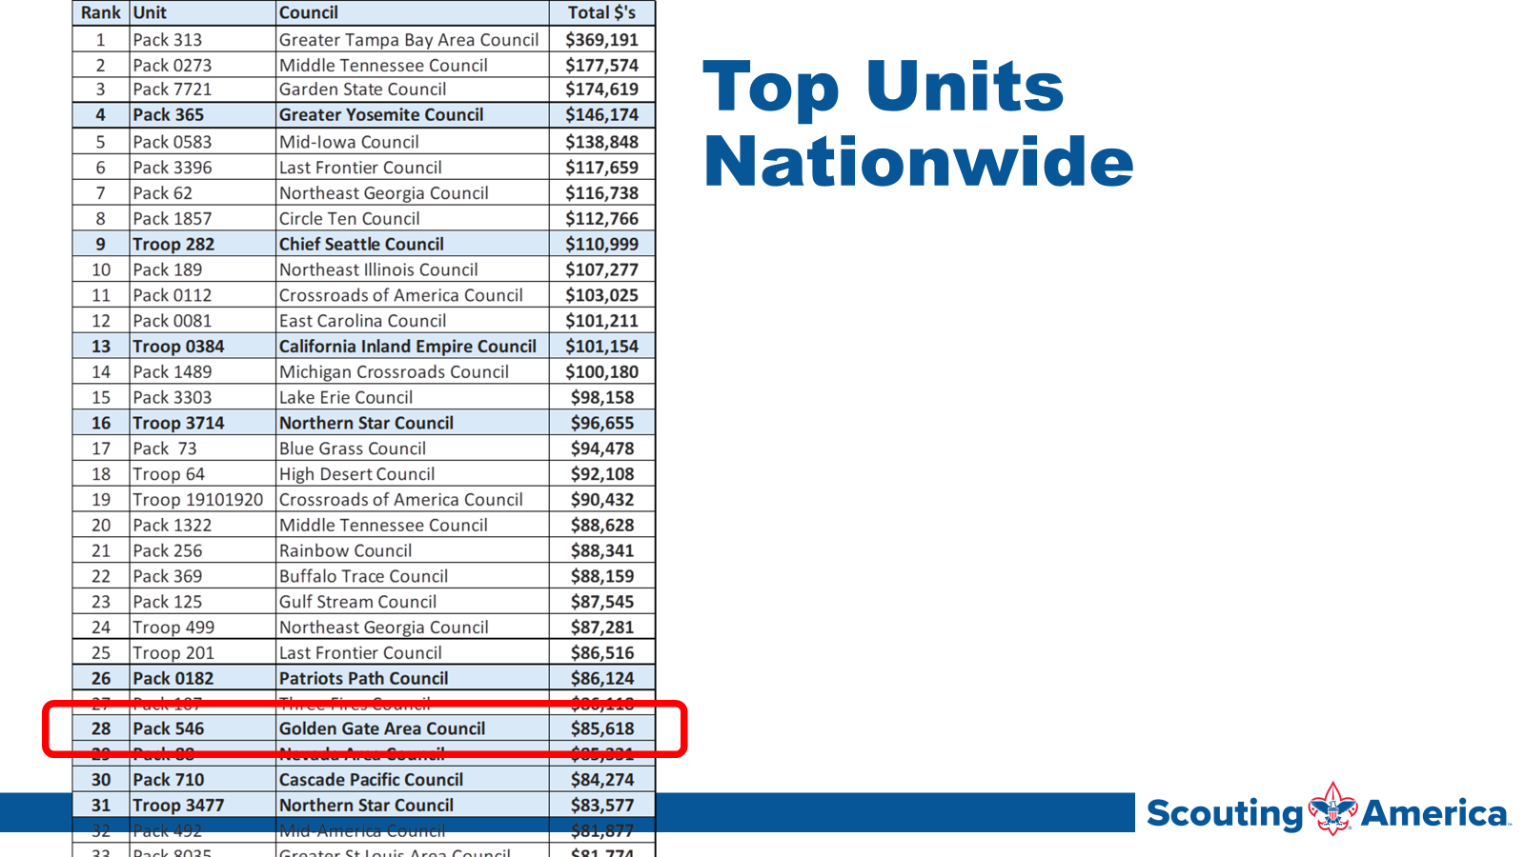

Slide 17
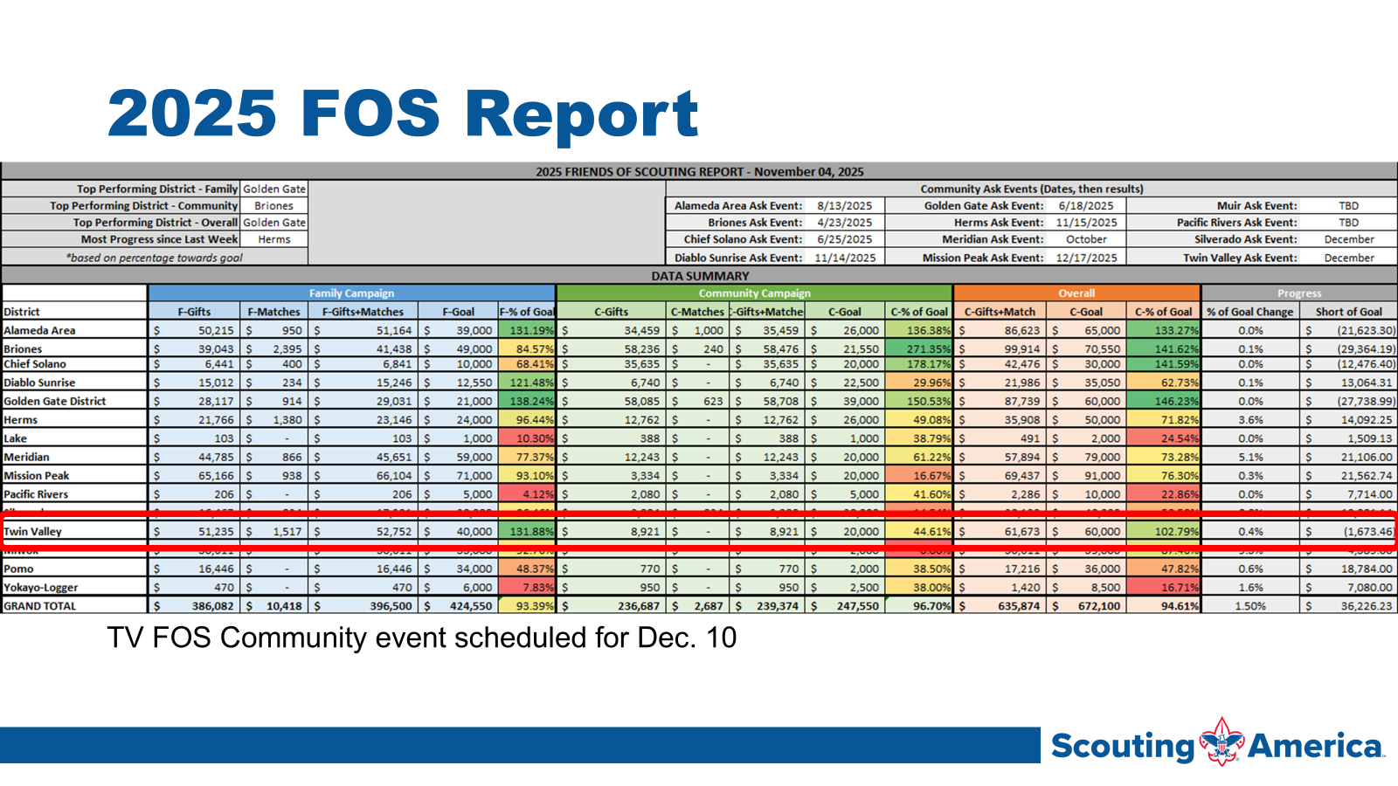

Slide 18
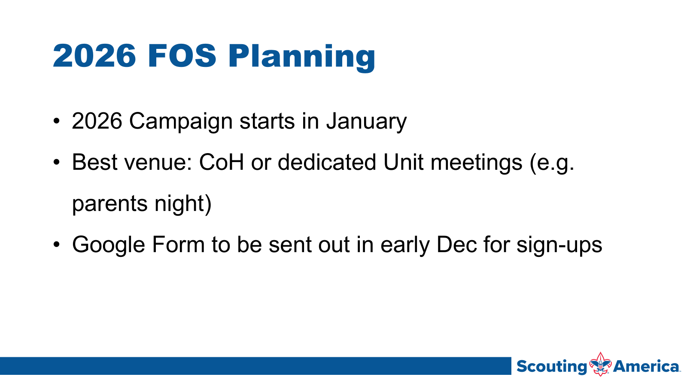

Slide 19
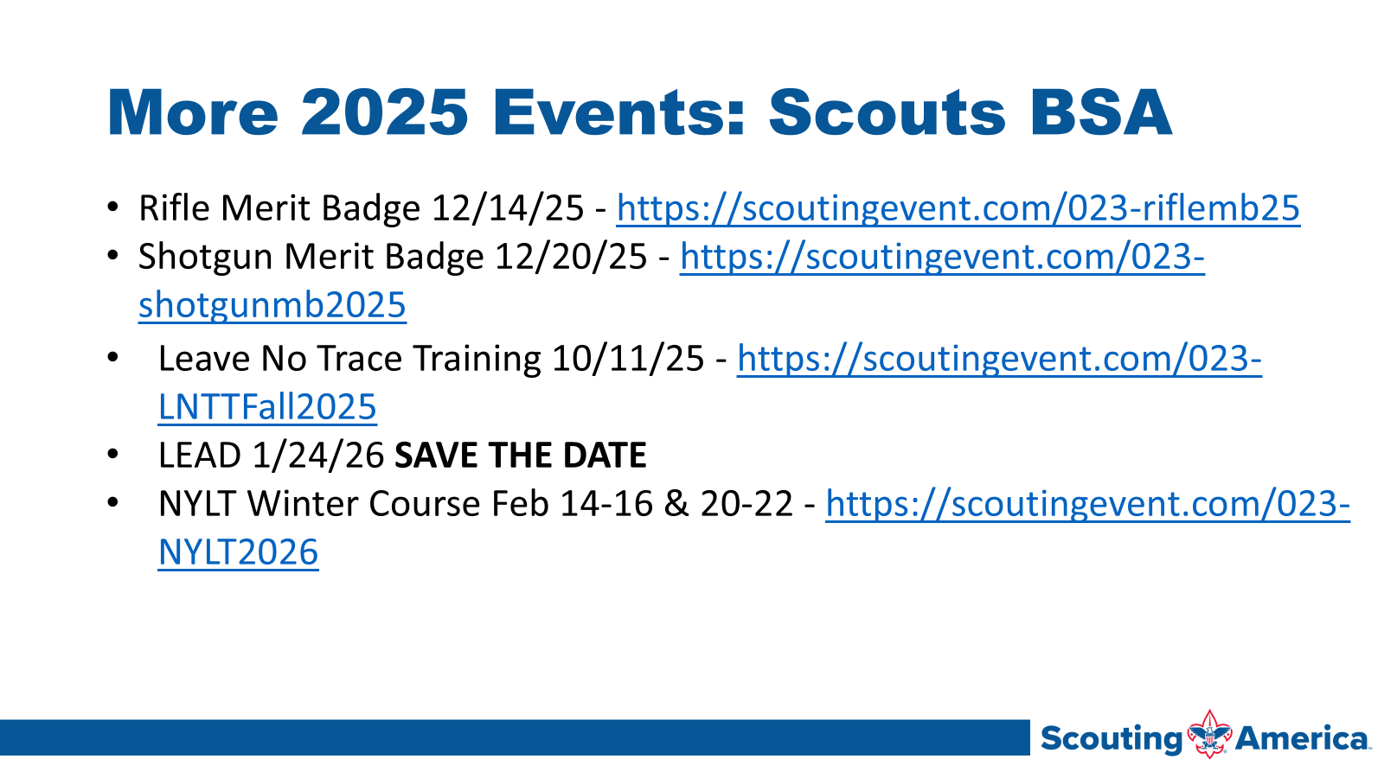

Slide 20
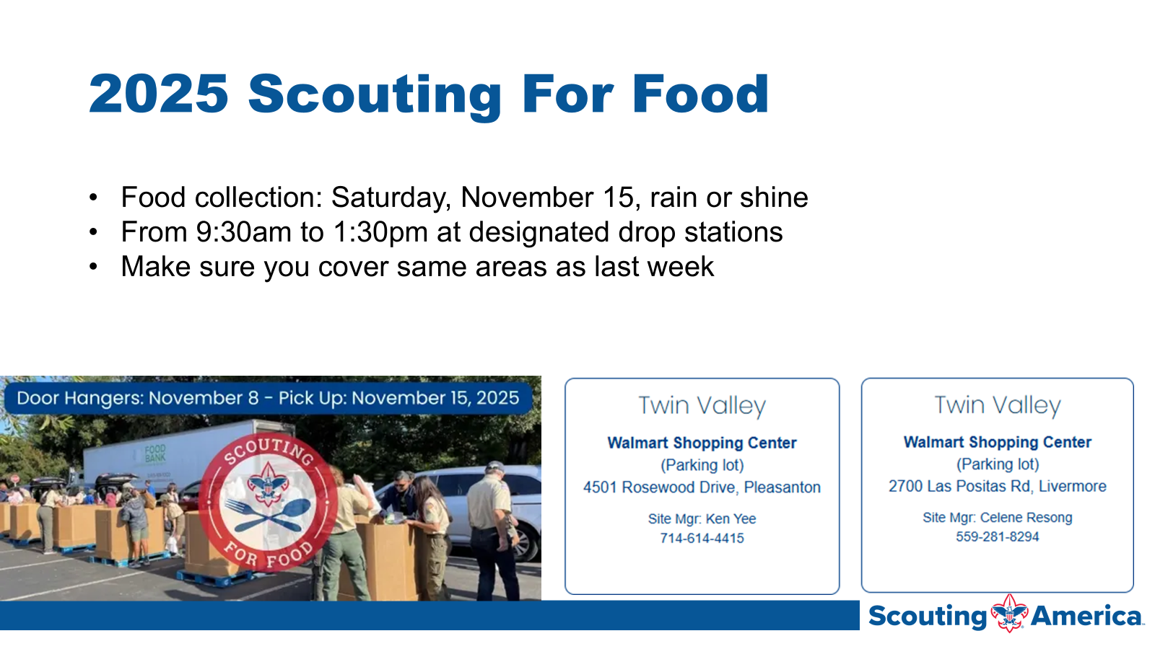

Slide 21
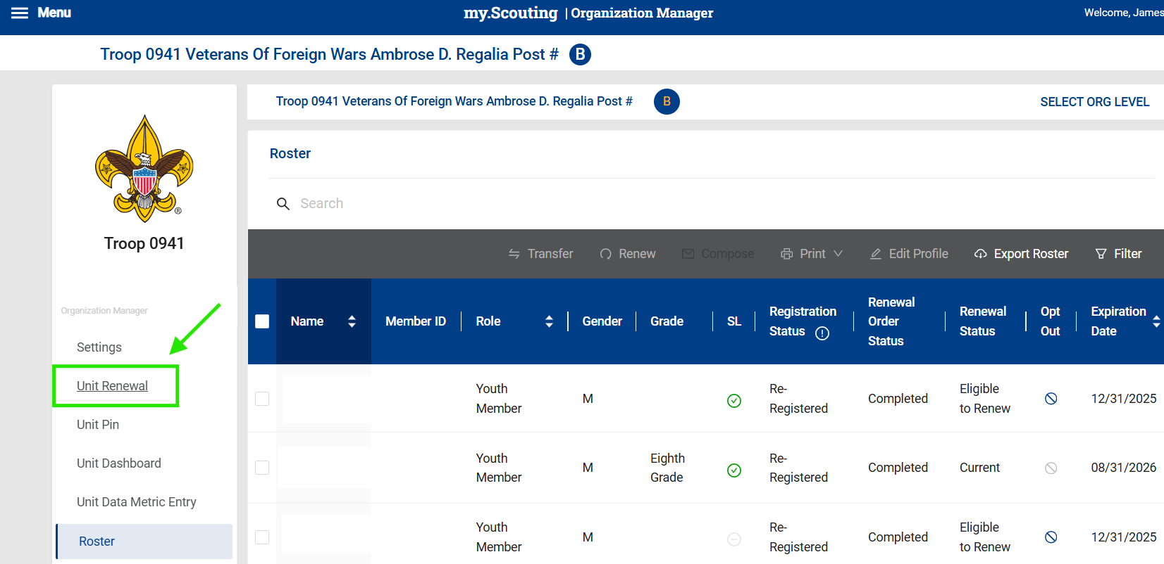
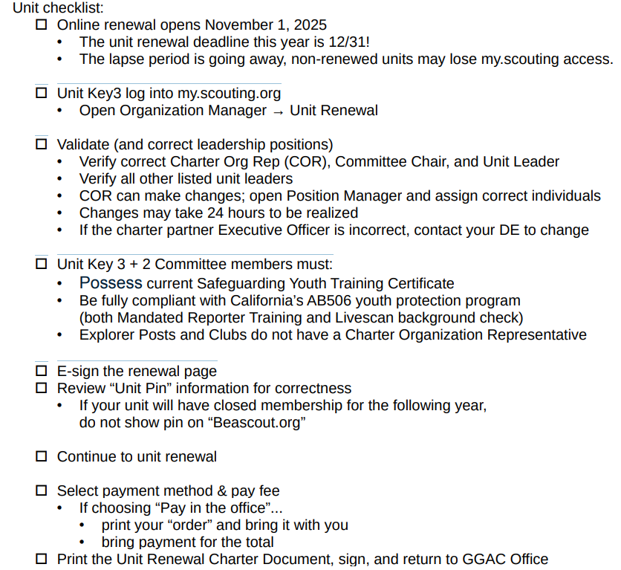
Unit Renewal (formerly known as Recharter)

Slide 22
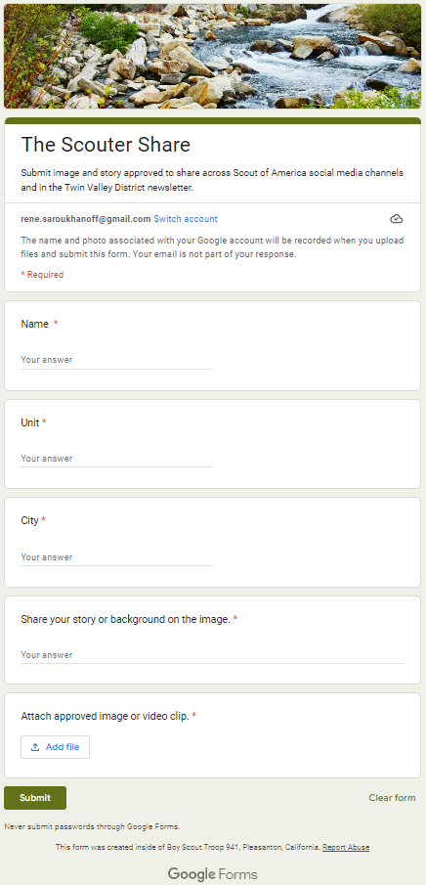
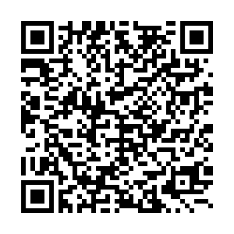
The Scouter Share
There are so many wonderful moments in our scout life - let’s share them!
Highlight your unit’s great moments or great scouts to be shared across the Twin Valley District’s newsletter, website and social media handles.
All you need:
Name, Email, City, Unit
A sentence or two about the moment/scout
One photo approved to be used

Slide 23
Annual Recharter
Annual recharter process opened as of Monday, October 2nd
The process is completely online and available at Internet Advancement
GGAC’s YPT policy is stricter than the National BSA policy
YPT and AB506 certification must be valid through the entire calendar year 2024 at time of recharter
The new AB506 training can be accessed from the California Scouting website
YPT & AB506 status for all registered members is always available on Dropbox.

Slide 24
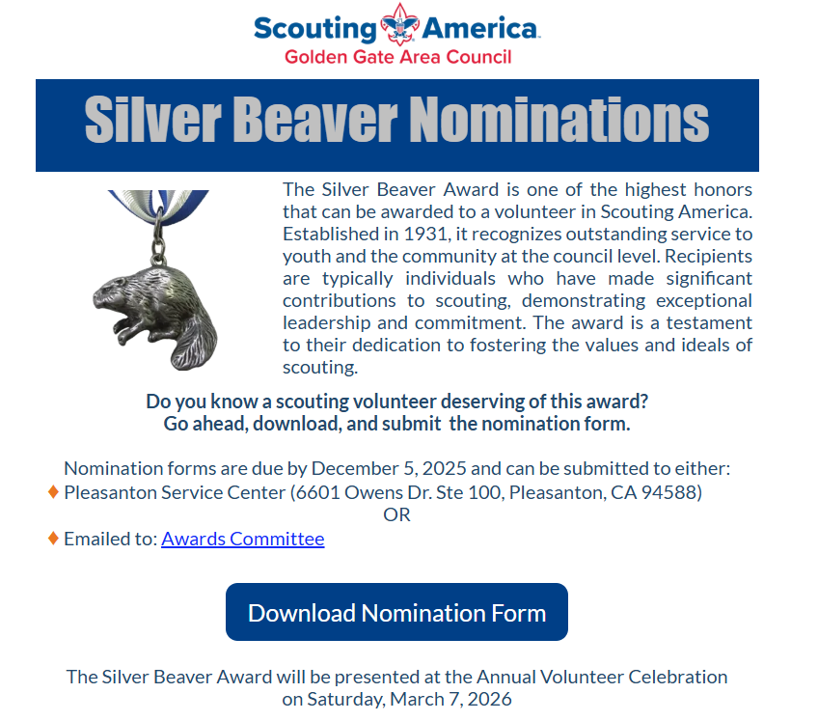

Slide 25
Troop Showcase - Dec 11
SPL / Scout pitch about their troop
Send graphics / slides by Dec. 1 to Roundtable@twinvalleyscouting.com
Space available for tables / displays following individual troop presentations

Slide 26
ACTIVITIES AND EVENTS
Really Fun Stuff

Slide 27
SPOTLIGHT
Really Fun Stuff

Slide 28

Scouting for Food Pick Up
Don’t forget to pick up food on Saturday.
Take the food to either the Pleasanton or Livermore Wal-Mart.
More details at https://goldengatescouting.org/scouting-for-food/

Slide 29
Weather Hazards Training
Congratulations to the following 100% Units:
Pack 901, Pack 910, Pack 915
Troop 904, Troop 2904

Slide 30
Breakout
Cub Scouts

Slide 31
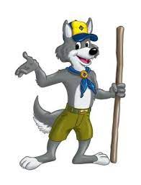
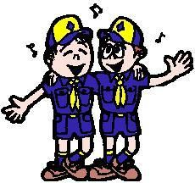
“The More We Get Together”
Tune: “Ach Du Lieber Augustine”
The more we get together, together, together,
The more we get together, the happier we’ll be.
For your friends are my friends, and my friends are your friends,
The more we get together, the happier we’ll be.
The more we get together, together, together,
The more we get together, the happier we’ll be.
For you know that I know, and I know that you know,
The more we get together, the happier we’ll be.

Slide 32

Registration opens Jan 1st for 2026!!!
Please share these dates and events with your Packs.
Events fill up quickly so please register early.

Slide 33

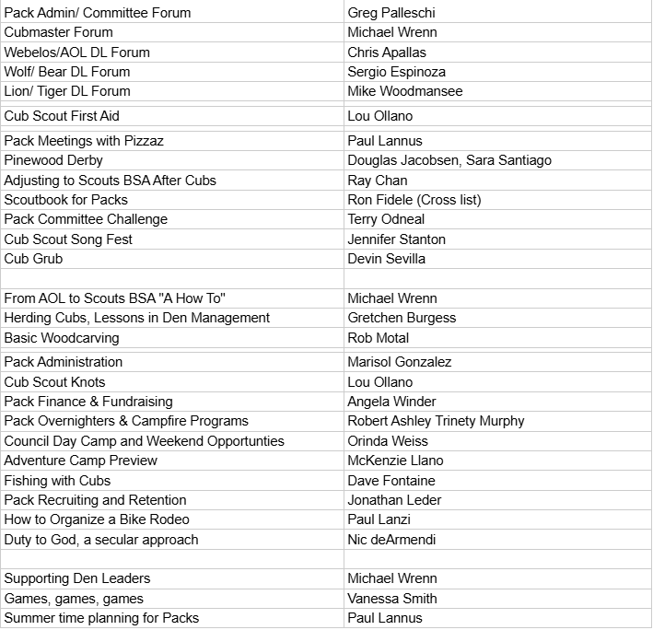
Leader Education And Discovery - January 24, 2026
https://goldengatescouting.org/lead/
What is L.E.A.D?
Leader Education and Discovery (L.E.A.D.) is the ultimate one-day training conference for Scout Leaders, Parents, Volunteers, and Older Youth. It combines University of Scouting and Pow Wow into one epic training event. Join us for an action-packed day of learning, fun, and connecting with fellow Scouters!
What Will I Learn?
L.E.A.D. offers over 120 classes across seven colleges. Cub Scouts, Scouts BSA, Young Adult Programs, Outdoor Education, Continuing Education, Technology, and, new this year, Special Needs and Disabilities.

Slide 34
Pack Training Certification Status
546 (Murray School PFA) - Dublin - 21 Adults - 35% Trained - Cubmaster Kristina Fischer
901 (Lions of Pleasanton) - Pleasanton - 4 Adults - 66.7% Trained - Cubmaster Clayton Carroll
910 (Rotary Club of Pleasanton North) - Pleasanton - 17 Adults - 52.9% Trained - Cubmaster Duane Howard
912 (Sunol Business Guild) - Sunol - 6 Adults - 12.5% Trained - Cubmaster Andrew Lee
914 (American Legion Post 47 Livermore) - Livermore - 11 Adults - 50% Trained - Cubmaster Devin Cook
916 (VFW Post 6298) - Pleasanton - 12 Adults - 38.5 Trained - Cubmaster Suneeta Pal
942 (Sunset PTA) - Livermore - 10 Adults - 36.4% Trained - Cubmaster David Mayes
943 (VFW Post 6298) - Pleasanton - 21 Adults - 36.4% Trained - Cubmaster Ryan Gillard
948 (Graceway Presbyterian Church) - Pleasanton - 15 Adults - 33.3% Trained - Cubmaster Javier Gros
950 (Rotary Club of Livermore) - Livermore - 9 Adults - 63.6% Trained - Cubmaster Greg Palleschi
951 (Rotary Club of Livermore) - Livermore - 22 Adults - 56.5% Trained - Cubmaster Katherine McGuire
969 (VFW Post 7265) - Livermore - 16 Adults - 50% Trained - Cubmaster Charles Mingola
981 (Muslim Community Center of the East Bay) - Pleasanton - 18 Adults - 42.1% Trained - Cubmaster Shahed Latif
986 (John Green Elem PFC) - Dublin - 21 Adults - 27.3% Trained - Cubmaster Cyrus Harrison

Slide 35
Scoutbook Plus - Updates
Scoutbook Plus is transitioning from connection-based permissions to position-based permissions, which will enhance performance and allow for greater customization of permissions.
**Background:**
In Scoutbook Legacy, permission options were limited to "Full Control," "View Profile," "Edit Profile," "View Advancement," and "Edit Advancement." For leaders in positions such as Scoutmaster or Troop Admin, their connection provided "Full Control" over every youth in the unit, enabling them to edit advancements, profiles, and more. However, for other roles, such as Secretary or Outdoor Coordinator, the connection options were insufficient and did not align with the necessary permissions to effectively perform their duties. As a result, leaders were granted either excessive or inadequate permissions compared to what was appropriate for their positions.
**What's New:**
In Scoutbook Plus, units can now actively modify most registered and functional adult positions within their unit. For instance, a Chartered Organization Representative can change an adult's registration from Committee Member to Assistant Cubmaster directly in Scoutbook Plus, a task that previously could only be done through My.Scouting. When assigning leaders to registered or functional positions, a basic set of permissions will be established for each role, enabling leaders to fulfill their responsibilities in the full unit or sub-unit. Furthermore, additional permissions can be customized and added.

Slide 36
What is your pack doing next summer?
Day camps, family camps, sure.
But what else? Do your Scouts know all of the options available to them?

Slide 37
Breakout
BSA Scouts

Slide 38

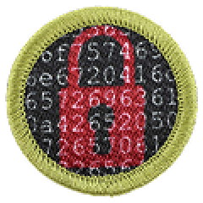
New Merit Badges
Artificial Intelligence
Key Concepts, AI Basics, Automation Basics, Ethics in AI, Deepfakes, Developing AI Skills, Practical Application, Career Exploration
Cybersecurity
Safety, Ethics, Fundamentals, Cyber Threats, Vulnerabilities, and Attacks, Cyber Defenses, Cryptography, Internet of Things, Careers

Slide 39

Dancing with the Scouts
Dance just dropped in the Scouting America Test Lab (https://www.scouting.org/skills/merit-badges/test-lab/dance/)
Dance Styles (Swing, Tap, Hip Hop, Jazz)
Dance Performance (Disco, Haka, Tap)
Dance Careers

Slide 40

In Case You Missed It…
Multisport Merit Badge
Multisport is a racing competition that includes any combination of running, biking, or swimming. This badge serves as a natural progression for Scouts who are interested in or have earned individual badges for Swimming, Cycling, Athletics, or Personal Fitness.

Slide 41
What is your troop doing next summer?
Summer camp, sure.
But what else? Do your Scouts know all of the options available to them?

Slide 42

National Jamboree
July 22-31, 2026
Summit Bechtel Reserve in WV
Start at https://goldengatescouting.org/jamboree/

Slide 43
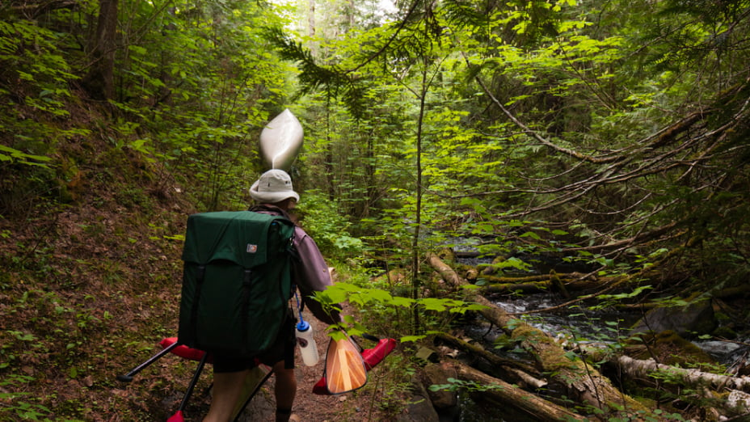
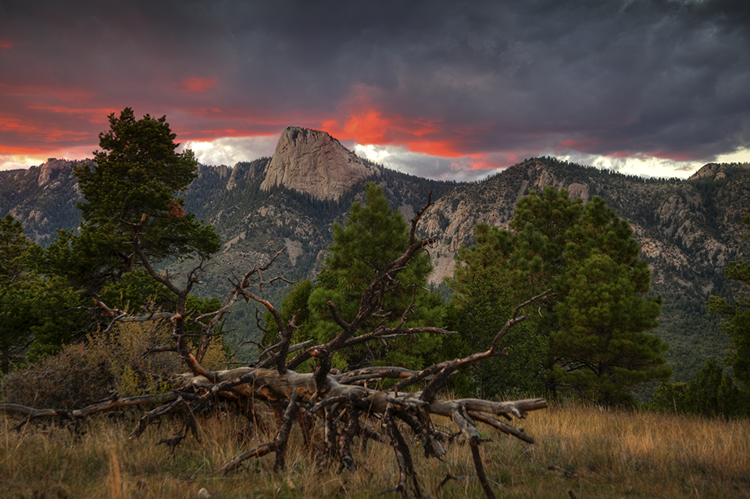
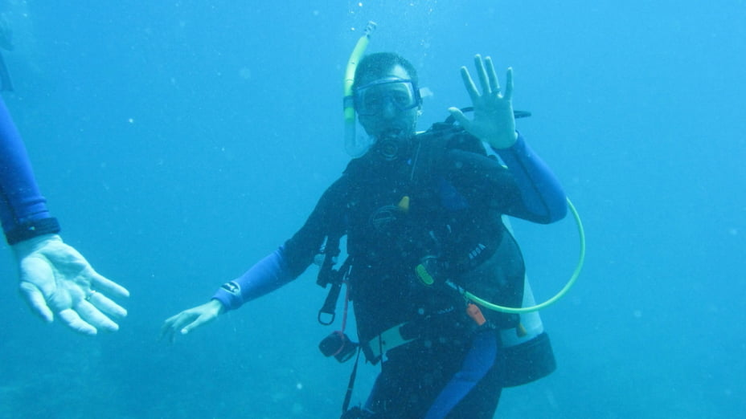
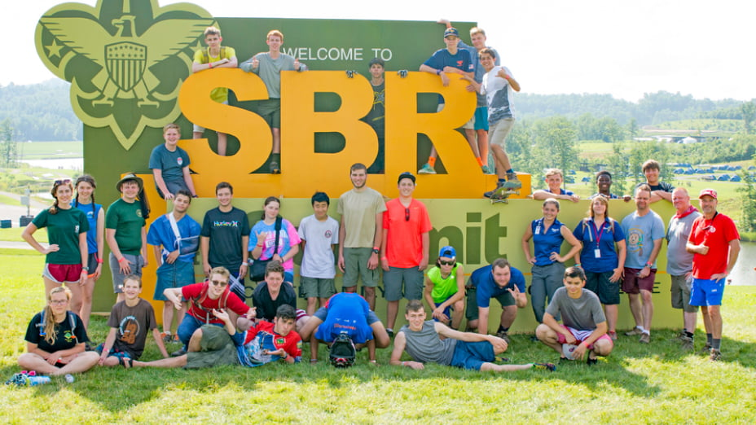
High Adventure Bases
Northern Tier
Philmont
Sea Base

Slide 44

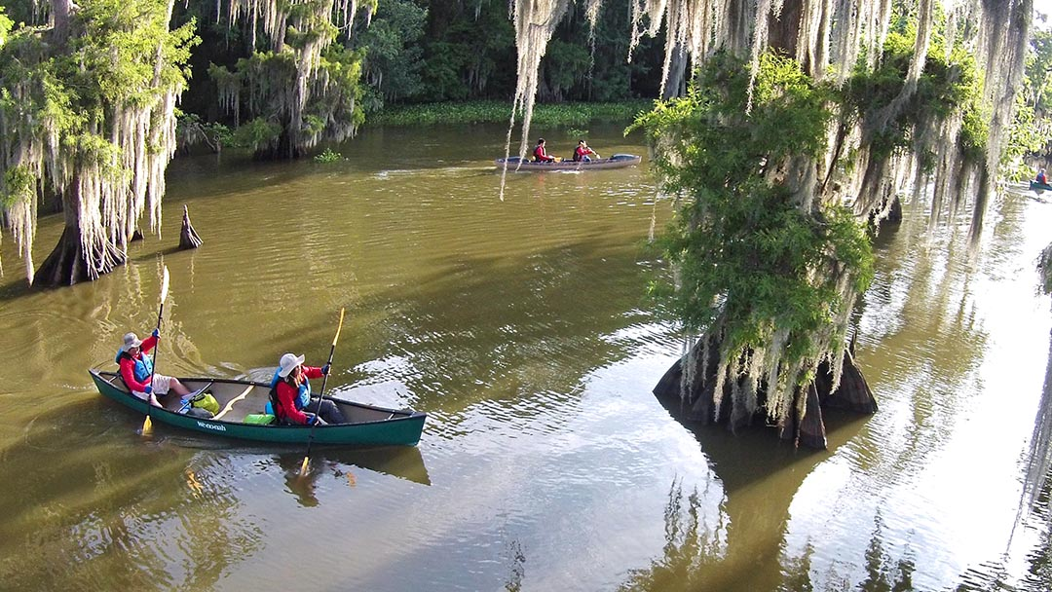
Swamp Base
61.6 mile paddle in the swamp
Crews of 11 + 2 guides
They cook for you!
7 days + whatever else
you decide to do in
NOLA and the area

Slide 45
Or Let Your Scouts Create Their Own Adventure
Tahoe Rim Trail Section(s)
Section hike the John Muir Trail (JMT) or Pacific Crest Trail (PCT)
Joshua Tree
Lassen
Lost Coast Trail
What else have you done?

