Slide 1


Slide 2


Seunen Paschengink Contacts
https://yerbabuena.goldengatescouting.org/
Aditya Bakhandi
amazingadityab@gmail.com
Chapter Chief
Shannon Carroll
shannoncarrollggac@gmail.com Chapter Advisor
***please remember to use YPT protocol when communicating with youth members***

Slide 3

Twin Valley Roundtable
August 28, 2025

Slide 4
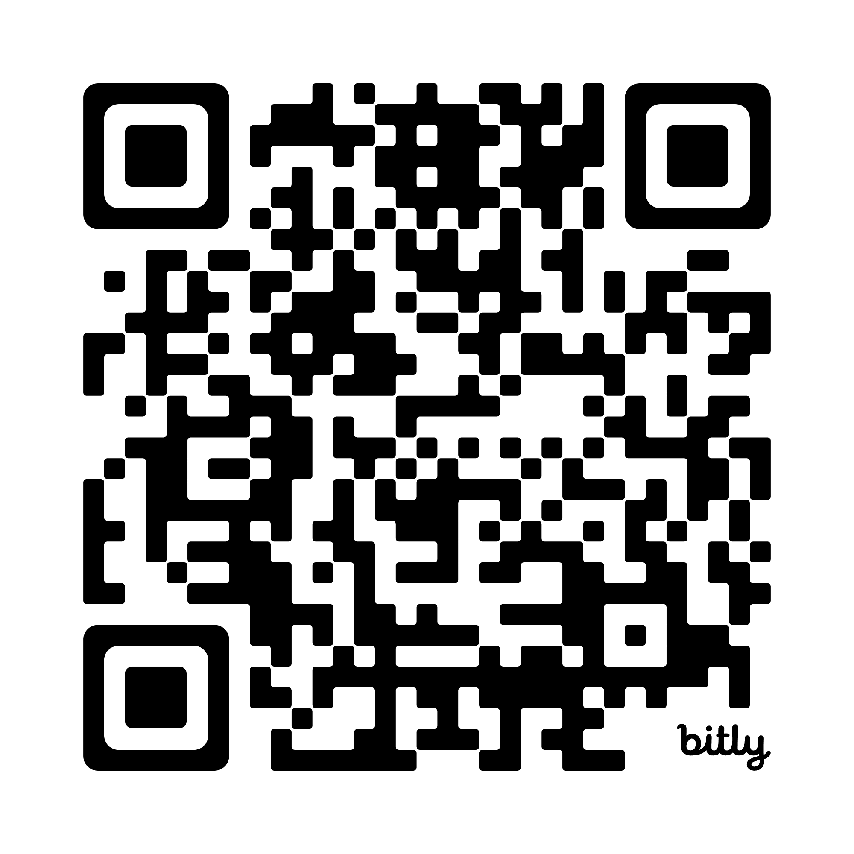
Please Sign-in
Network: Blue Oaks
Password: 7139KollCenter

Slide 5
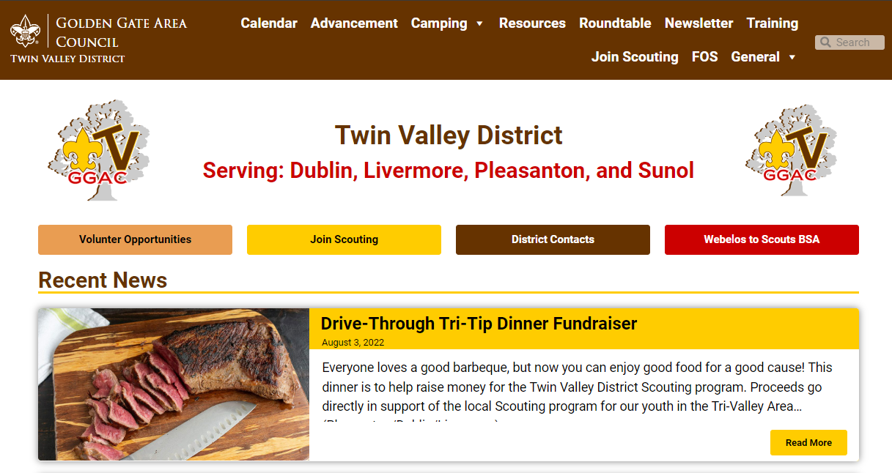
Welcome to Roundtable
Tonight’s slides are available online at:
https://twinvalley.ggacbsa.org/

Slide 6
District Updates
September 11, 2025

Slide 7
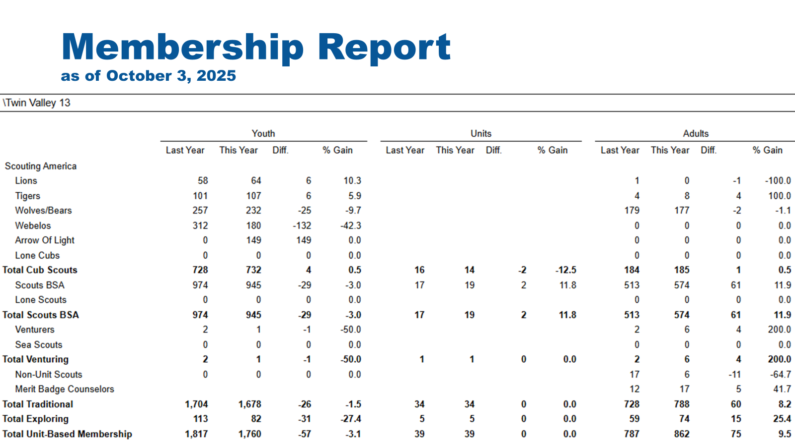

Slide 8
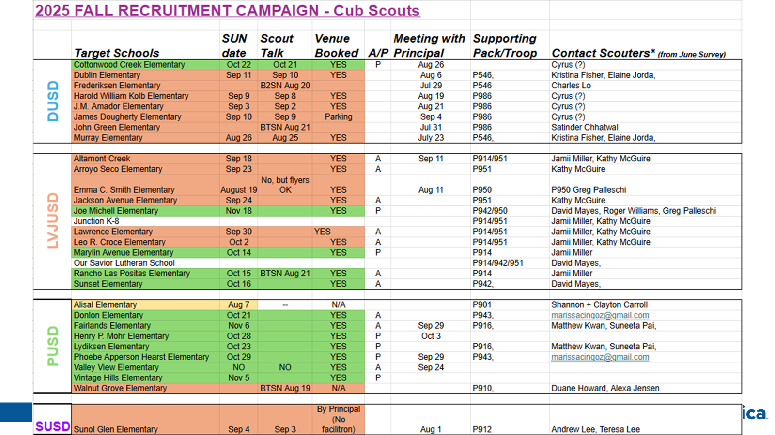

Slide 9
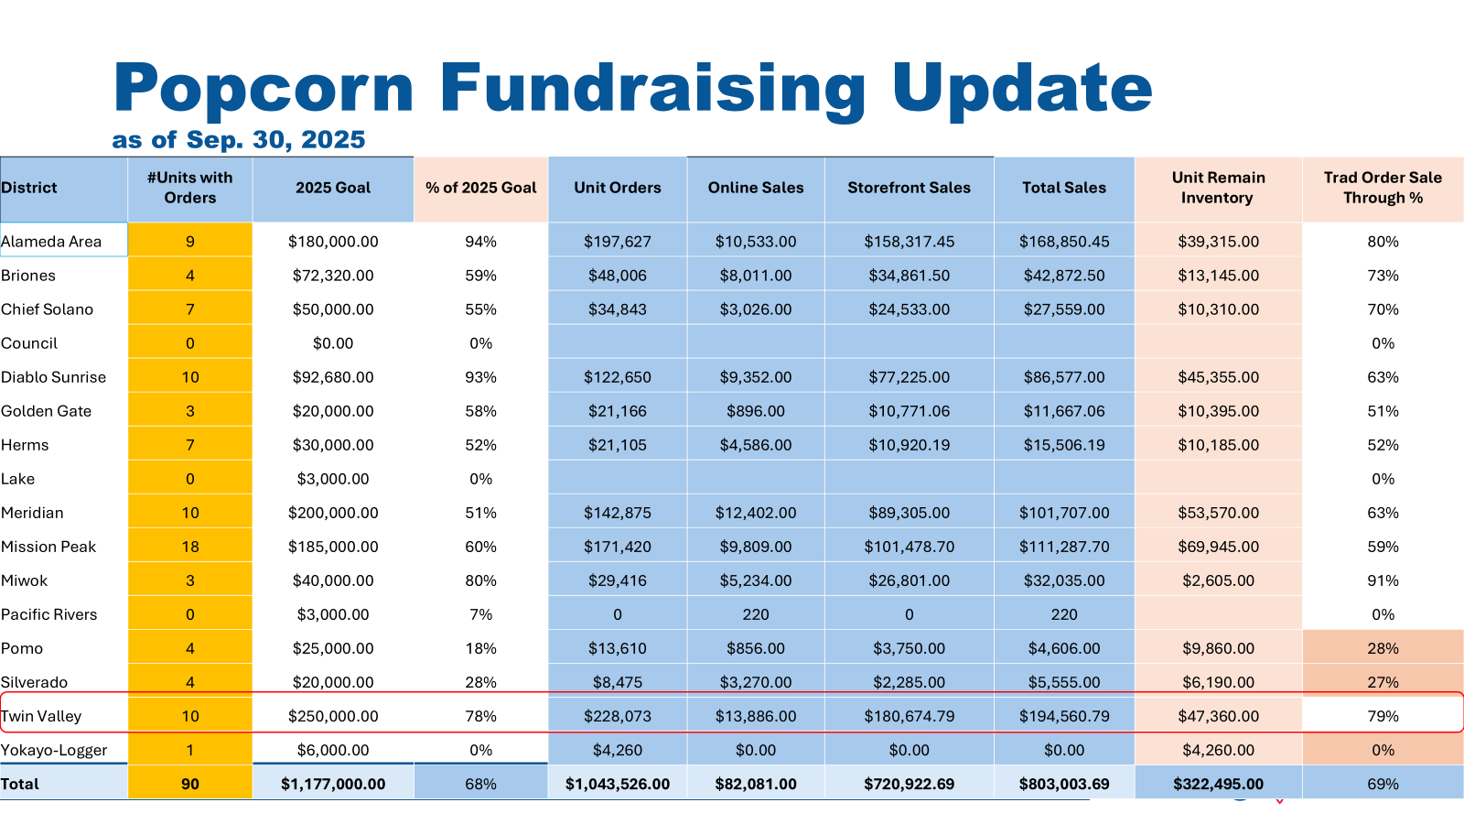

Slide 10
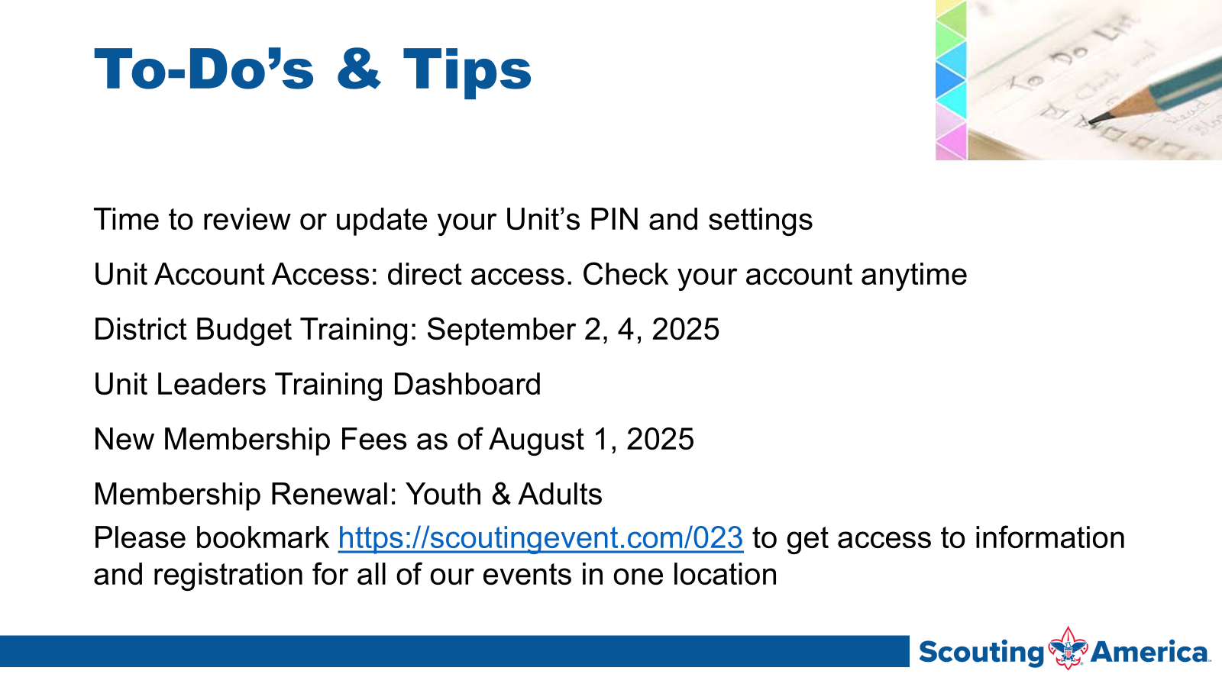

Slide 11
Unit Renewal (formerly known as Recharter)
Jim to add details

Slide 12
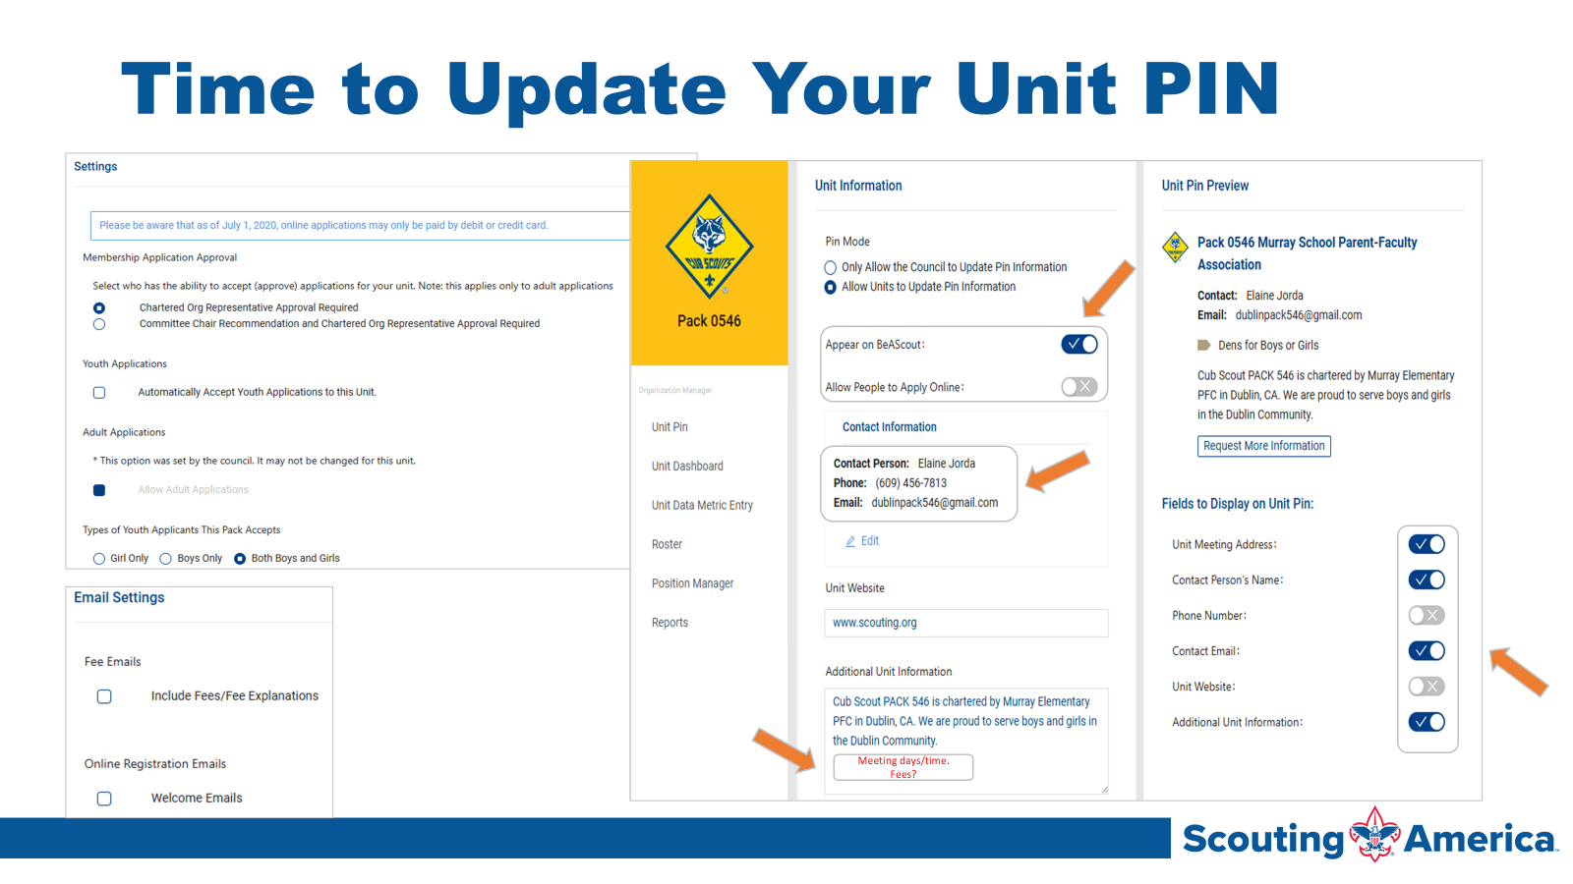

Slide 13
ACTIVITIES AND EVENTS
Really Fun Stuff

Slide 14
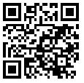
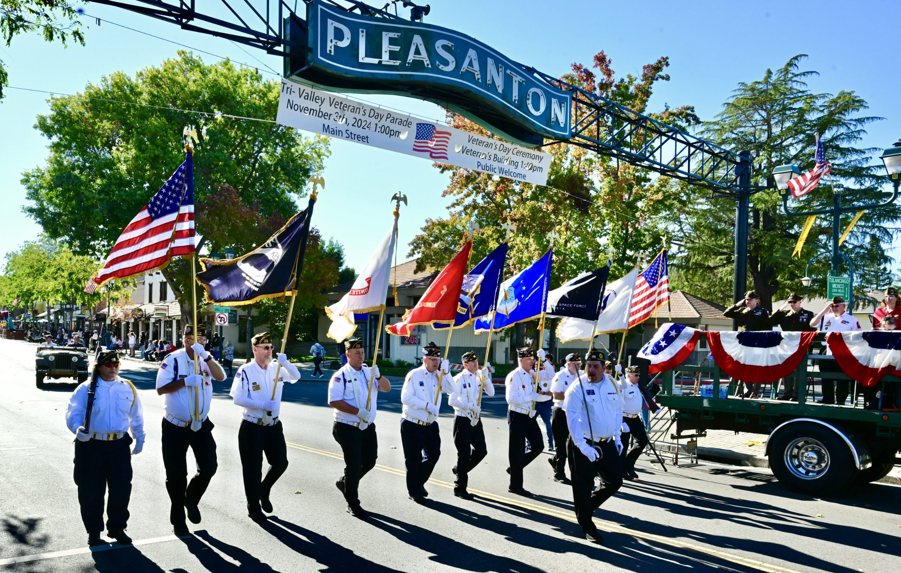
Veterans Day Parade
Register here:
http://bit.ly/4gPTcB0
Sunday November 9
1pm
301 Main Street, Pleasanton

Slide 15

T-Shirt Club
Be in the room where it happens
Change into a t-shirt
and see you there!
This month, let’s try…
4805 Hacienda Dr, Dublin

Slide 16
SPOTLIGHT
Really Fun Stuff

Slide 17
celenebis@yahoo.com 559)281-8294

Slide 18
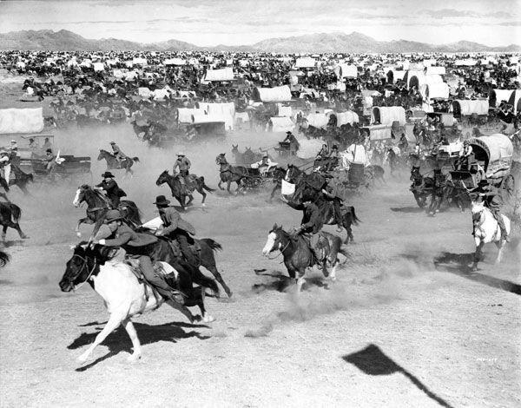
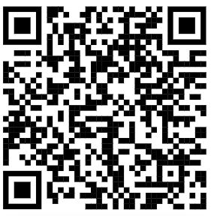
Scouting for Food Land Grab
Here’s the link:
landgrab.twinvalleyscouting.com
Pickup: Sunday Nov 15
More details at https://goldengatescouting.org/scouting-for-food/

Slide 19
Breakout
Cub Scouts

Slide 20


“The Cub Scout Pack”
Tune: “You’re a Grand Old Flag”
We’re a Cub Scout pack, we’re a high-flying pack;
Down the trail of Akela we go,
From Wolf to Bear to Webelos,
As into good Cub Scouts we grow.
Every Cub is true to the gold and the blue,
And we never forget the fact…
That all the fun a cub could want
You can find in a Cub Scout pack.

Slide 21

Notes:
Fil asked us to share these slides with you all. Please share this information with your pack. A PDF version of this flyer is available if requested.

Slide 22
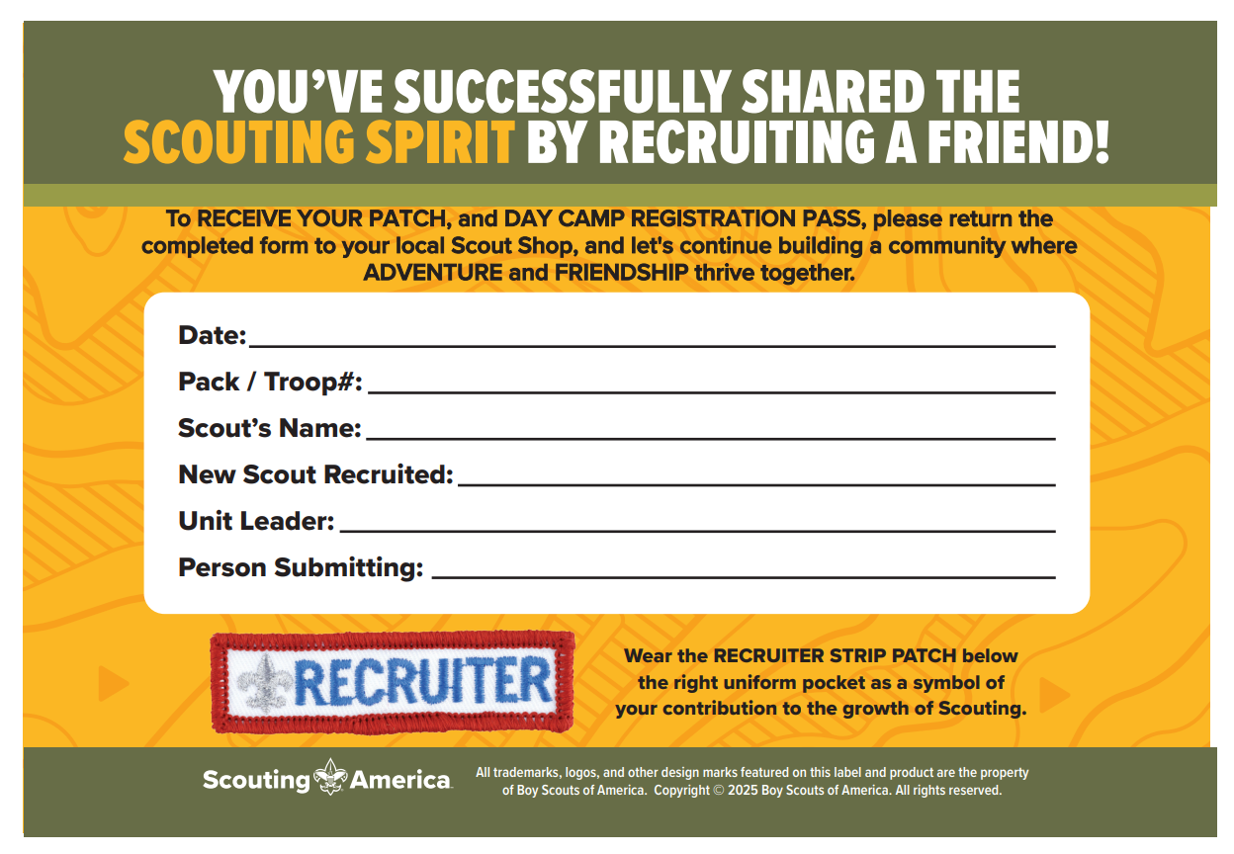

Slide 23
Tiger Cub Pumpkin Patch Day
NEW DATE - Sunday, October 19, 2025 - 10:00am-1:00pm
NOTE: Pumpkin and Kite Day can be impacted by severe weather, therefore we ask you to RSVP to TigerCubSafari@Gmail.com to stay informed of any last minute changes
From 10:00am-1:00pm, Tigers and their Adult Partners can explore the wonderful fruits of Joan's Farm in Livermore. The Farm is at 4351 Mines Rd, Livermore, CA 94550
For $20, the Tiger receives 3 tickets for a pumpkin, goard, or access to many FUN activities at Joan's and the first part of our world famous patch.
For Tiger Scouts attending Boo Camp, they can stop on their way home from Los Mochos and take part in the Pumpkin Patch.
It's on the way back into town!!!
Notes:
off Mines road.

Slide 24

Registration opens Jan 1st for 2026!!!
Please share these dates and events with your Packs.
Events fill up quickly so please register early.

Slide 25
Breakout
BSA Scouts

Slide 26


New Merit Badges
Artificial Intelligence
Key Concepts, AI Basics, Automation Basics, Ethics in AI, Deepfakes, Developing AI Skills, Practical Application, Career Exploration
Cybersecurity
Safety, Ethics, Fundamentals, Cyber Threats, Vulnerabilities, and Attacks, Cyber Defenses, Cryptography, Internet of Things, Careers

Slide 27

In Case You Missed It…
Multisport Merit Badge
Multisport is a racing competition that includes any combination of running, biking, or swimming. This badge serves as a natural progression for Scouts who are interested in or have earned individual badges for Swimming, Cycling, Athletics, or Personal Fitness.

Slide 28
What is your troop doing next summer?
Summer camp, sure. But what else? Do your Scouts know all of the options available to them?

Slide 29

National Jamboree
July 22-31, 2026
Summit Bechtel Reserve in WV
Start at https://goldengatescouting.org/jamboree/

Slide 30
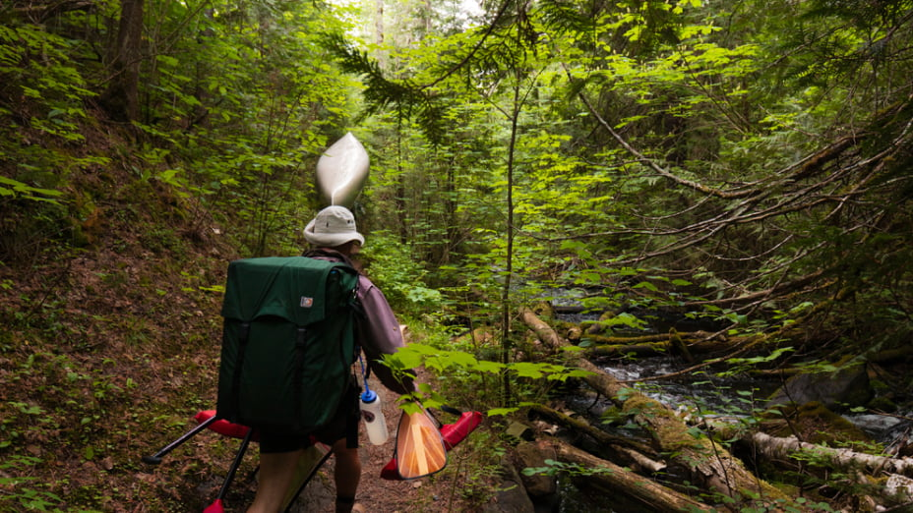
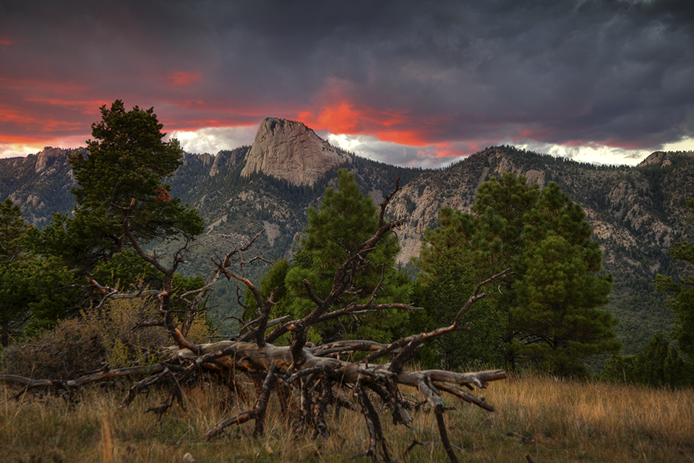
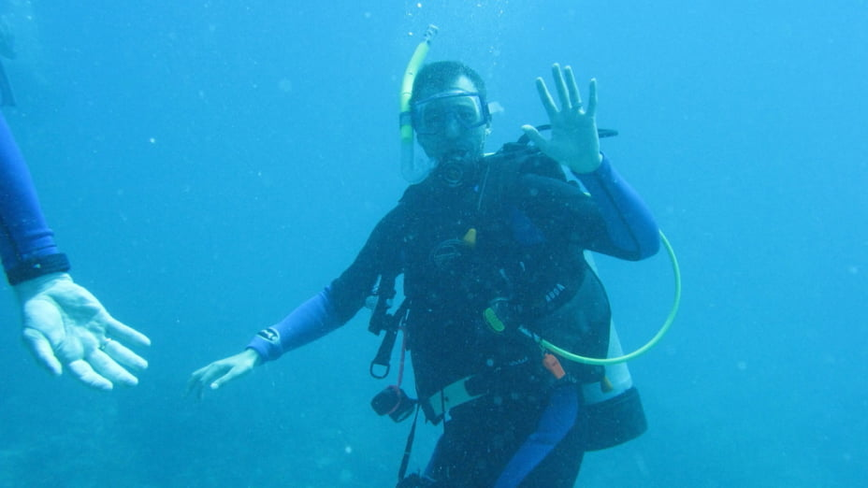
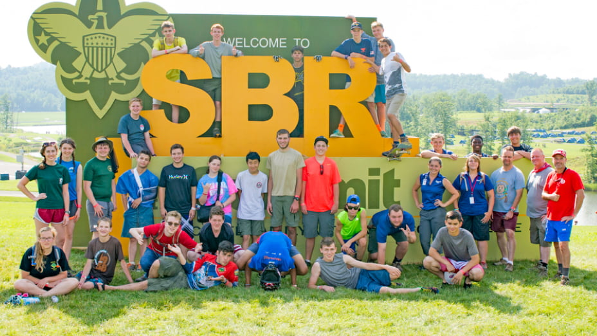
High Adventure Bases
Northern Tier
Philmont
Sea Base

Slide 31

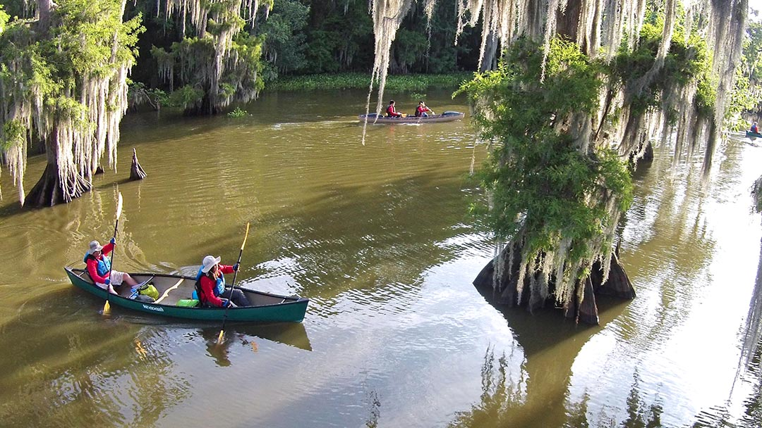
Swamp Base
61.6 mile paddle in the swamp
Crews of 11 + 2 guides
They cook for you!
7 days + whatever else you decide to do in NOLA and the area

Slide 32
Or Let Your Scouts Create Their Own Adventure
Tahoe Rim Trail Section(s)
Section hike the John Muir Trail (JMT) or Pacific Crest Trail (PCT)
Joshua Tree
Lassen
Lost Coast Trail
What else have you done?

