Slide 1


Slide 2


Seunen Paschengink Contacts
https://yerbabuena.goldengatescouting.org/
Aditya Bakhandi
amazingadityab@gmail.com
Chapter Chief
Shannon Carroll
shannoncarrollggac@gmail.com Chapter Advisor
***please remember to use YPT protocol when communicating with youth members***

Slide 3

Twin Valley Roundtable
August 28, 2025

Slide 4
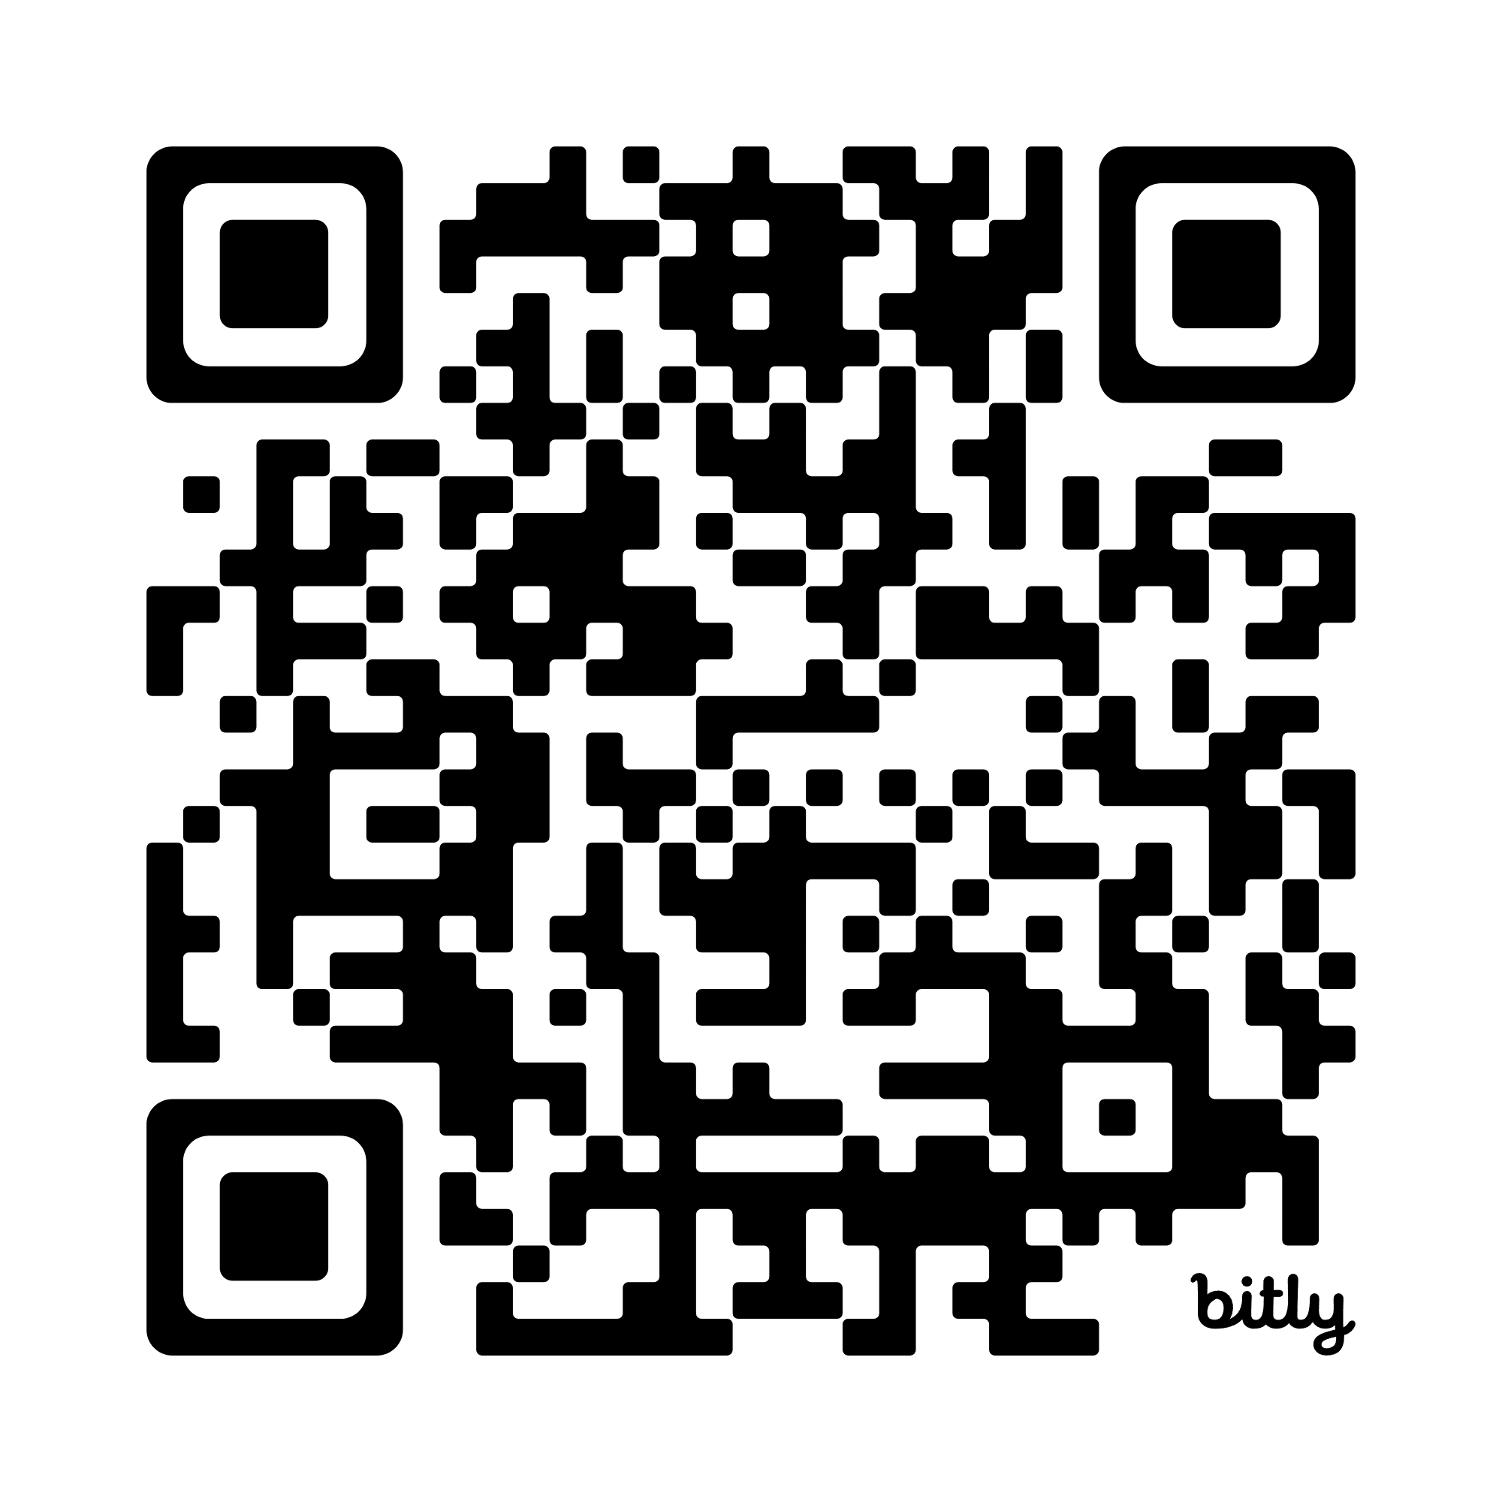
Please Sign-in
Network:
Password:

Slide 5
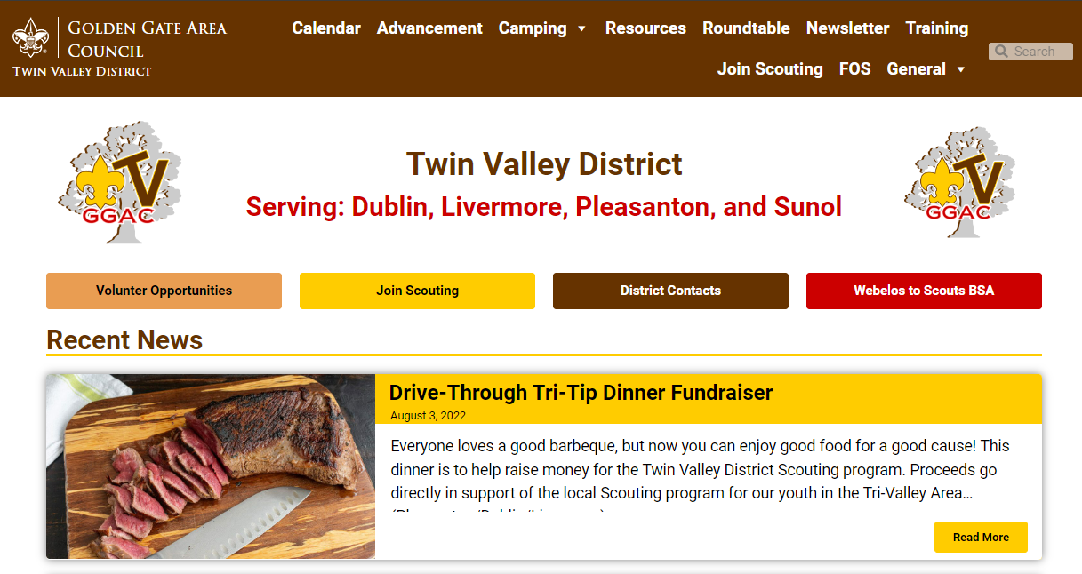
Welcome to Roundtable
Tonight’s slides are available online at:
https://twinvalley.ggacbsa.org/

Slide 6
District’s Updates
September 11, 2025

Slide 7
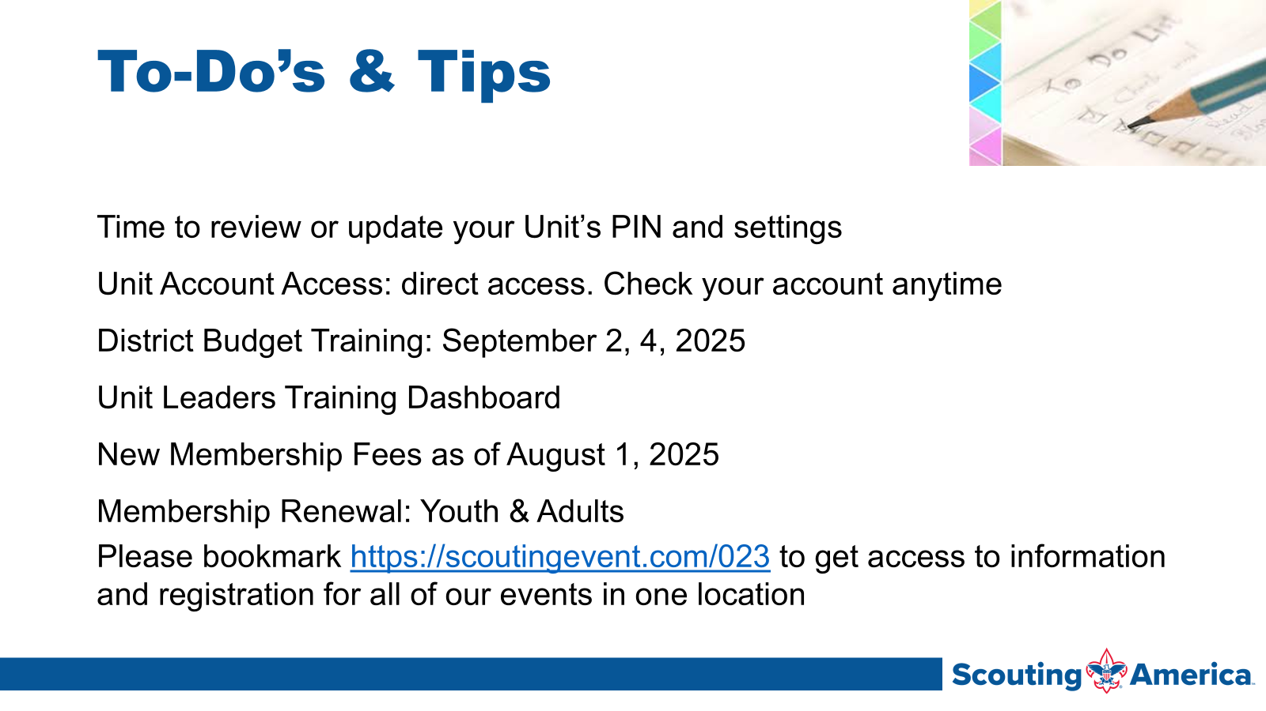

Slide 8
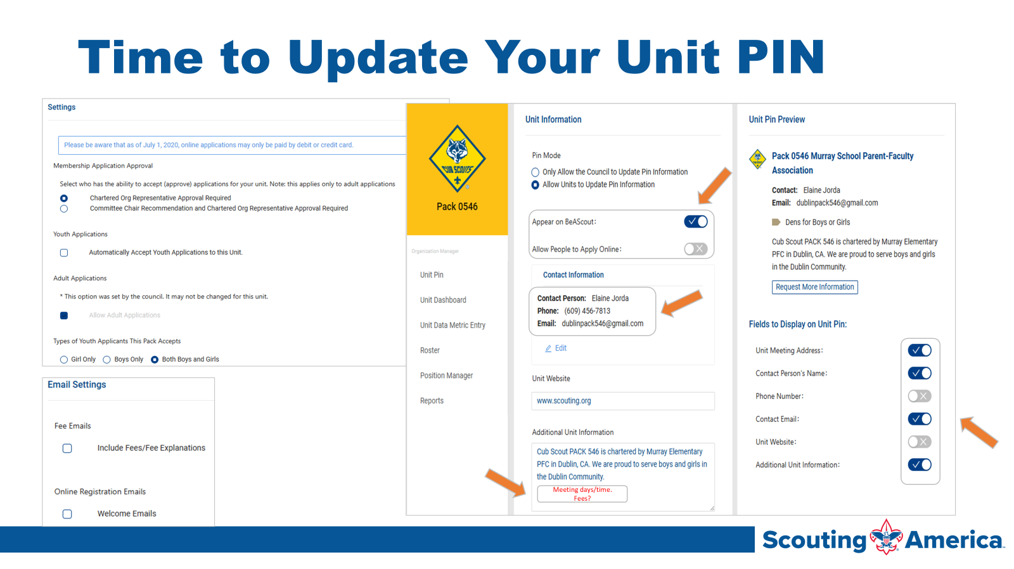

Slide 9
ACTIVITIES AND EVENTS
Really Fun Stuff

Slide 10

T-Shirt Club
Be in the room where it happens
Change into a t-shirt
and see you there!
This month, let’s try…
4805 Hacienda Dr, Dublin

Slide 11
SPOTLIGHT
Really Fun Stuff

