Slide 1


Slide 2
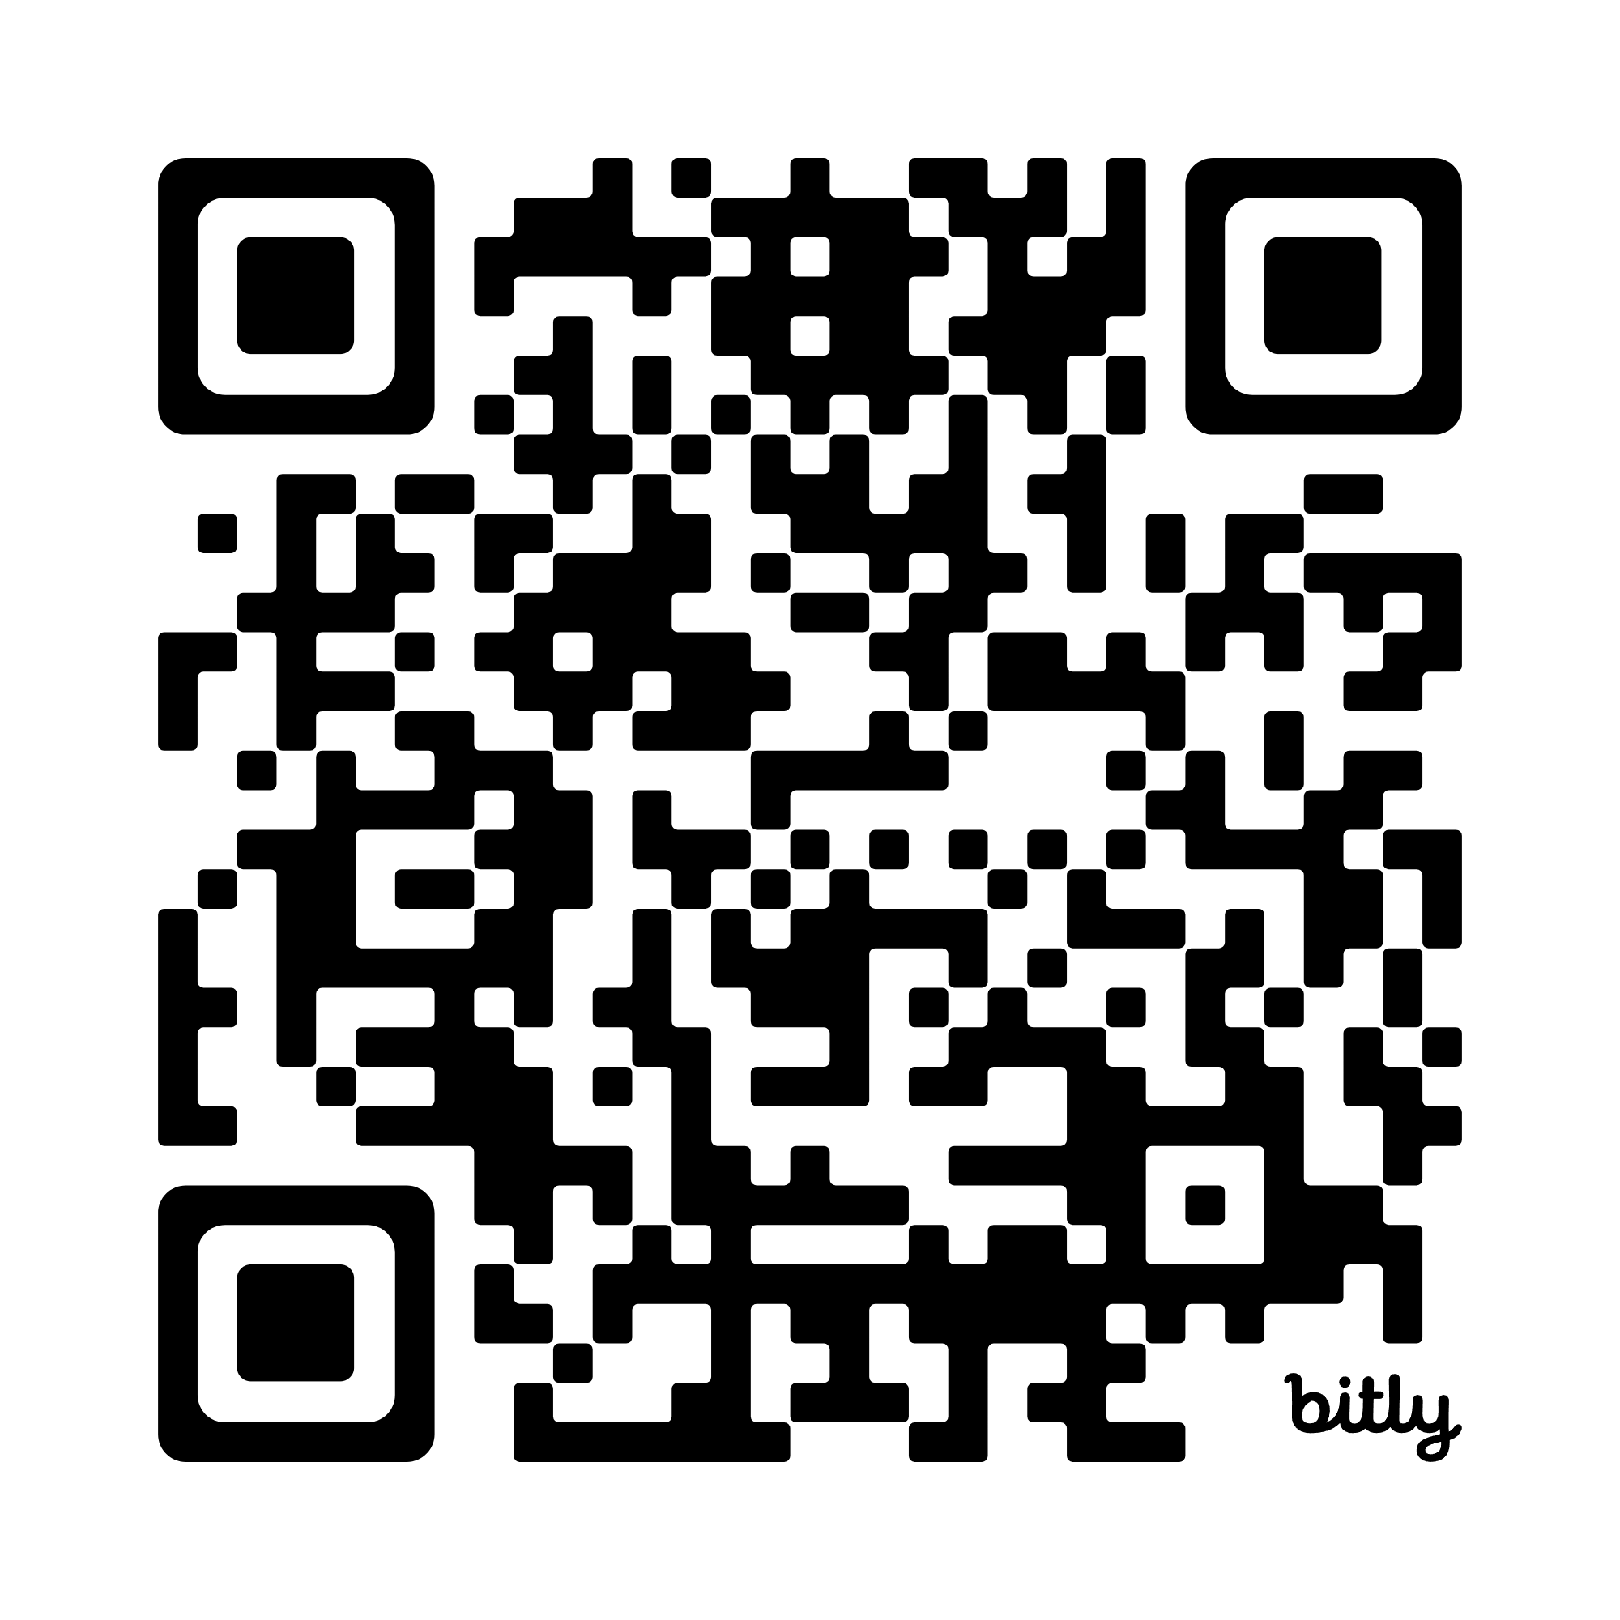
Please Sign-in
Network: Blue Oaks
Password: 7139KollCenter

Slide 3


Seunen Paschengink Contacts
https://yerbabuena.goldengatescouting.org/
Andrew Gaddis
andrew_gaddis@yahoo.com
Chapter Chief
Shannon Carroll
shannoncarrollggac@gmail.com Chapter Advisor
***please remember to use YPT protocol when communicating with youth members***

Slide 4

Twin Valley Roundtable
February 5, 2026

Slide 5
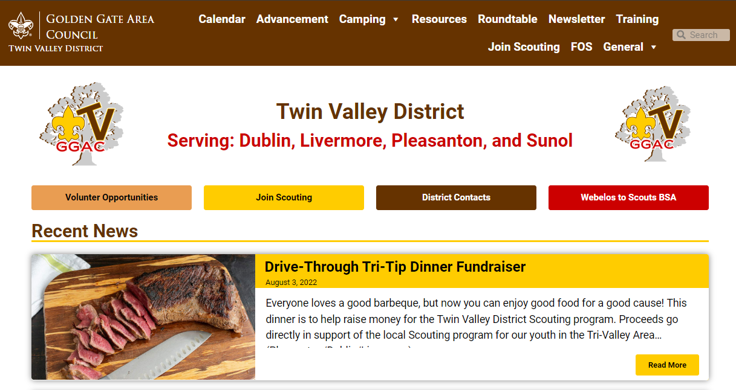
Welcome to Roundtable
Tonight’s slides are available online at:
https://twinvalley.ggacbsa.org/

Slide 6
A word from Dr. Weiss
Silver Beaver
District Awards

Slide 7

District Updates
Twin Valley District Roundtable
February 5, 2026
Fil de Cal - District Executive, Twin Valley
Golden Gate Area Council

Slide 8
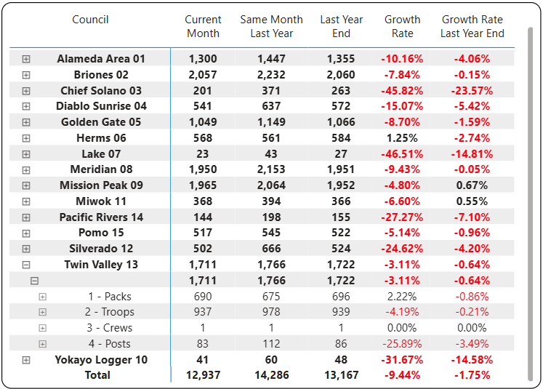
January 2026 Membership Update
As of 2/2/2026
Dec: -2.82%

Slide 9
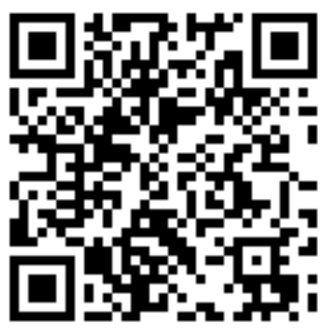
2026 Membership Campaign - Council
Council Goal: +2.00% Growth*
4,000 new Scouts**
                of which 2,500 Cubs
                32 New Units***
                72% retention****
Five pillars of Membership Growth
Peer-to-Peer
Unit Join Events⁺
Community Awareness
Fall Round Up (Sign-Up Nights)
New Unit formation
⁺
2025 YE:
* -7.19%
** 3,372
*** 26
**** 68.1%

Slide 10
2026 Membership Campaign - District
 | 2025 YE | 2026 Goal
Maintain a full-time District Membership Chair | √ | √
Improve Cub Scout retention by 3 percentage points | 60.91% | 63.91%
Improve Scouts BSA retention by 2 percentage points | 81.78% | 83.78%
80% of units host join events in the first half of the year | N/A | 32
80% of units host join events in the second half of the year | N/A | TBD
Grow total new paid Scout registrations | 426 | 530

Slide 11
2026 Membership Campaign - District
 | 2025 YE | 2026 Goal | Gain/Loss %
Packs | 14 | 15 | 7.14
Troops (B) | 13 | 13 | 0.00
Troops (F) | 1 | 2 | 100.00
Troops (G) | 5 | 4 | -20.00
Crews | 1 | 1 | 0.00
Ships | 0 | 1 | --
Posts | 5 | 5 | 0.00
TOTAL UNITS | 39 | 41 | 5.13
TOTAL MEMBERSHIP | 1,722 | 1,757 | +2.03%

Slide 12
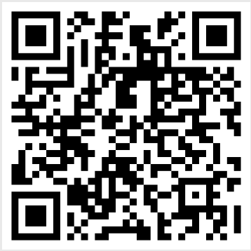
2026 FOS Campaign – District Goals
 | 2025 Goal | 2026 Goal | Variance
Family | $40,000 | $52,000 | +30%
Community | $20,000 | $15,000 | -25%
TOTAL | $60,000 | $67,000 | +12%
Encourage recurring donations
Every Family will be asked once
2 Community Events planned
Incentive details to follow
To book your FOS event, please scan:

Slide 13
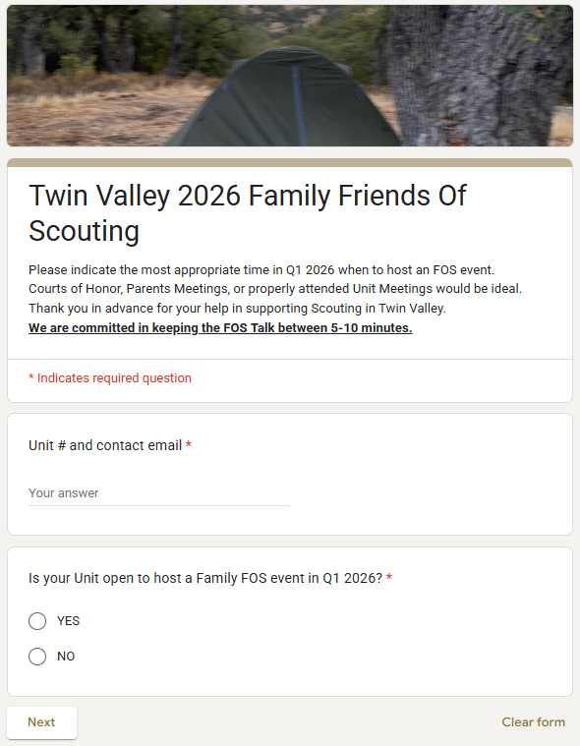
2026 FOS Planning
2026 Campaign starts in January
Best venue: CoH or dedicated Unit meetings (e.g. parents night)
Google Form is out for sign-ups
Missing details from:
Packs 546, 901, 912, 914, 916, 942, 943, 948, 951, 969, 981, 986
Troops 904, 908, 911, 916, 924, 939, 941, 947, 948, 981, 998, 999, 2904, 2981, 2998

Slide 14

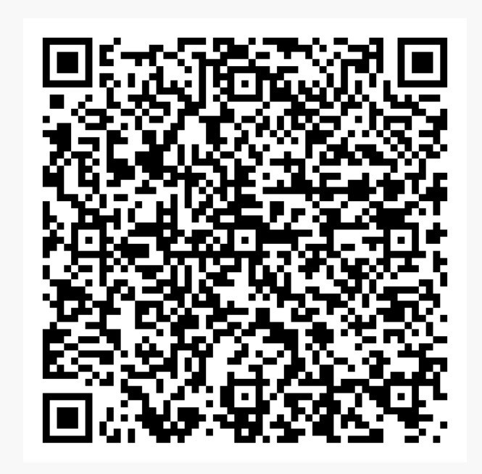
2026 Popcorn Campaign
Registration is LIVE for 2026 commitment. Register your Unit for 2026!
“Work hard for six weeks, enjoy a year of free Scouting adventures!”
In 2025:
$87,000+ in TV Unit rewards
12 Scouts obtained 100% Campership discount
14 obtained 50% discount
48 obtained 25% discount
‘000’s in gift cards

Slide 15
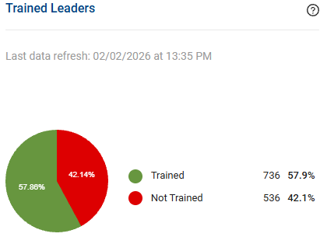
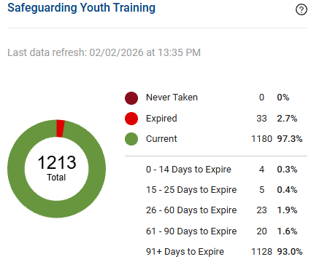
Unit Leader Training
As of 2/2/2026
Jan 2026: 736 + 536
December 2025: 58.0% and 42.0%
(669 + 545)
December 2025: 0%, 1.7%, and 98.3%
(1200)
Check your Unit folder for a list of Adult leaders missing HWT.

Slide 16
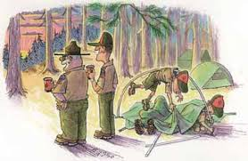
More District Events:
IOLS / BLUE OAKS: April 10-12
65th District Dinner: May 9
Camporee: May 15-17
Cub Scouts Day Camp: June 23-26
Sea Scouts Weekend: September 12-13
Trail To Troop: October 2-4
Ocean to Redwoods Adventure: July 5-11

Slide 17

Check Your Unit Folder – Scouts BSA
Ages 14-20
13 Spots available
New Adventure Each Day:
  Backpacking
  Beach exploration
  Canoeing
  Rope course
  Up to 4 Merit Badges (incl. Cooking)
50% off fee* deal
* If In-Council Camp week booked.
Regular fee: $800 until 03-25

Slide 18

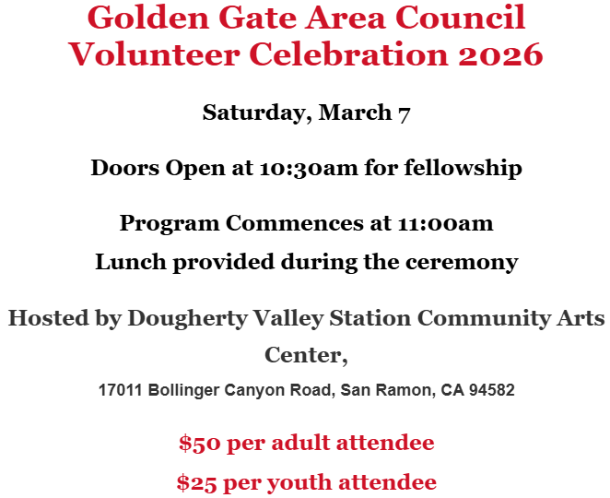
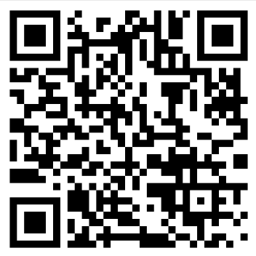
More Council Events:
Clayton Carroll
Greg Dyson
Terri Dyson
Robert Nuddleman

Slide 19
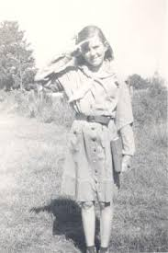

2026 Summer Camps
 | Week 1 | Week 2 | Week 3 | Week 4 | Week 5 | Week 6
Camp Royaneh | 924 | 908, 2981 |  | 2981
Wente Scout Reservation | 900 | 947 | 948, 981 | 939, 941, 998, 2942, 2998 | 905
Camp Wolfeboro | 941, 998, 999, 2942 |  | 911
Bold: multiple weeks booked
Consider Provisional Scout option

Slide 20
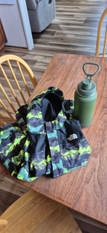
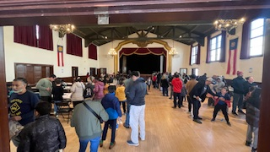
Lost & Found
PWD Tune Up, Jan. 10, 2026 Pleasanton

Slide 21

What If?
District-wide
Best 3 cars/Pack
Best-In-Show
Adult Outlaw
Trophies!
… and More!
Entry fee to cover logistics + prizes
Interest list at: filiberto.decal@scouting.org

Slide 22

In Other News:
Apply by 2/20/2026
Adult-only award (Scout years count)
Pin worn on civilian clothing only
Submit application to: kara.posey2@scouting.org

Slide 23
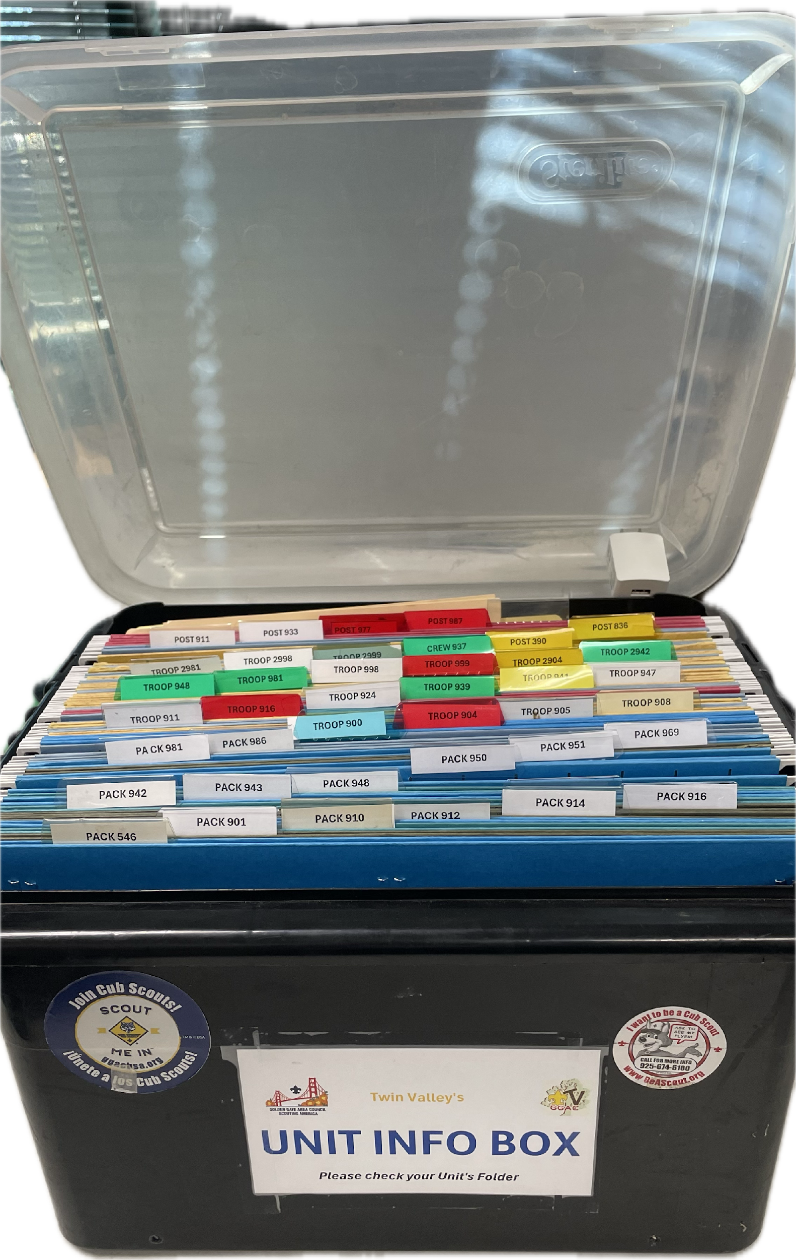
Don’t Forget To Check Your Info Box!
Reminders
Updates
Reports
Certificates
Announcements
EAGLE Kits (T908, T924, T941, T2999)

Slide 24
Next Roundtable:
March 5, 2026

Slide 25
ACTIVITIES AND EVENTS
Really Fun Stuff

Slide 26

T-Shirt Club
Be in the room where it happens
Change into a t-shirt
and see you there!
This month, let’s try…
4805 Hacienda Dr, Dublin

Slide 27
Breakout
Cub Scouts

Slide 28

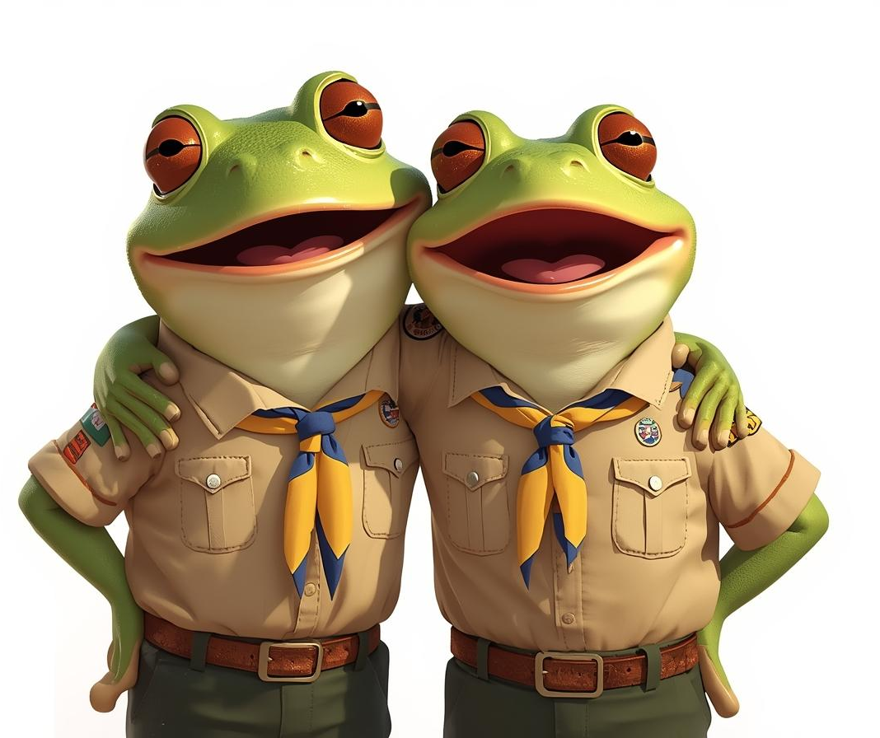
“Froggy”
Tune: Repeat After Me Song
Say as I say (Say as I say)
Do as I do (Do as I do)
Dog (Dog)
Dog cat (Dog cat)
Dog cat mouse (Dog cat mouse)
Froggy! (Froggy)
Itsy bitsy, Teeny weeny, Little green froggy!
Itsy bitsy, Teeny weeny, Little green froggy
Jump, Jump, Jump little froggy!
Jump, Jump, Jump little froggy
Gobble up all those, Worms and spiders!
(Gobble up all those, Worms and spiders)
Fleas and flies are Scrump diddly-umptious!
(Fleas and flies are Scrump diddly-umptious)
Ribbit, Ribbit, Ribbit, Ribbit,
Ribbit, Ribbit, CROAK!
(Ribbit, Ribbit, Ribbit, Ribbit, Ribbit,
Ribbit, CROAK!)

Slide 29
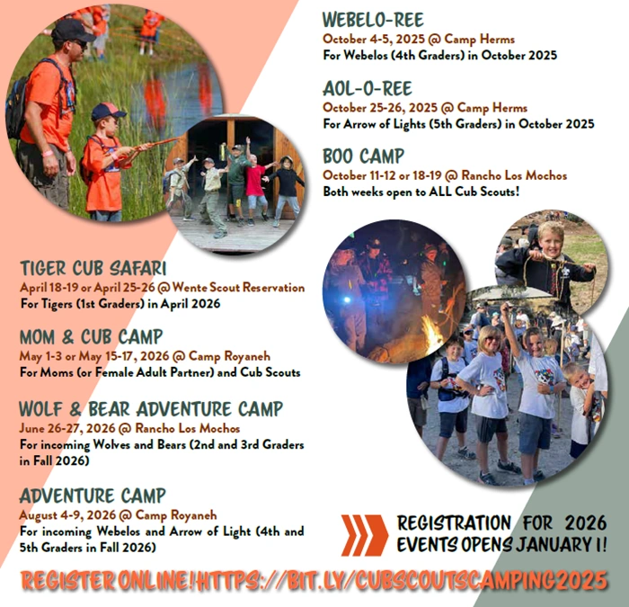
Registration opened Jan 1st for 2026!!!
Please share these dates and events with your Packs.
Events fill up quickly so please register early.

Slide 30

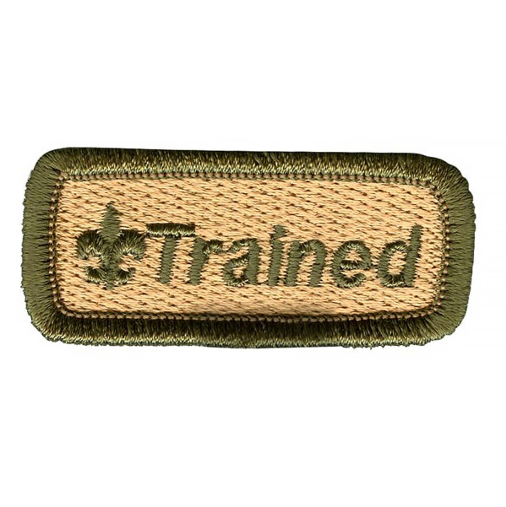
Get Trained for your Position!
Cub Scout Den Leader Training
February 21 at GGAC Office
Link Coming
Introduction to Outdoor Leader Skills
March 25 AND April 10-12
Register at https://scoutingevent.com/023-blueoak44

Slide 31
Basic Adult Leader Outdoor Orientation
Who should take BALOO?
The BSA requires that you have at least one BALOO-trained adult on every Cub Scout den or pack overnight outdoor event. That include pack camping and Webelos den overnighters. A BALOO-trained leader should be at any overnighter regardless of whether it is a pack, district or council event. Having at least one BALOO-trained adult will make your Cub Scouts’ camping experience as awesome as it can be.
Why should take BALOO?
The BSA requires that you have at least one BALOO-trained adult on every Cub Scout den or pack overnight outdoor event. That include pack camping and Webelos den overnighters. A BALOO-trained leader should be at any overnighter regardless of whether it is a pack, district or council event. Having at least one BALOO-trained adult will make your Cub Scouts’ camping experience as awesome as it can be.
How do I take BALOO?
BALOO consists of two components: online and hands-on. You’ll need to complete both — in order — to qualify as a “Trained” Cub Scout outdoor leader and receive the BALOO recognition patch.
1.Online component: The online portion of BALOO is available 24/7 on the BSA Learn Center. Just log in to My.Scouting.org to
2.Practical:This 1.5-day course is designed as an introduction to the Cub Scout outdoor program for leaders interested in adding a camping component to their Pack

Slide 32


Slide 33

Twin Valley 1st Annual AOL Trail to Troop
October 2nd- 4th at RLM
Open to 200 AOL Scouts & Parents (not a family camping event, have to be an AOL Scout to attend)
Cost $85 per participant
Registration opens 4/1 through 9/1 or until sells out
Looking for the following adult help
  BB Gun ROS & Instructor
  Medic

Slide 34
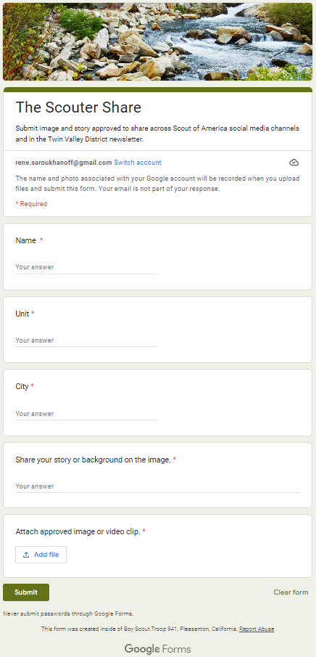
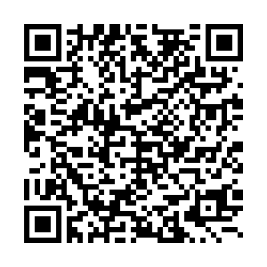
The Scouter Share
There are so many wonderful moments in our scout life - let’s share them!
Highlight your unit’s great moments or great scouts to be shared across the Twin Valley District’s newsletter, website and social media handles.
All you need:
Name, Email, City, Unit
A sentence or two about the moment/scout
One photo approved to be used
Notes:
With all the fun events over the past few months from parades, family events, to pinewood derbys, now is a great time to share your stories about your scouts and your programs.

Slide 35
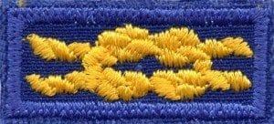
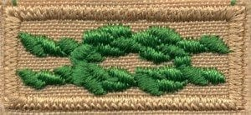
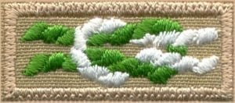
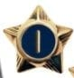

Recognizing Leaders & Volunteers
Scouting Awards - Knots
Service Stars -
Veteran Scouter Recognition
Annual Volunteer Recognition Awards
  Submit your nomination using the online form found here
  Current accepting award nominations through March 13, 2026.
  DISTRICT AWARD OF MERIT, UNIT LEADERS OF THE YEAR, UNSUNG HERO, SPARK PLUG, SCOUTING FAMILY
How does your unit celebrate those that make it all happen?
Notes:
Scouting Awards - Knots:
The Scouting Program offers many ways to recognize your leaders in the form of Knots that Share
Den Leader Training Award - This award recognizes den leaders who have completed training, tenure, and performance requirements.
It is available for Lion, Tiger, Wolf, Bear, and Webelos den leaders and can be earned in each position, but tenure must be completed separately for each award. In addition to a certificate and a medal, a yellow square knot on a blue background is available to wear on the uniform.
DEN LEADER TRAINING AWARD APPLICATION
Scouter’s Training Award - This award can be presented to registered Cub Scout adult leaders who have two years’ tenure in the pack and have completed position-specific training and other performance requirements designed to encourage and recognize those who give of their resources to make the pack successful. Tenure does not need to be in the same position. In addition to a certificate and medal, a green square knot on a khaki background is available to wear on the uniform.
SCOUTER'S TRAINING AWARD APPLICATION
Cubmaster’s Key - This award is for Cub Scout adult leaders with three years’ tenure—including at least two years as Cubmaster—who have completed training and other performance requirements. The Cubmaster’s Key is also a great way to incorporate a succession plan for Cubmaster. In addition to a certificate and medal, a green-and-white square knot on a khaki background is available to wear on the uniform
CUBMASTER'S KEY AWARD APPLICATION
Service Stars Just as you recognize Cub Scouts with service stars, adult leaders are also eligible to receive these pins. After one year of service an adult may be presented with a one-year service star. An adult who has been involved in Scouting as a youth or has been involved for more than five years is also eligible for the Veteran Award.
Veteran Scouter Recognition - After five years of registered service in Scouting America, an adult may, upon application, receive the designation of “Veteran.” There are additional veteran awards for every five years. Applications are submitted to the local council service center.
DISTRICT AWARD OF MERIT --- A limited number of awards are given out each year. The number is based on the number of packs or troops registered as of December 31st. The recipients will have displayed service of outstanding merit to the Twin Valley District. A nominee should have at least 4 years of active Scouting service with at least the last 2 years in the Twin Valley District. This award is nominated using only BSA Form 33720 linked here:
https://drive.google.com/file/d/1L0zfzhasxFwAnHHQYD-93SBVszHqygwB/view?usp=sharing. This completed form must be submitted directly to Phil Weiss via email (phil.weiss.email@gmail.com)
UNIT LEADERS OF THE YEAR --- One award is presented for each of the primary scouting leadership positions plus Chartered Partner, Commissioners (Unit, Roundtable) and one outstanding District-wide scouter. These awards recognize a Scouter that distinguished him/herself in their Scouting roles.
UNSUNG HERO --- All units are encouraged to nominate one individual from their unit in a key leadership position who has given strong and continued support to the success of the unit’s program.
SPARK PLUG --- All units are encouraged to nominate a new leader who has fired up or re-energized the unit.
SCOUTING FAMILY --- All units are encouraged to nominate one family from their unit who has given strong and continued support to the success of the unit’s program.

Slide 36
Breakout
BSA Scouts

Slide 37
How are you welcoming new Scouts?
Less than 50% of troops in GGAC have a designated New Member Coordinator. Does your troop have one?
If you do not have one in your troop, consider creating the position.
How does your troop handle bridging ceremonies?
  Is there a designated set of Scouts? A patrol?
  What do you give to Scouts on the other side of the bridge?
Does your PLC know when Cubs are going to be visiting? Do they plan anything special?
Is there anything else your troop does to welcome new Scouts?

Slide 38

Camporee!
Register here
$20 until 4/3
$30 after

Slide 39
Summer Camp
It’s time to start thinking about Summer Camp (if you aren’t already)
Calls to Action:
Start talking about Summer Camp with your Scouts and families
Start collecting deposits for camp (due to council late March)
Let your Scouts and families know that merit badge schedules are being released February 17 (for GGAC camps)
Encourage Scouts who may need financial help to apply for Camperships
Encourage older Scouts to apply for staff positions here
More information at https://goldengatescouting.org/summer-camp/

Slide 40


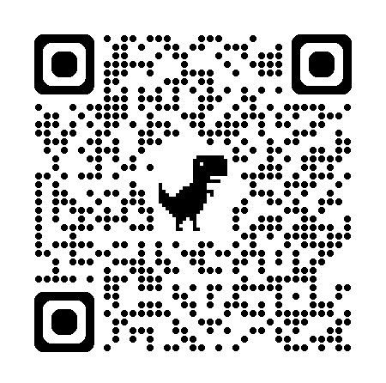
oceantoredwoodadventure
Who: Provisional Scouts, aged 14-20
What: Backpacking, canoeing, COPE,
trail cooking, leadership devo
When: July 5 – July 11
Where: Camp Royaneh
Cost: Same as camp, $815
Discount: Half off for anyone attending a week of camp
Questions: croraadventure@gmail.com
Registration & More Info

Slide 41
Reverence Hike
Last weekend, Troop 998G toured local houses of worship
Muslim Community Center in Pleasanton
Gurdwara Sahib Of Livermore Tri-Valley Sikh Center
Shiva-Vishnu Temple in Livermore
San Francisco Zen Center
St. Mary’s Cathedral in San Francisco
The Synagogue was closed :(
But we did get to go to Japan Town!

Slide 42
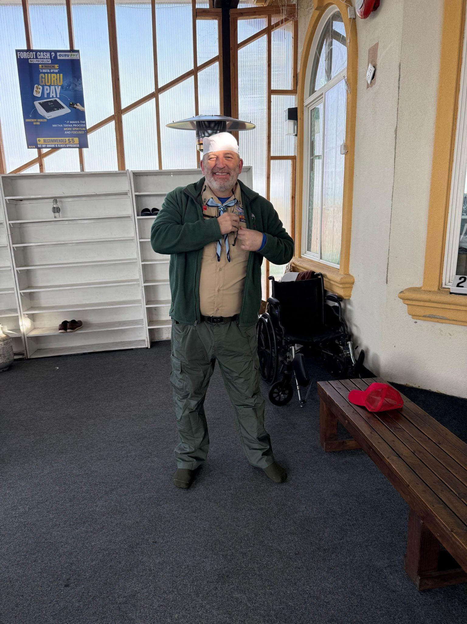
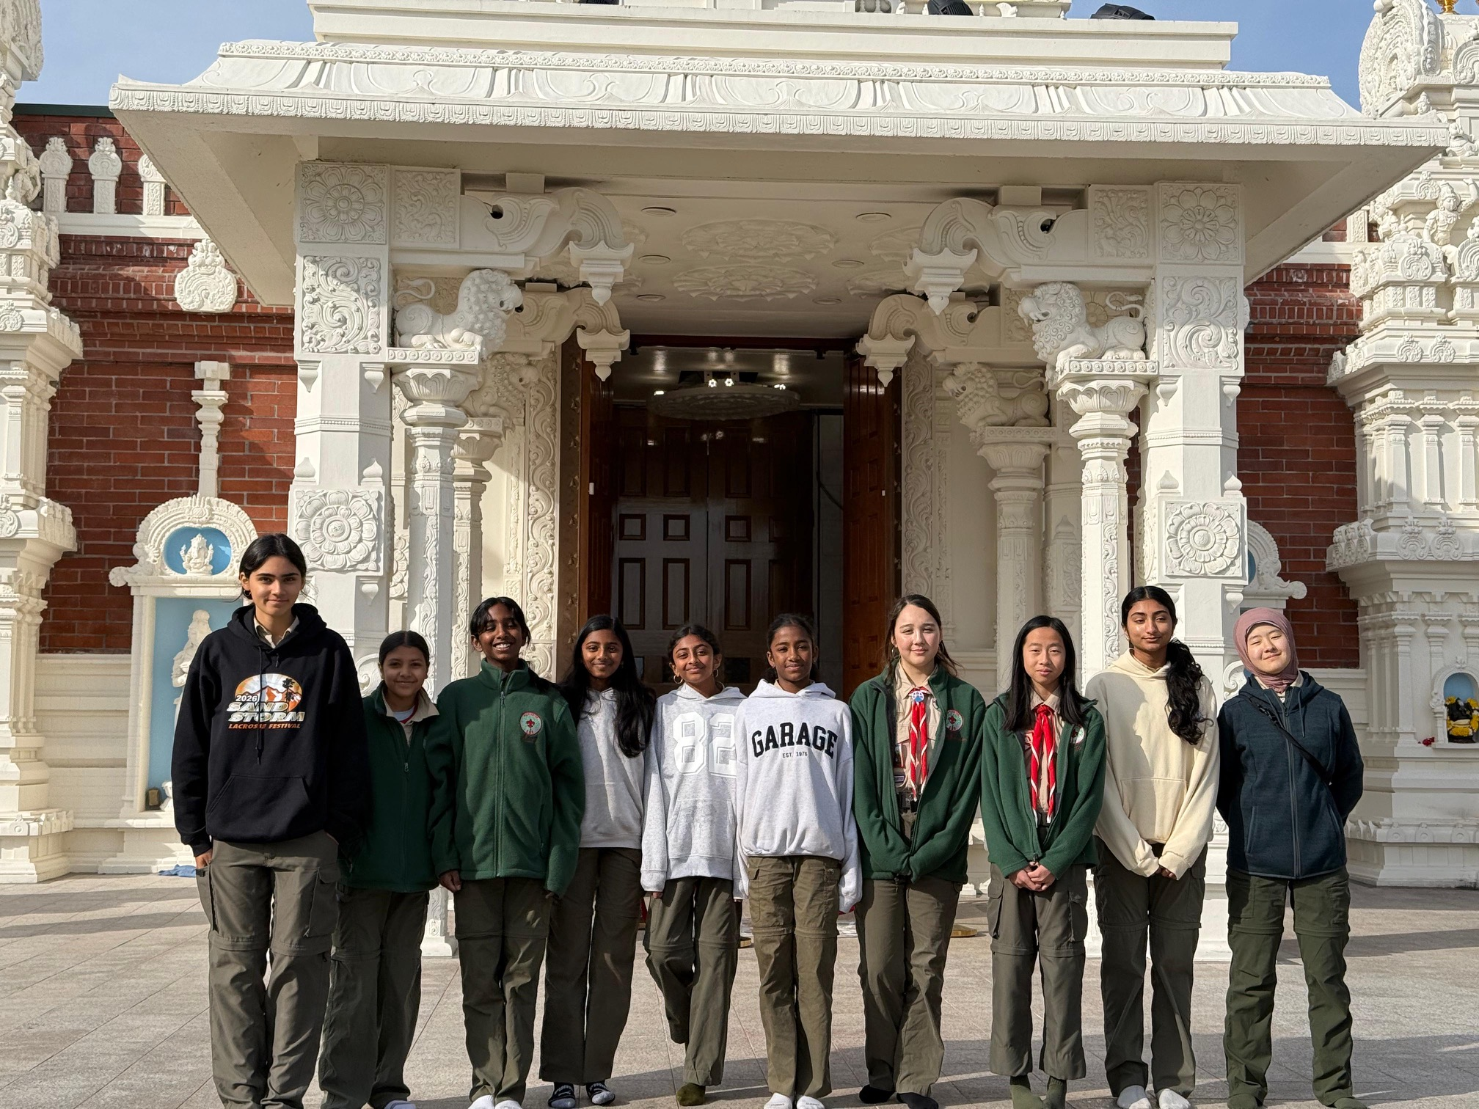

Slide 43

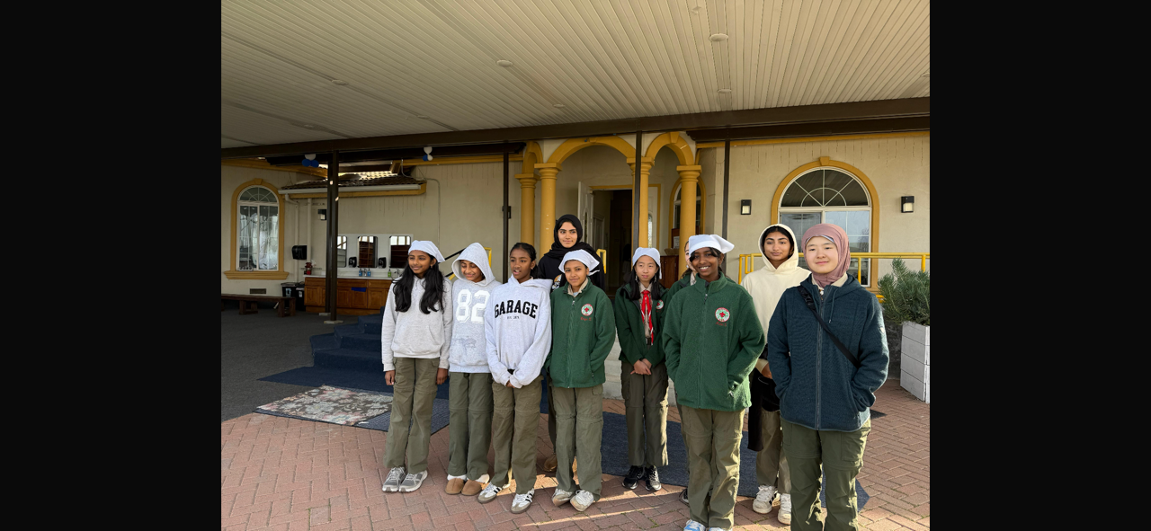

Slide 44

International Spirit Award
The International Spirit Award is awarded to registered Scouts and Scouters who have completed the necessary requirements, have gained a greater knowledge of international Scouting, and have developed a greater appreciation and awareness of different cultures and countries.

Slide 45
International Spirit Award
What do Scouts need to do?
What do Scouters need to do?
Earn the World Conservation Award.
Earn Citizenship in the World
Participate in Jamboree-on-the-Air or Jamboree-on-the-Internet.
Organize a World Friendship Fund collection at a unit meeting or district roundtable.
Complete three of the 10 Experience Requirements.
Learn about and explain the World Organization of the Scout Movement (www.scout.org).
Read and promote the most current International Department newsletter
Help organize or participate in two JotA or JotI events.
Organize a World Friendship Fund collection at a unit meeting or district roundtable.
Complete four of the 10 Experience Requirements.

Slide 46
International Spirit Award
Experience Requirements (there are 10 - this is a curated list)
Host an international Scout or unit at a local Council camp.
Learn about another country and prepare a dinner traditionally served there.
Organize and participate in a Messengers of Peace project.
Research Scouting in another country. Make a presentation at a unit meeting.
Research the process of obtaining a U.S. passport. Create a fact sheet for your unit.

Slide 47
International Spirit Award
Where can I get more information?
Award application is here.
All international recognitions can be found here.
JOTA and JOTI information is here.
Messengers Of Peace information is here.

