Slide 1


Slide 2
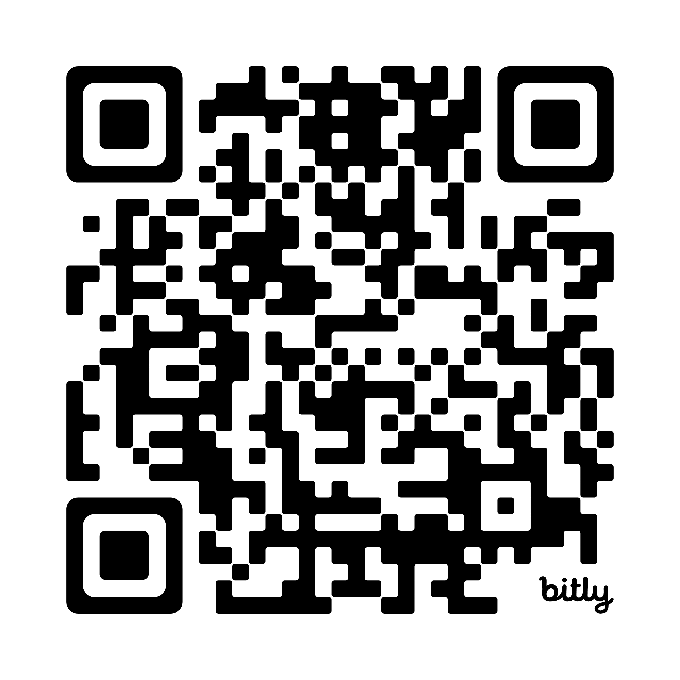
Please Sign-in
Network: Blue Oaks
Password: 7139KollCenter

Slide 3


Seunen Paschengink Contacts
https://yerbabuena.goldengatescouting.org/
Aditya Bakhandi
amazingadityab@gmail.com
Chapter Chief
Shannon Carroll
shannoncarrollggac@gmail.com Chapter Advisor
***please remember to use YPT protocol when communicating with youth members***

Slide 4

Twin Valley Roundtable
January 15, 2026

Slide 5
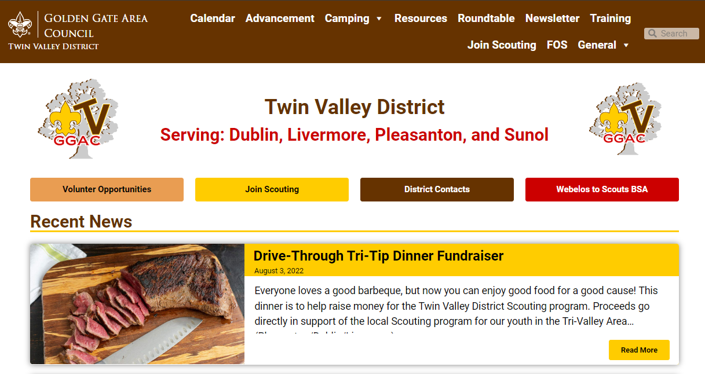
Welcome to Roundtable
Tonight’s slides are available online at:
https://twinvalley.ggacbsa.org/

Slide 6
District Updates
District Roundtable
January 15, 2026
Fil de Cal - District Executive, Twin Valley
Golden Gate Area Council

Slide 7
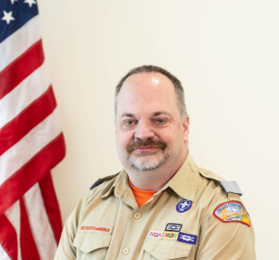
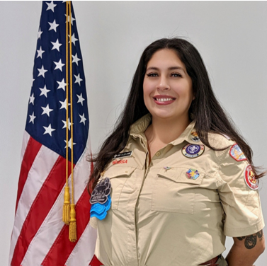
2026 Personnel Announcements
Brian McGuire has left GGAC and will pursue similar assignments in other Councils.
Maria Obledo-Ewing is the new District Director for Meridian & Diablo Sunrise and will provide overall leadership to the East Service Area (incl. TV).

Slide 8
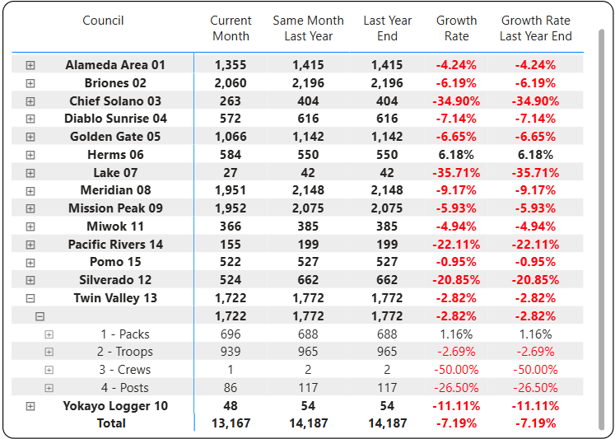
2025 YE Membership Update
As of 1/12/2026
Nov.: -6.05%

Slide 9

2026 Membership Campaign
District’s Objectives to be reviewed by Key 4 on January 31
Sign-Up Nights
Back 2 School events
Peer-To-Peer
Support for Unit-led events
Rocket Days
…

Slide 10
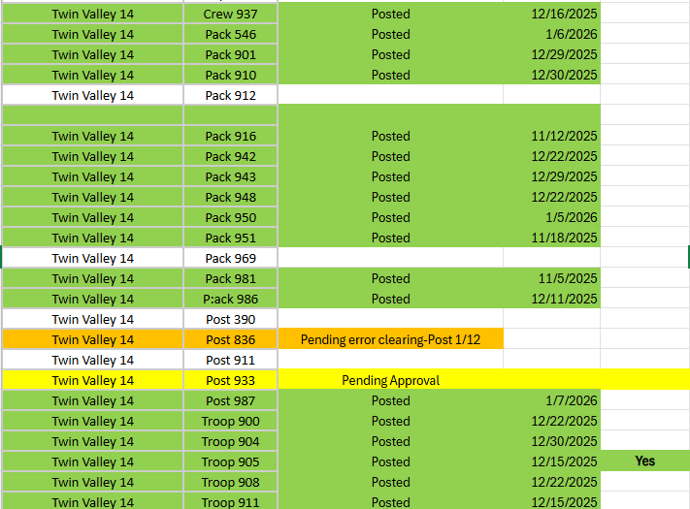
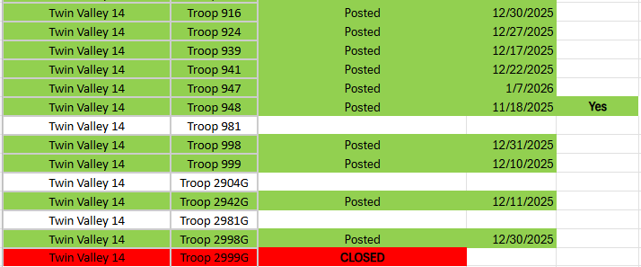
Unit Renewals
As of 1/12/2026

Slide 11
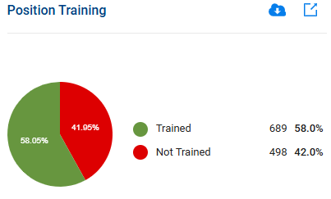
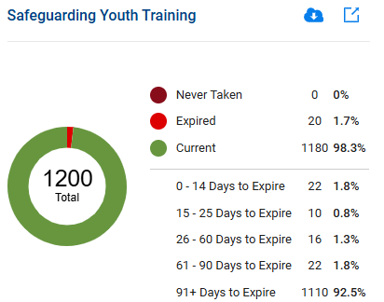
Unit Leader Training
As of 1/12/2026
November 2025: 55.1% and 44.9%
(669 + 545)
November 2025: 0%, 0.8%, and 99.2%
(1129)

Slide 12
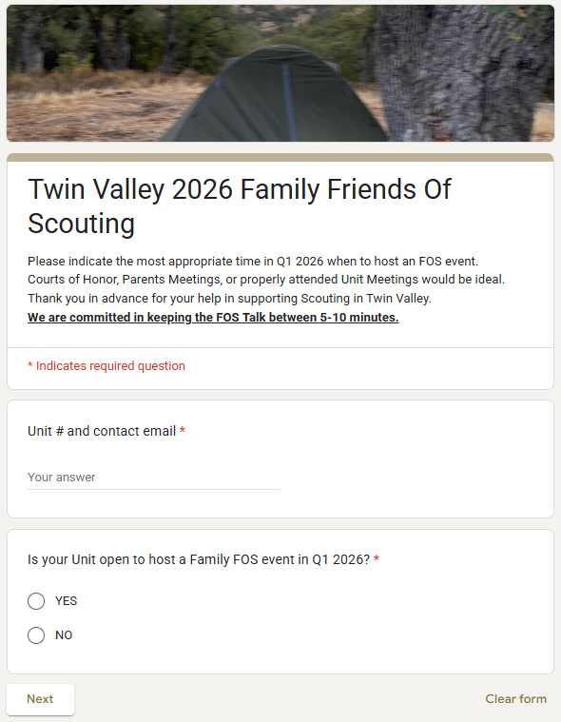
2026 FOS Planning
2026 Campaign starts in January
Best venue: CoH or dedicated Unit meetings (e.g. parents night)
Google Form is out for sign-ups

Slide 13
More 2025 Events: Scouts BSA
LEAD 1/24/26 SAVE THE DATE
NYLT Winter Course Feb 14-16 & 20-22: https://scoutingevent.com/023-NYLT2026

Slide 14


L.E.A.D. 2026

Slide 15

What If?
District-wide
Best 3 cars/Pack
Best-In-Show
Adult Outlaw
Trophies!
… and More!
Entry fee to cover logistics + prizes
Interest list at: filiberto.decal@scouting.org

Slide 16
Don’t Forget To Check Your Info Box!
Reminders
Updates
Reports
Certificates
Announcements
…….
Imagine a picture of the Unit Info Box here (I removed it to make this presentation smaller)
Next Roundtable:
February 5, 2026

Slide 17

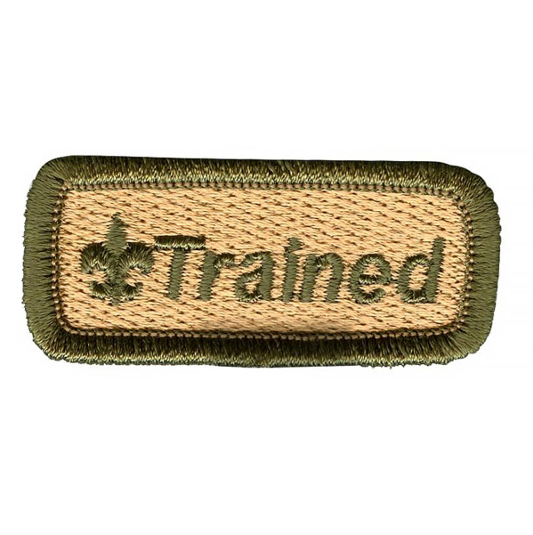
Get Trained for your Position!
Cub Scout Den Leader Training
February 21 at GGAC Office
https://www.scoutingevent.com/023-denleaderspecific
Introduction to Outdoor Leader Skills
March 25, April 1, AND April 10-12
Register at https://scoutingevent.com/023-blueoak44

Slide 18

Twin Valley 1st Annual AOL Trail to Troop
October 2nd- 4th at RLM
Open to 200 AOL Scouts & Parents (not a family camping event, have to be an AOL Scout to attend)
Cost $85 per participant
Registration opens 4/1 through 9/1 or until sells out
Looking for the following adult help
BB Gun ROS & Instructor
Medic

Slide 19
ACTIVITIES AND EVENTS
Really Fun Stuff

Slide 20

T-Shirt Club
Be in the room where it happens
Change into a t-shirt
and see you there!
This month, let’s try…
4805 Hacienda Dr, Dublin

Slide 21
Breakout
Cub Scouts

Slide 22


“Pinewood Derby”
Tune: “Camptown Races”
Cub Scouts all join in the song, Do-da, do-dah! Pine car track am mighty long, Oh, do-day-day!
Chorus:
Going to run so fast, Going to get ahead, Bet my money on a blue pine car, Somebody bet on the red.
Black cars, blue cars, green and gray, Do-da, do-da! Are running on the track today, Oh, do-da-day!
Chorus
Pine cars do have lots of class, Do-da, Do-dah! Even though they don't use gas, Oh, do-da-day!
Chorus
They're the pride of all the Dens, Do-da, do-da! Built by Cub Scouts and their friends, Oh, do-da-day!
Chorus

Slide 23

Registration opened Jan 1st for 2026!!!
Please share these dates and events with your Packs.
Events fill up quickly so please register early.

Slide 24

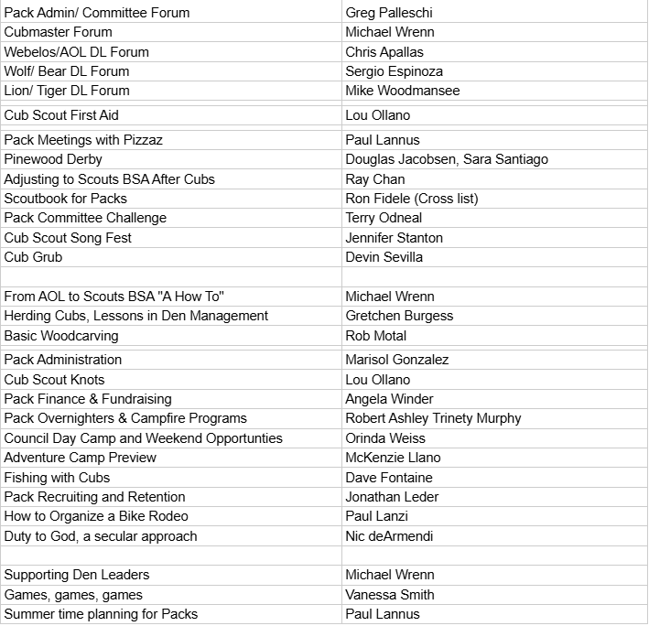
Leader Education And Discovery - January 24, 2026
https://goldengatescouting.org/lead/
What is L.E.A.D?
Leader Education and Discovery (L.E.A.D.) is the ultimate one-day training conference for Scout Leaders, Parents, Volunteers, and Older Youth. It combines University of Scouting and Pow Wow into one epic training event. Join us for an action-packed day of learning, fun, and connecting with fellow Scouters!
What Will I Learn?
L.E.A.D. offers over 120 classes across seven colleges. Cub Scouts, Scouts BSA, Young Adult Programs, Outdoor Education, Continuing Education, Technology, and, new this year, Special Needs and Disabilities.

Slide 25
Get Trained for your Position!
Cub Scout Den Leader Training
February 21 at GGAC Office
Link Coming
Introduction to Outdoor Leader Skills
March 25 AND April 10-12
Register at https://scoutingevent.com/023-blueoak44

Slide 26
Basic Adult Leader Outdoor Orientation
Who should take BALOO?
The BSA requires that you have at least one BALOO-trained adult on every Cub Scout den or pack overnight outdoor event. That include pack camping and Webelos den overnighters. A BALOO-trained leader should be at any overnighter regardless of whether it is a pack, district or council event. Having at least one BALOO-trained adult will make your Cub Scouts’ camping experience as awesome as it can be.
Why should take BALOO?
The BSA requires that you have at least one BALOO-trained adult on every Cub Scout den or pack overnight outdoor event. That include pack camping and Webelos den overnighters. A BALOO-trained leader should be at any overnighter regardless of whether it is a pack, district or council event. Having at least one BALOO-trained adult will make your Cub Scouts’ camping experience as awesome as it can be.
How do I take BALOO?
BALOO consists of two components: online and hands-on. You’ll need to complete both — in order — to qualify as a “Trained” Cub Scout outdoor leader and receive the BALOO recognition patch.
1.Online component: The online portion of BALOO is available 24/7 on the BSA Learn Center. Just log in to My.Scouting.org to
2.Practical:This 1.5-day course is designed as an introduction to the Cub Scout outdoor program for leaders interested in adding a camping component to their Pack

Slide 27

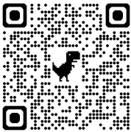
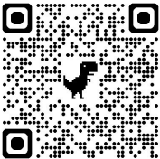

Slide 28
Troop 941 - Push Cart Derby
On Monday, January 26th, Troop 941 in Pleasanton will be having our annual pushcart derby! Here are some quick reminders and some information.
Who: Troop 941 Scouts and AOL/Webelos Scouts
When: Monday, January 26th, 2026
Time: 7-9 pm
Where: Blue Oaks Church Back Parking Lot
What to Bring: CLASS B!, Bike helmets, flashlight/headlamp, jacket, long pants, closed-toed shoes, and water
T941 Scouts will help power AOL Scout drivers as they race on a loop track around the parking lot trying to log the fastest time while parents can learn more about Troop 941 and the transition to Scouts BSA. For questions, email Patrick Markel at scoutmaster@troop941.org or markelpatrick@troop941.org.

Slide 29
Troop 924 - Monkey Bridge
Troop 924 is proud to host the construction of a Monkey Bridge to showcase Scout Pioneering Skills.
When: Saturday, January 24th – 11:00 to 12 noon Enjoy the Bridge and Troop provided Pizza Lunch, Pizza!
Where: 501 Daisyfield Dr, Livermore, CA (In the Arroyo, just south of Hagemann Park)
Who: T924 Scouts will construct the bridge, Scouts, Cub Scouts, friends and siblings are invited 11 am to 12 noon.
Why: The Scouts will use knots and other skills to construct a bridge, then the brave will cross the bridge.
Details: We will be down in the Arroyo, just south of the address. There is a gravel trail leading down to the paved trail and an opening on either side of the creek bed. Please wear a Class B uniform and wear shoes you don’t mind getting muddy, bring gloves if you desire.
The T924 Scouts will have built the bridge across the Arroyo. Once it has been assessed for safety, we’ll let the brave and adventurous Cub Scouts cross it.

Slide 30
Twin Valley 1st Annual AOL Trail to Troop
October 2nd- 4th at RLM
Open to 200 AOL Scouts & Parents (not a family camping event, have to be an AOL Scout to attend)
Cost $85 per participant
Registration opens 4/1 through 9/1 or until sells out
Looking for the following adult help
BB Gun ROS & Instructor
Medic

Slide 31
What event includes for AOL & Their Parents
Parents get to learn about the transition from Cubs to Troop
AOL get to mingle with Troop level Scouts
AOL get to earn (pins not supplied):
Outdoor Adventure
Bobcat
First Aide
BB Gun

Slide 32
What is covered at the event?
Fun patch
Campsite (Blue Oak North & South)
Meals on Saturday (B/L/D/Dessert) & Sunday Breakfast (Friday is BYOD)
Pack list & event guide will be sent out to attendees closer to the event
Contact Erin Storm with questions tvggactrail2troop@gmail.com

Slide 33
Pinewood Derby / Blue & Gold
How do you make it special for your pack?
What are your packs traditions?
How do you celebrate your scouts?
What is the best thing about your event?

Slide 34
Breakout
BSA Scouts

Slide 35


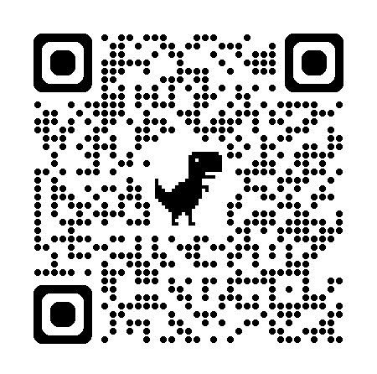
oceantoredwoodadventure
Who: Provisional Scouts, aged 14-20
What: Backpacking, canoeing, COPE,
trail cooking, leadership devo
When: July 5 – July 11
Where: Camp Royaneh
Cost: Same as camp, $815
Discount: Half off for anyone attending a week of camp
Questions: croraadventure@gmail.com
Registration & More Info

Slide 36
oceantoredwoodadventure
Who: Provisional Scouts, aged 14-20
What: Backpacking, canoeing, COPE,
trail cooking, leadership devo
When: July 5 – July 11
Where: Camp Royaneh
Cost: Same as camp, $815
Discount: Half off for anyone attending a week of camp
Questions: croraadventure@gmail.com
Registration & More Info

Slide 37
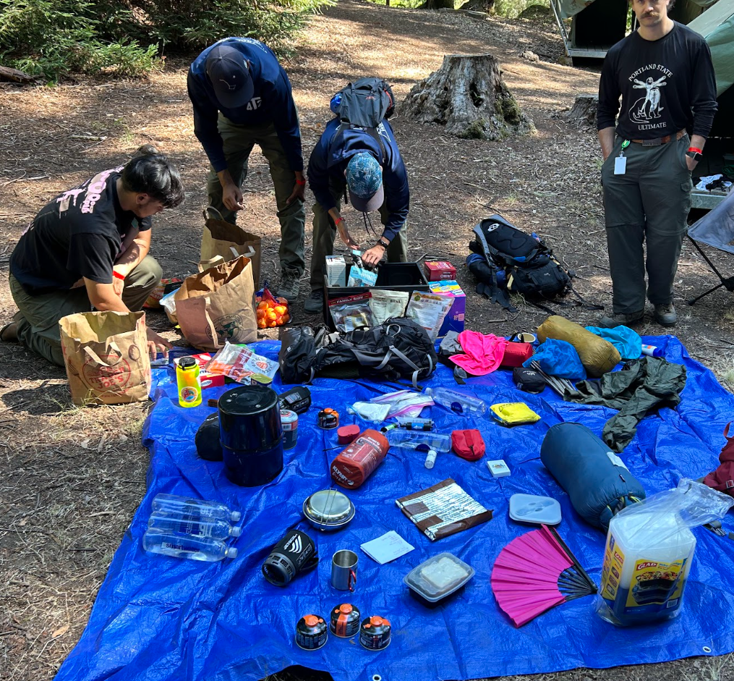
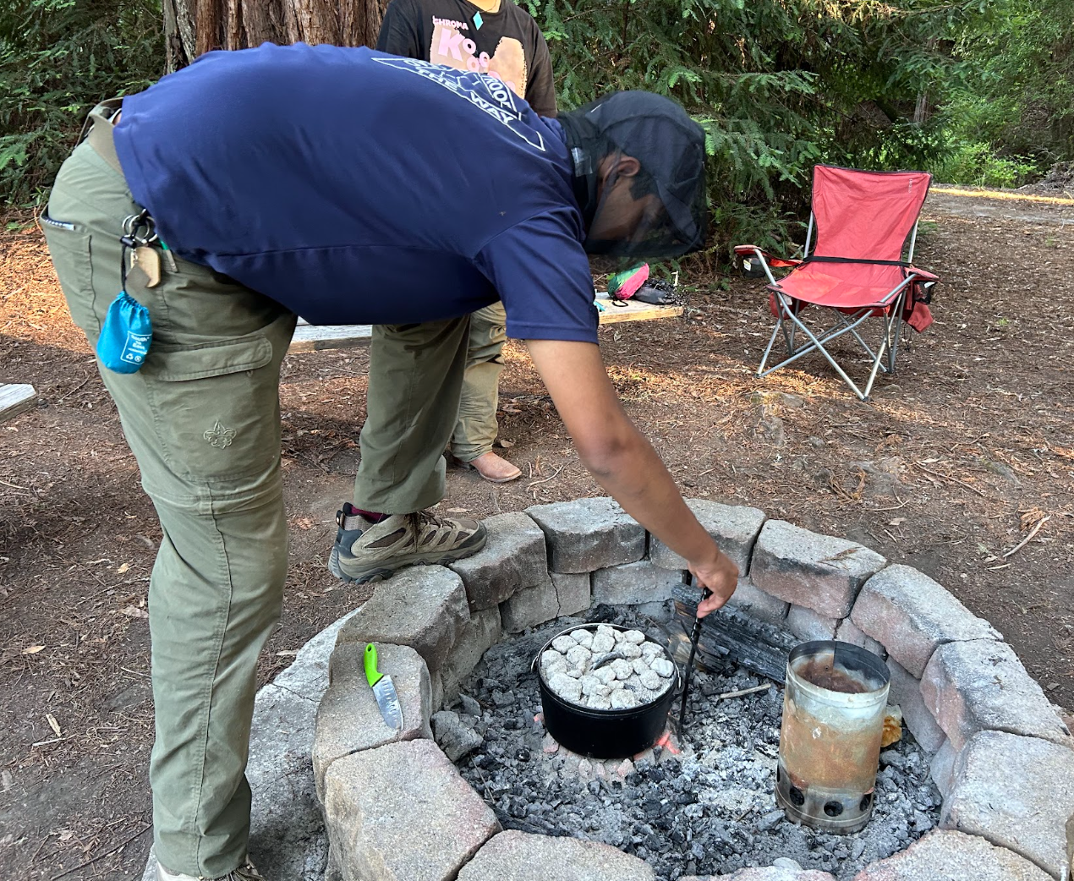
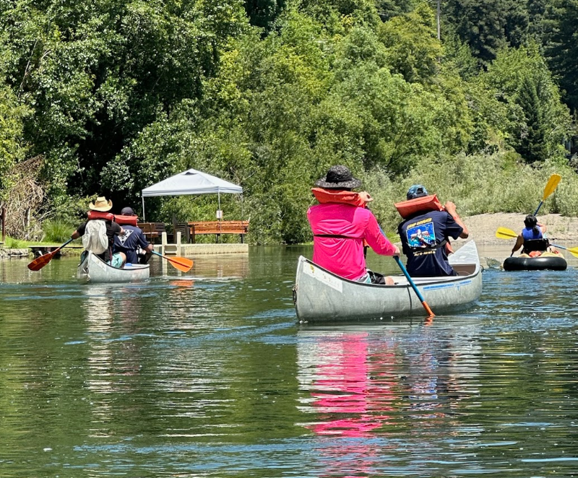

Slide 38
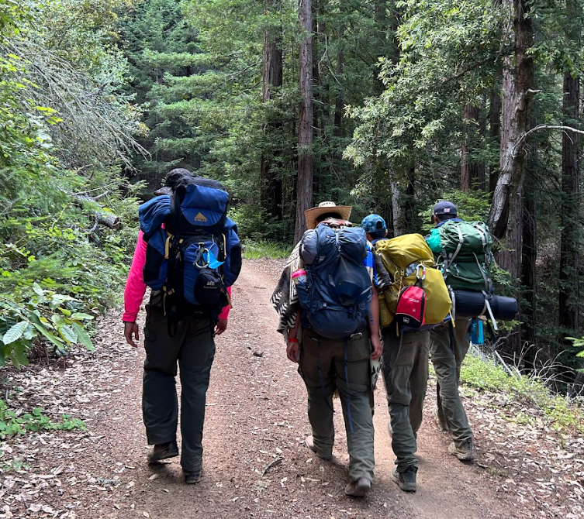
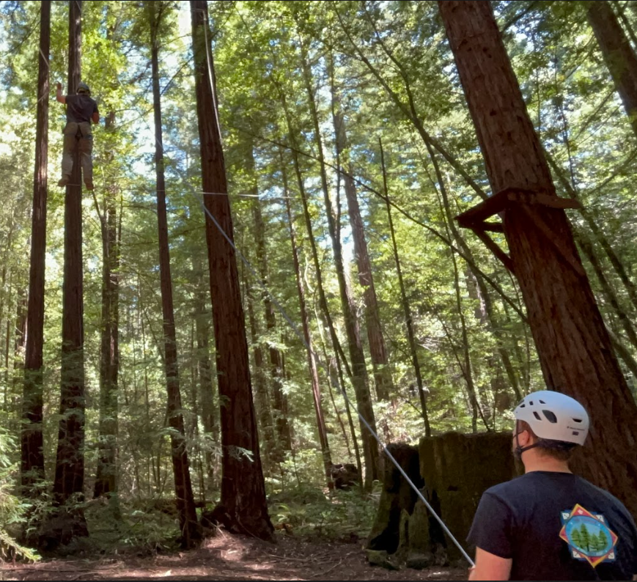
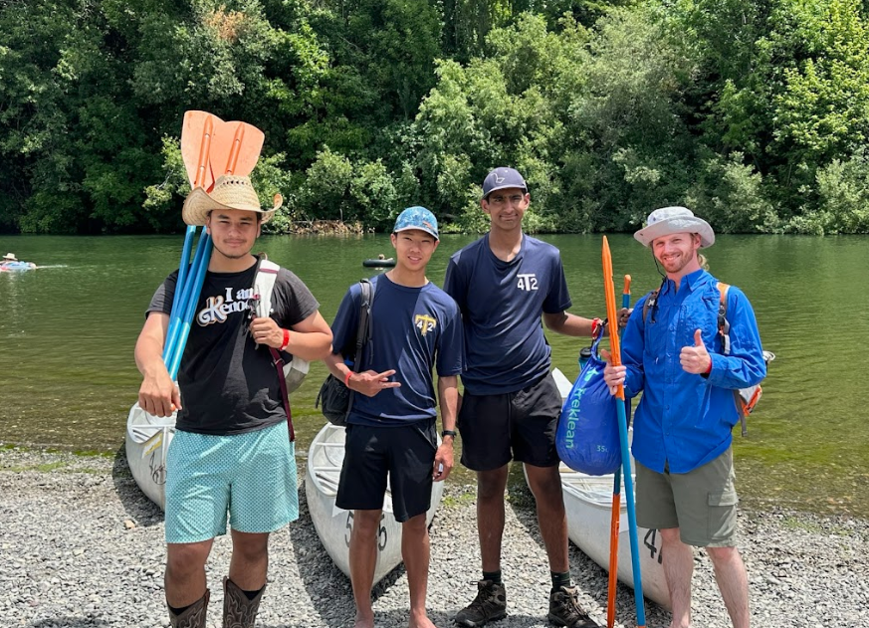

Slide 39
Troop Help Needed
Need help from Twin Valley Troops to help run this event
Open to 60 Scouts & Registered Leaders
Cost is $0
Registration opens 4/1/26
Camping at Aqua Mesa at RLM
Includes Meals on Saturday (B/L/D/Dessert) & Sunday Breakfast (Friday is BYOD) & a fun patch

Slide 40
How can you help?
What roles that we need help with:
Running Stations for 3x AOL adventures (Scouts & Adults)
Patrol Leaders for AOL Patrols
ROS & Instructor for BB Gun Range (Saturday AM)
Medic
Contact Erin Storm with questions tvggactrail2troop@gmail.com

Slide 41

Scout Sunday, Scout Jumuah, and Scout Sabbath
Scout Sunday
First Sunday in February (or whenever makes sense for the church)
Scout Jumuah
Scout Jumuah is most commonly the first Friday of February
Scout Sabbath
Commonly begins at sundown on the first Friday of February and continues into the next day

Slide 42
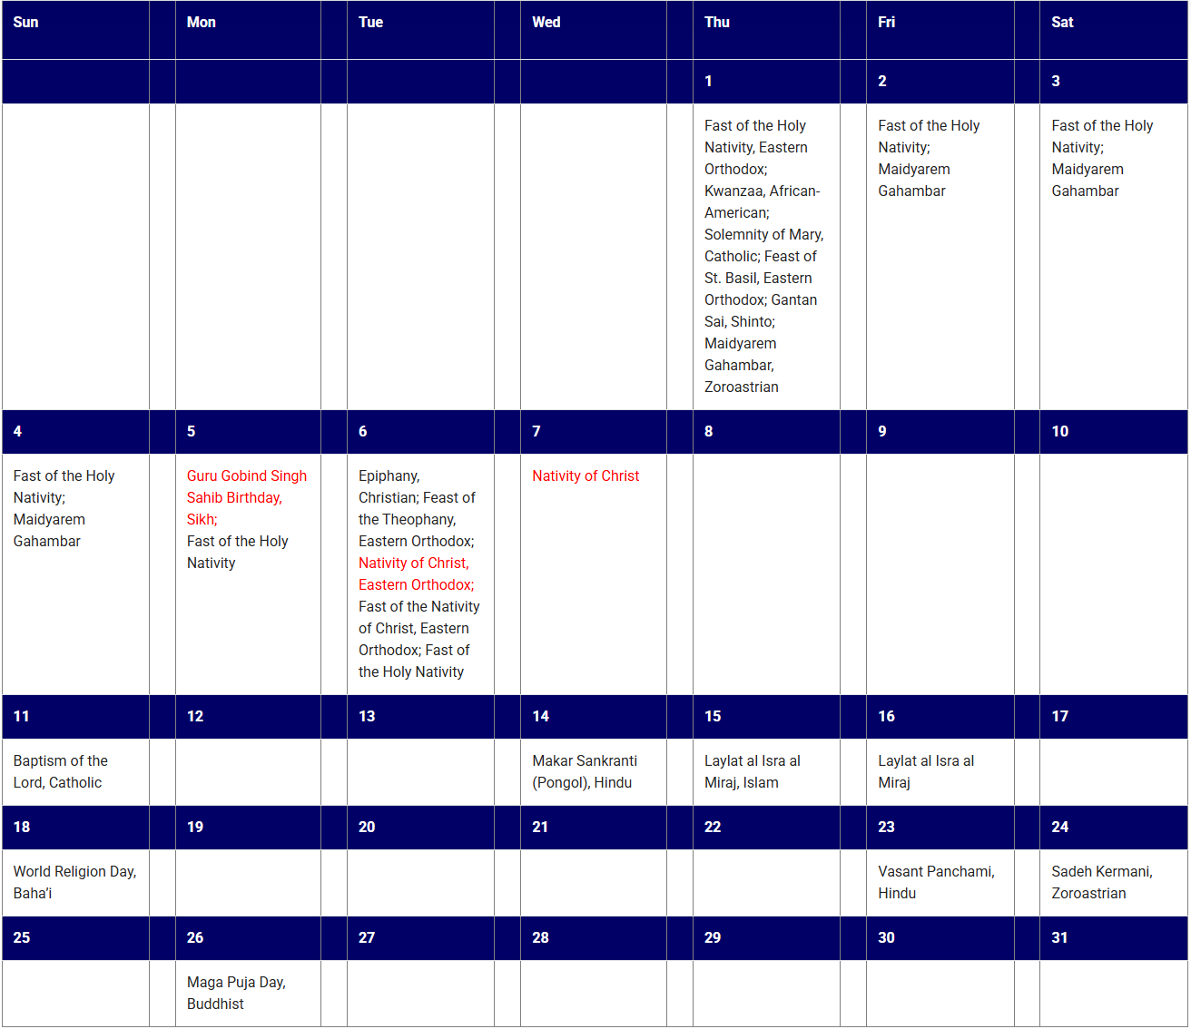
Calendar of Religious Observances
Helpful to know when to schedule (and not schedule) events
Scouting America discourages scheduling events on red highlighted dates.
Calendar can be found at https://www.scouting.org/resources/relationships/religious-observances/calendar-of-religious-observances-2026/

Slide 43
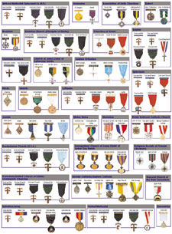
Religious Emblem Program
Created by the various religious groups to encourage youth to grow stronger in their faith. The religious groups—not Scouting America—have created the religious emblems programs themselves.
More at https://www.scouting.org/awards/religious-awards/

Slide 44
How to get started
Obtain the specific workbook for their religion
Parents review the program guidelines
Work with religious leaders
Complete requirements
Presentation of emblem

Slide 45

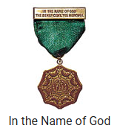
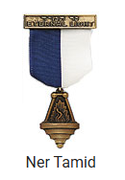


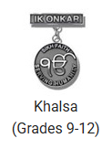

Some Examples
Hindu
Islamic
Jewish
Sikh
Roman Catholic
Presby- terian Church (U.S.A.)

Slide 46
What about your troop?
Do you encourage Scouts to earn religious emblems?
Do you have any plans for Scout Sunday, Scout Jumuah, or Scout Sabbath?

Slide 47
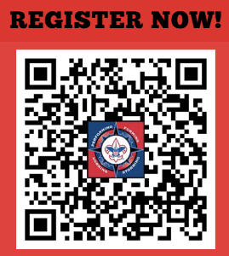
National Youth Leadership Training
Why Join NYLT?
Why are we Different?
Build leadership & confidence
Learn teamwork & problem-solving
Make new Scouting connections
Fully youth-led experience
One of the largest NYLT courses in the U.S.
60+ staff, including 1/3 female staff
Hosted 193 participants in 2025
Who can Attend?
First Class Scouts & Above
Must be at least 13 years of age
Dates/Location/Cost?
Camp Racho Los Mochos, Livermore CA
June 7-13, 2026 - $495 (Before May 1st, $525 after)
Camperships are available

Slide 48
National Youth Leadership Training
Calls to Action:
Share Information with your Sr. Scouts
Foster a Troop Culture that includes scouts attending NYLT
Provide Guidance that allows Participants to Leverage their new Skills and Experience in your Troop
Adult Leaders are needed to help run this program
Please contact Jean Kuznik - jfkuznik@gmail.com for more information on how to help and participate in this program.

