Slide 1


Slide 2
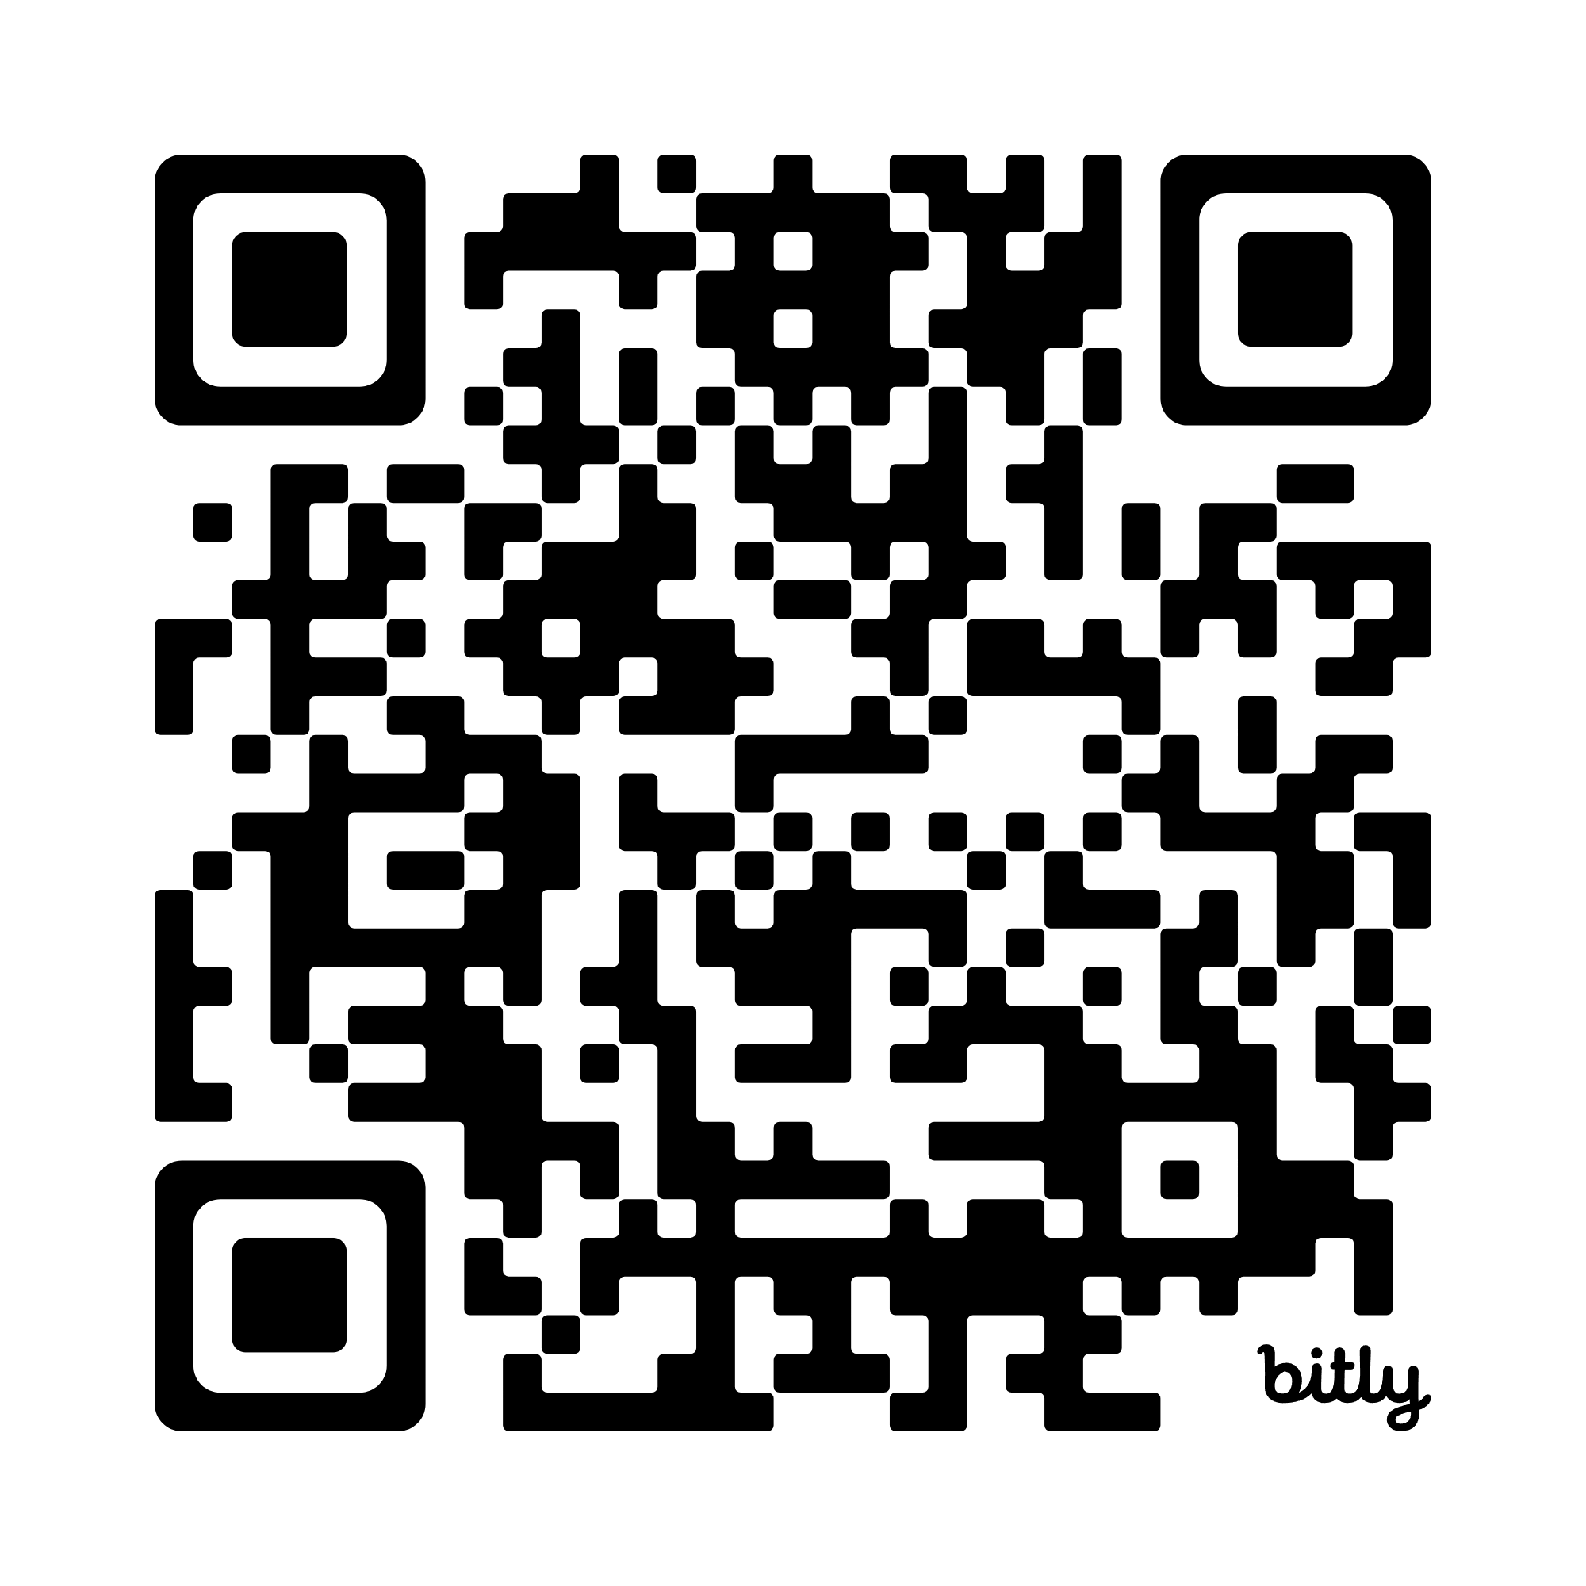
Please Sign-in
Network: Blue Oaks
Password: 7139KollCenter

Slide 3


Seunen Paschengink Contacts
https://yerbabuena.goldengatescouting.org/
Aditya Bakhandi
amazingadityab@gmail.com
Chapter Chief
Shannon Carroll
shannoncarrollggac@gmail.com Chapter Advisor
***please remember to use YPT protocol when communicating with youth members***

Slide 4

Twin Valley Roundtable
December 11, 2025

Slide 5
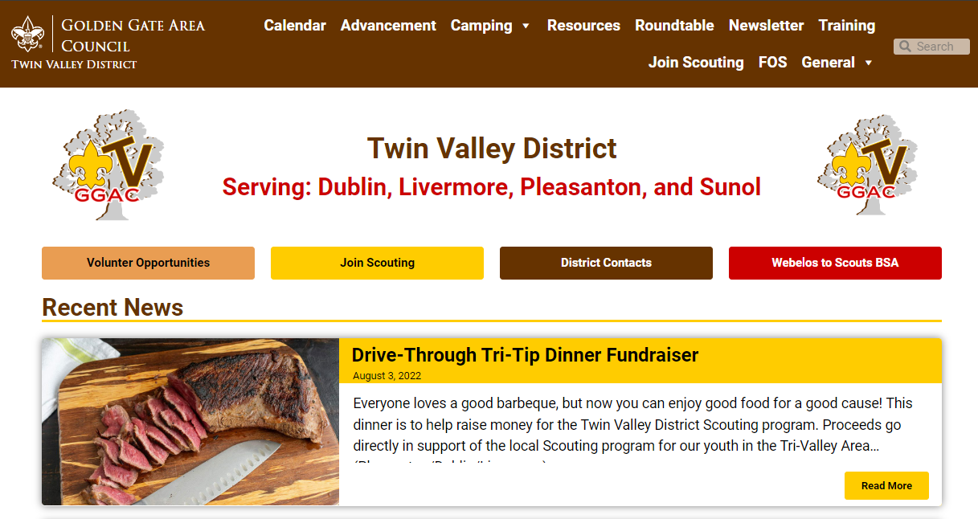
Welcome to Roundtable
Tonight’s slides are available online at:
https://twinvalley.ggacbsa.org/

Slide 6

District Updates
December 11, 2025

Slide 7
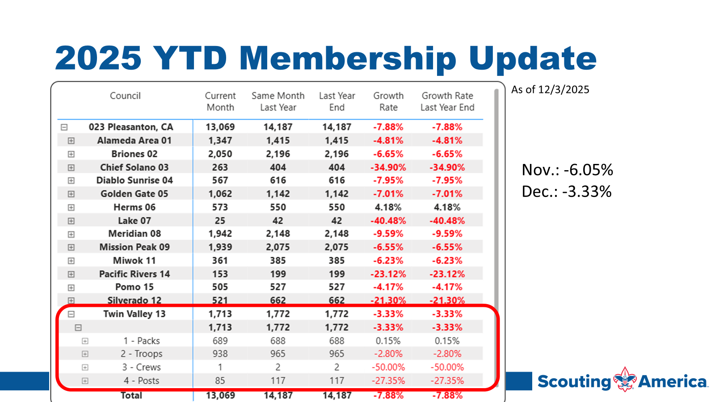

Slide 8
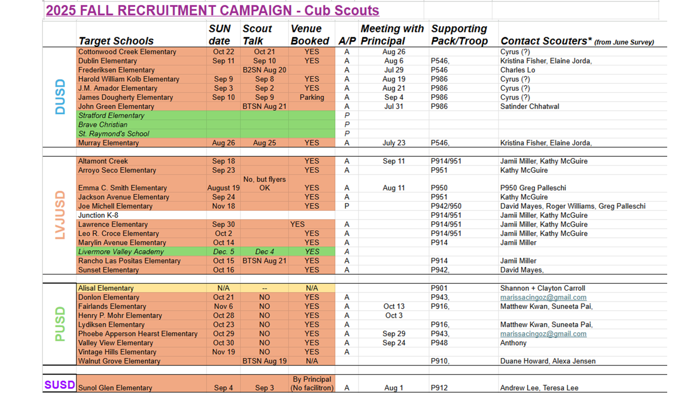

Slide 9

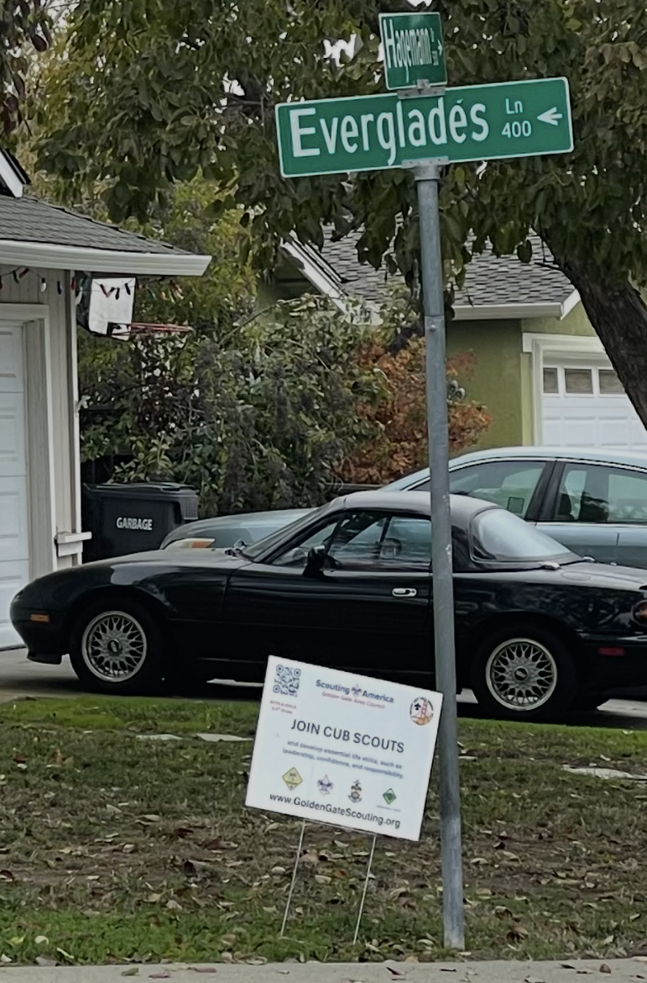
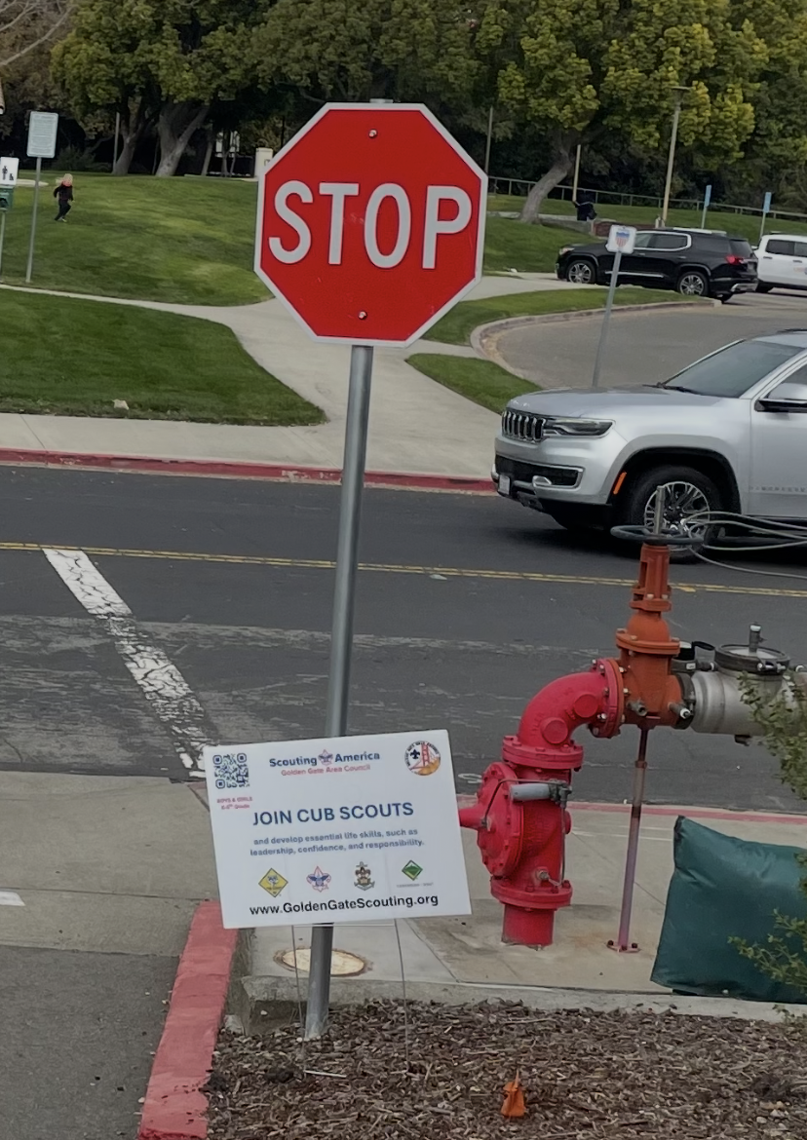
Available for you:
18" x 24" Yard sign
Semi-permanent
Check local restrictions
Schools, neighborhoods, meeting places
Available for pick up tonight

Slide 10
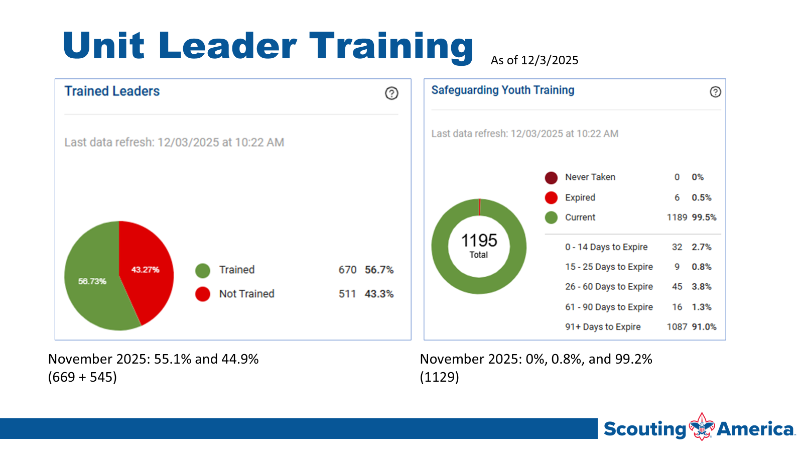

Slide 11
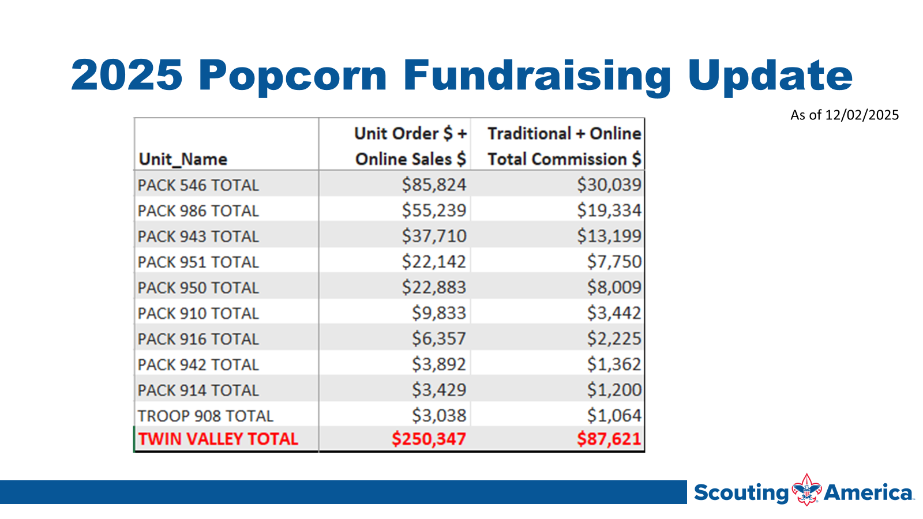

Slide 12


Slide 13
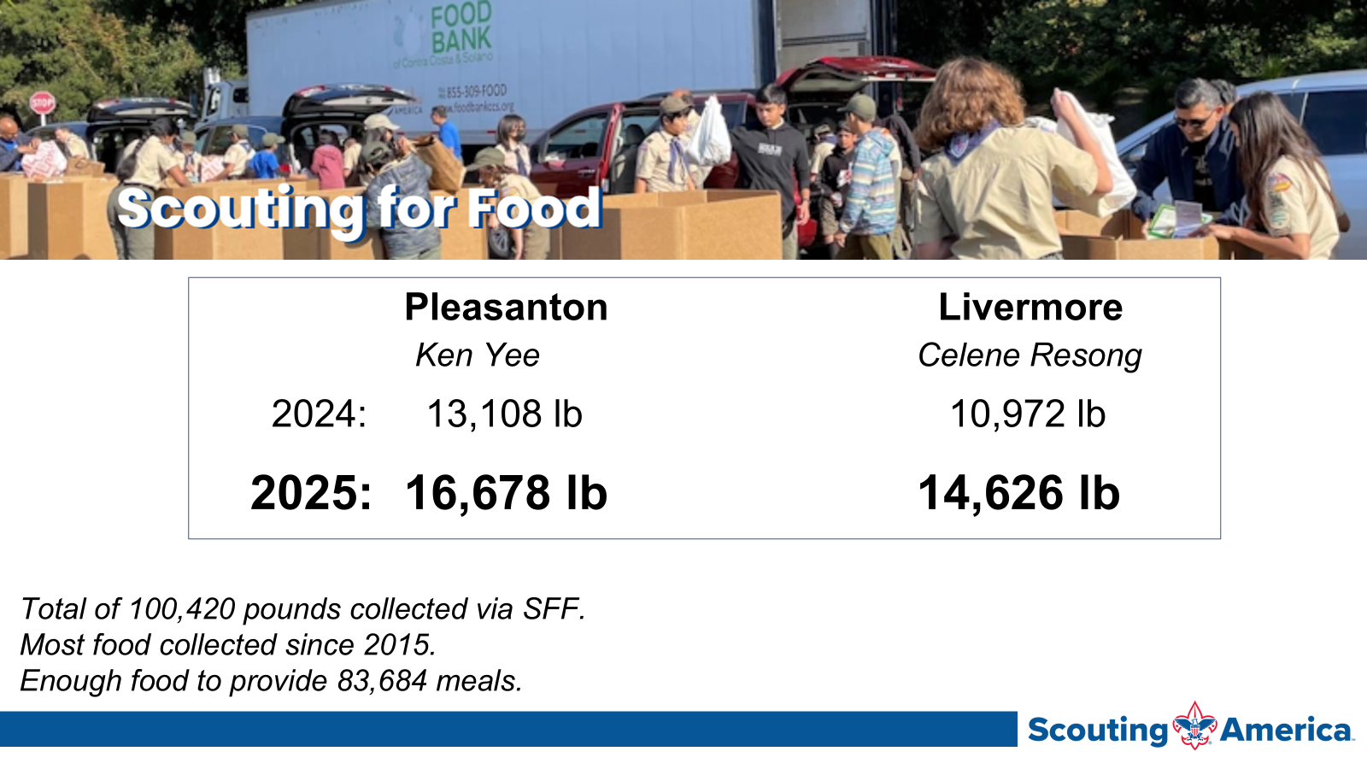

Slide 14
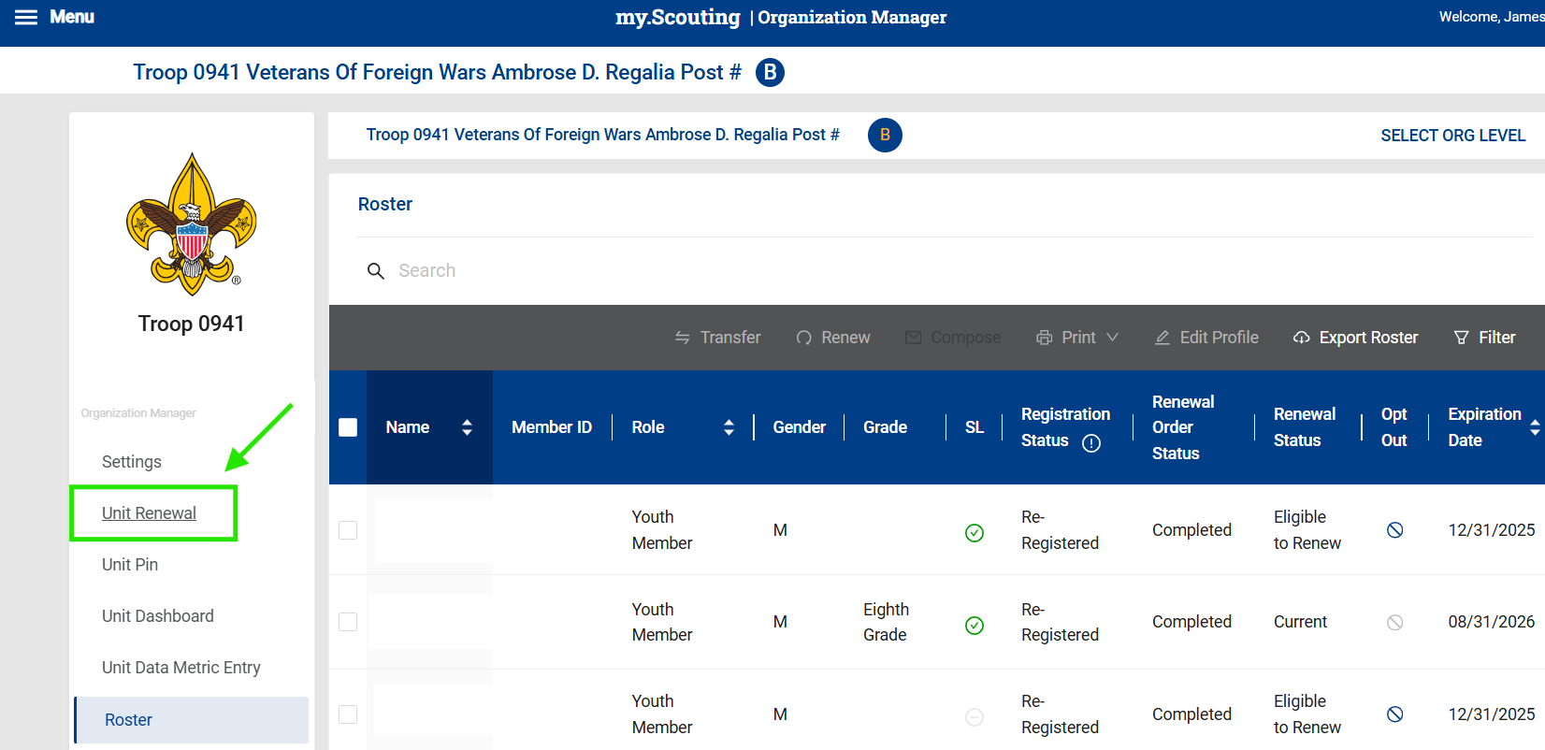
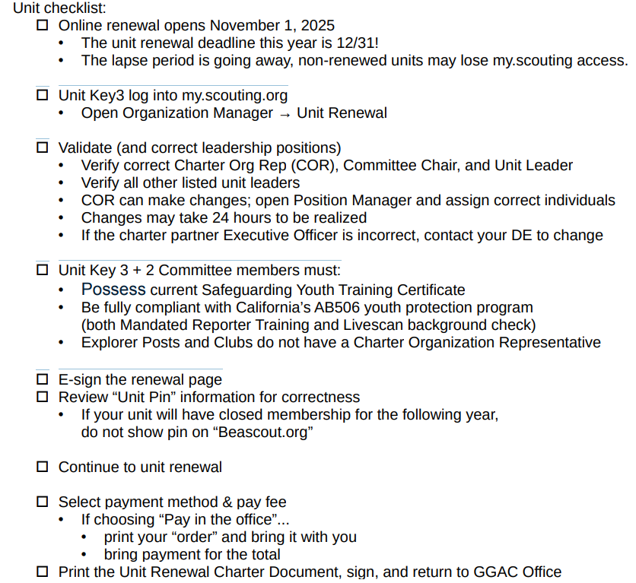
Unit Renewal (formerly known as Recharter)

Slide 15
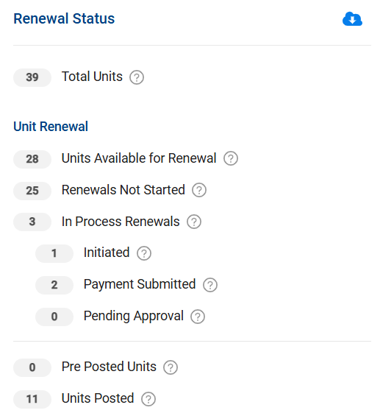
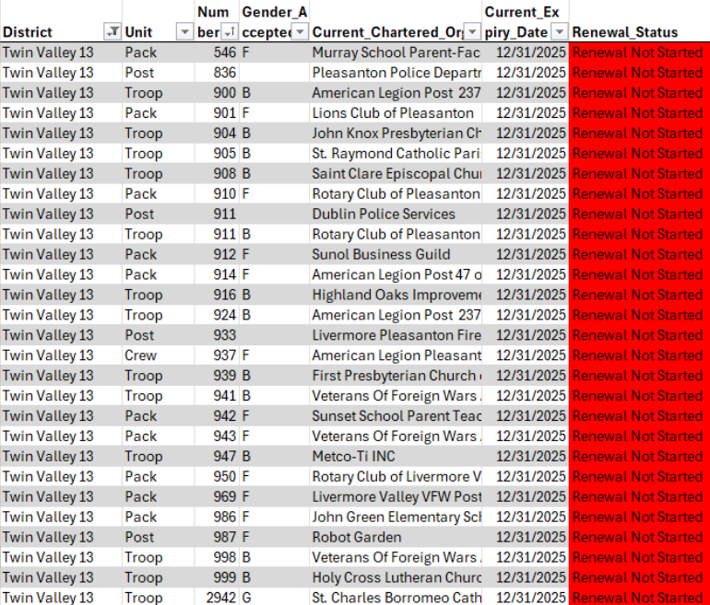
Unit Renewal - Need to start

Slide 16
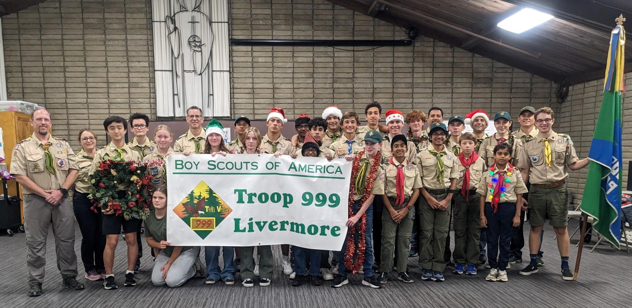
Family Troop Option
Look for formal announcement from National on December 15th

Slide 17

Scouting for Food Update
Council Total = 217,000 lbs
Twin Valley = 45,000 lbs

Slide 18

Pinewood Derby Tune-up
Veterans Memorial Building
301 Main Street, Pleasanton
Saturday, January 10, 2026
9:00 am to 1:00 pm
WE NEED HELP!!!
Contact: Greg Dyson dyson_greg@hotmail.com 925/321-3748

Slide 19

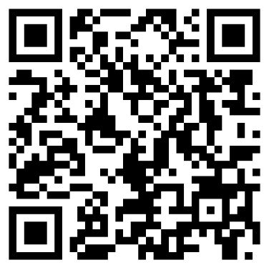
L.E.A.D. Training
Saturday, January 24, 2026
Diablo Valley College, Pleasant Hill
Join your Fellow Scouters for a complete day of learning, fun and experience!

Slide 20

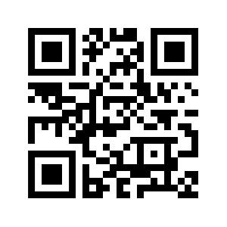
L.E.A.D. Training
Saturday, January 27, 2024
Diablo Valley College, Pleasant Hill
Join your Fellow Scouters for a complete day of learning, fun and experience!

Slide 21


Get Trained for your Position!
Cub Scout Den Leader Training
February 21 at GGAC Office
Link Coming
Introduction to Outdoor Leader Skills
March 25 AND April 10-12
Register at https://scoutingevent.com/023-blueoak44

Slide 22
ACTIVITIES AND EVENTS
Really Fun Stuff

Slide 23

T-Shirt Club
Be in the room where it happens
Change into a t-shirt
and see you there!
This month, let’s try…
4805 Hacienda Dr, Dublin

Slide 24
SPOTLIGHT
Really Fun Stuff

Slide 25
TROOP SHOWCASE
Find Your New Troop

Slide 26
Order of Troop Presentations:
Troops 904 and 2904 (Dublin)
Troop 900 (Livermore)
Troop 941 (Pleasanton)
Troop 905 (Dublin)
Troop 999 (Livermore)
Troop 939 (Livermore)
Troop 998G (Pleasanton)

