Slide 1

Twin Valley Roundtable
March 10th, 2022

Slide 2

OPENING

Slide 3
Welcome to Roundtable
Tonight’s slides are available on the Twin Valley’s website
Contact me:
  Peter Zischka, Scout BSA Roundtable Commissioner
  2vroundtable@gmail.com

Slide 4
TV’s Newest District Executive
Please welcome Andrew Evans.
andrew.evans@scouting.org

Slide 5
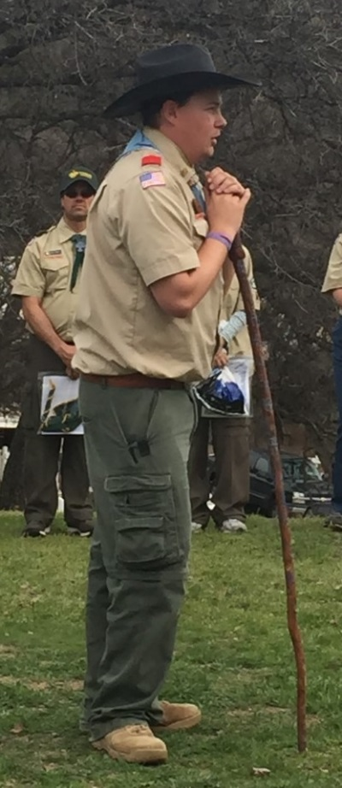
Twin Valley’s Newest Silver Beaver
Congratulations to Trevor Bormann
Twin Valley District newest Silver Beaver recipient.
Trevor has a long history of service to others.
  National Eagle Scout Association Co-Chair for 7 years.
  Dedication to the achievement of youth in the promotion of Eagle Scout achievement throughout the Bay Area.
  Working with youth in the baseball training.
  Volunteered umpiring and trained little league umpires.
  Volunteered at the local high schools, little leagues and other local organizations for camps.
  Trevor sits on the board of the Betty Ross Foundation. This foundations aim is to help underprivileged youth afford to participate in travel/ club sports.

Slide 6
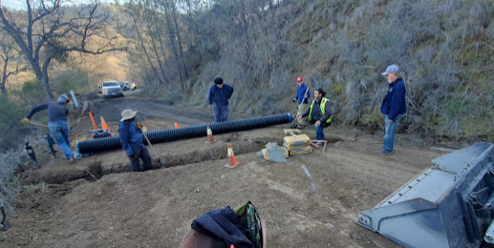
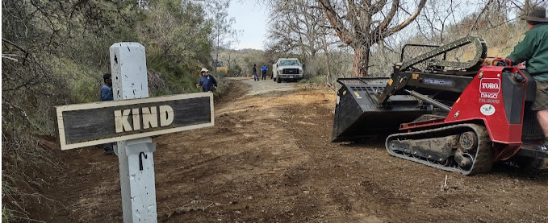
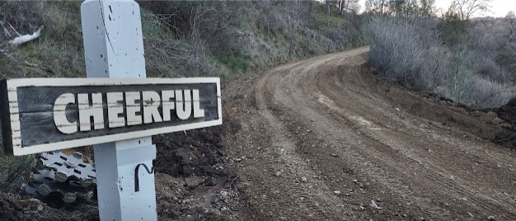
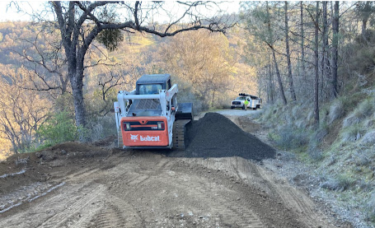
Ranchos Los Mochos Road Project

Slide 7
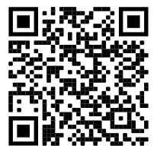
AB 506 Update
Mandated Reporter Training
  due by February 28, 2022
Live Scan background check
  due before April 30
Am I required to take AB 506 training and fingerprinting?
Unit Role Required?
Registered Leader yes
Unregistered unit volunteer Yes, if working with youth > 16 hr/mo or 32 hrs/year

Slide 8
Training
Introduction to Outdoor Leader Skills (Blue Oak)
  Outdoor session: Fri Mar 25 2022 - Sun Mar 27 2022
Scoutmaster/Asst Scoutmaster Specific Training
  May 14th @ Rancho Los Mochos (Camporee)
450 online classes @ https://training.scouting.org/catalog
Training questions contact: training@twinvalleyscouting.com

Slide 9
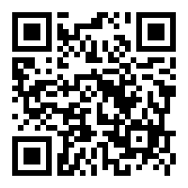
TV Volunteer Recognition Awards!
Nominations open now through April 2, 2022
  Unit Leader of the Year (Pack, Troop, Crew, Post)
  Unsung Hero
  Spark Plug
  Scouting Family
  District Scouter
  District Award of Merit
  EPIC! (Exceptional Perseverance in spite of Crisis!) Award - for this year only!
Can nominate others online or via pdf-fillable forms to be emailed
Contact Phil Weiss for more info
(phil.weiss.email@gmail.com or 925-989-4656)
It only takes a few minutes to nominate a great volunteer; the thanks provided lasts a lifetime!
Scan for the online nomination form
Awardees Recognized at Annual Volunteer Recognition Dinner on May 7, 2022

Slide 10

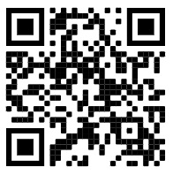
Golden Gate Area Council
Volunteer Celebration 2022
Saturday, April 2
Doors Open at 2pm, Program Commences Soon After
Hosted at the Alameda County Fairgrounds
$45 per attendee

Slide 11
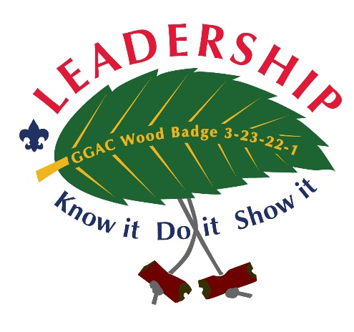
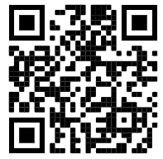
Wood Badge – 2022
BSA’s premiere Adult Leadership Training
Cancelled
March 25-27 at Camp Herms
April 22-24 at Rancho Los Mochos
Cost: $325
Contact: Fydra Muck (maihaa1@gmail.com)
Scouters learn valuable tools such as listening, communicating, conflict management, project planning and leading change.
Notes:
John Bird

Slide 12

BREAKOUTS
Cub Scouts
Scouts BSA
Eagle Path

Slide 13

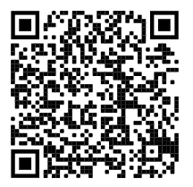
Citizenship in the Society (CIS)
Merit Badge Councilor Training is required for this badge
  Submit candidate names to 2vroundtable@gmail.com
Training Dates:
  Friday, Mar 18, 2022, 7:00 PM
  Friday, Apr 15, 2022, 7:00 PM

Slide 14

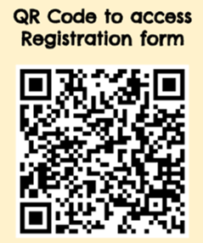
Camporee 2022
Theme: Mission Impossible
Date: May 13-15
Location: Rancho Los Mochos

Slide 15

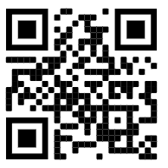
National Jamboree
July 19-28, 2023
Summit Bechtel Reserve, West Virginia
10 days of activities
$3,900 for Jamboree
The Council’s contingent will be 150 Scouts and Leaders

Slide 16

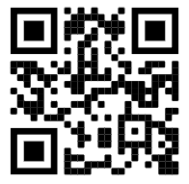
2023 World Scout Jamboree
August 1 to August 12, 2023
Saemangeum, South Korea
Youth Participants and Unit Leaders ‐ $6,100

Slide 17
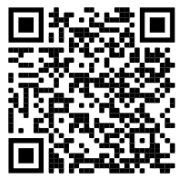
Wilderness First Aid Training
CPR/AED and Wilderness & Remote First Aid Certification
Required for High Adventure Activities
$145/person ?
Camp Herms
  Apr 2-3
  June 11-12
  Sept 10-11

Slide 18
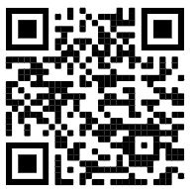

NYLT – New Youth Leadership Training
First Class Scouts who are at least 13 years of age or Venture Crew members.
$375 includes camp fees, meals and course materials
June 12 - 18
@ Rancho Los Mochos

Slide 19
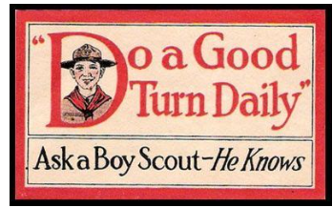
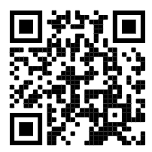
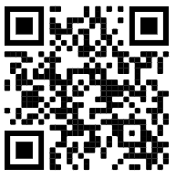
Good Turn Weekend
@ Camp Royaneh and Wente Scout Reservation
April 8 – 10
For Troops, Crews and Ships
Earn service hours and help
prep for summer camp
Royaneh
Wente

Slide 20


Slide 21
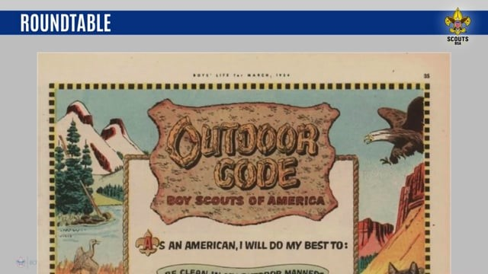

Slide 22
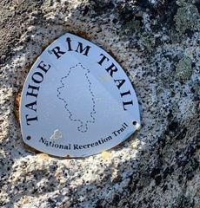
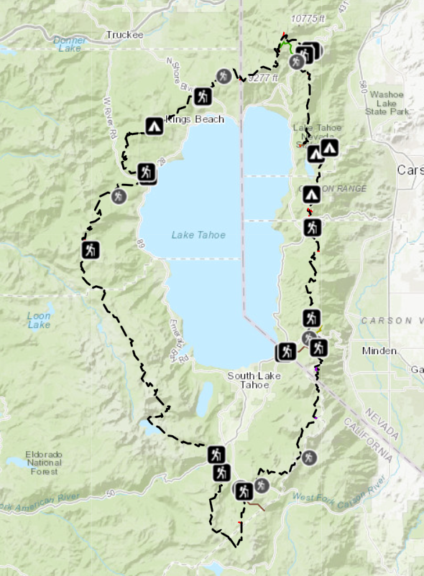
Hike the Tahoe Rim Trail
170 miles
Hike in 9-12 days
Could Hike it in sections
Covered so far:
  #1 Mt. Rose to Spooner Summit
  #2 Spooner Summit to Star Lake
  #3 Star Lake to Big Meadow
  #4 Big Meadow to Echo Lake
  #5 Echo Lake to Tahoe City
  #6 Tahoe City to Brockway Summit

Slide 23
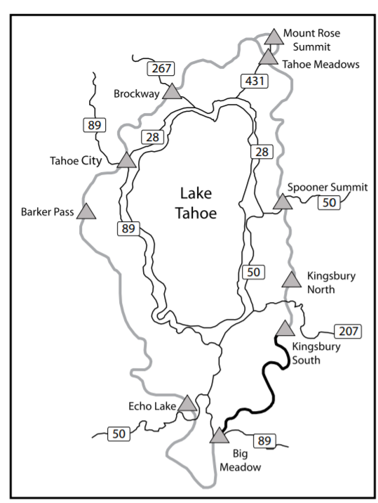
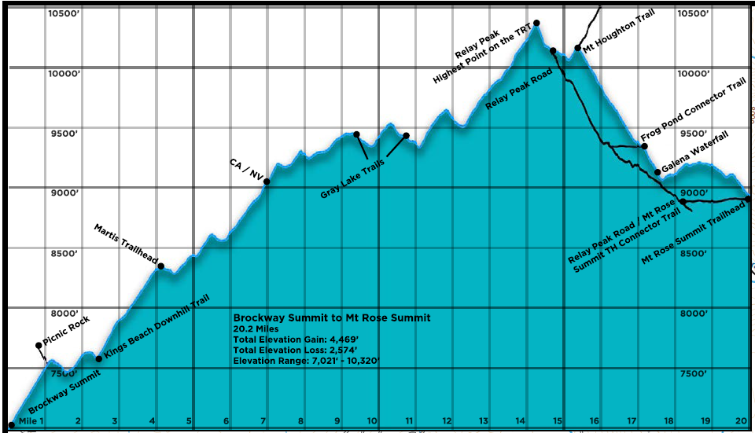
#6 Brockway Summit to Mt. Rose
Length: 20.2 miles
Duration 2 days
Start: Brockway Summit Trailhead
Camp: Near a water source or 10 miles in.
End: Mt, Rose Trailhead
Details:
  No permit required
  Year-round water at Galena Creek Falls, Gray Lake and Frog Pond
  Camp at Gray Lake (11 mi)
Attraction:
  Relay Peak @ 10,338 ft, Highest Point on TRT
  Tremendous panoramic views
E
C
S

Slide 24
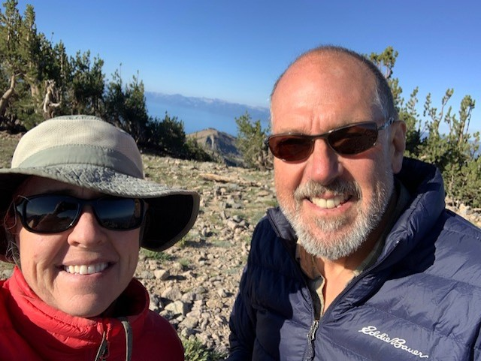
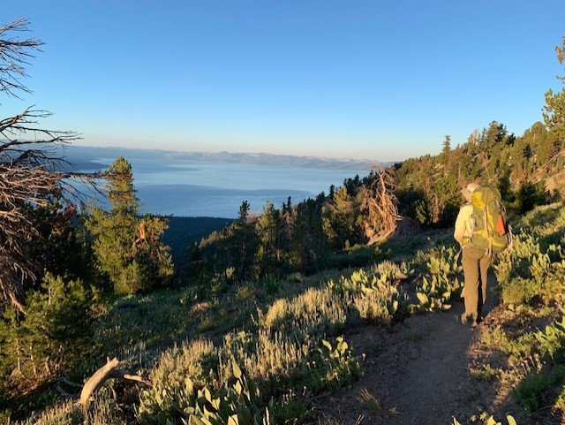
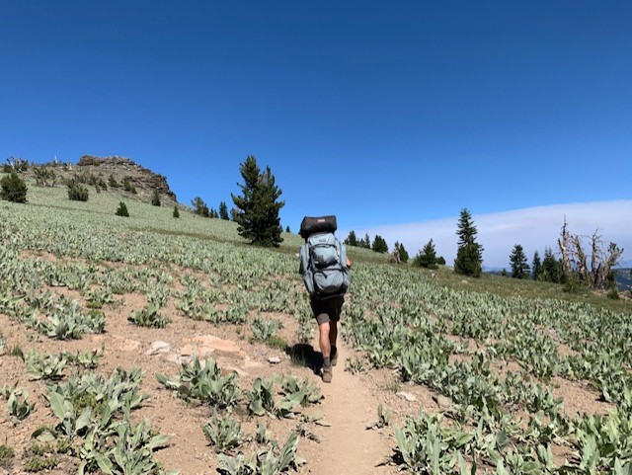
Pictures from the Trail
Relay Peak

Slide 25

CLOSING
General Discussion Topics
Next Roundtable: April 14th
Closing Thought

