Slide 1
Planning the Plan
Keys to improving Volunteering within you Pack

Slide 2
4 Keys to Improving Volunteering
Succession Planning
Training and Recognition
Honoring Commitments
Recruiting

Slide 3
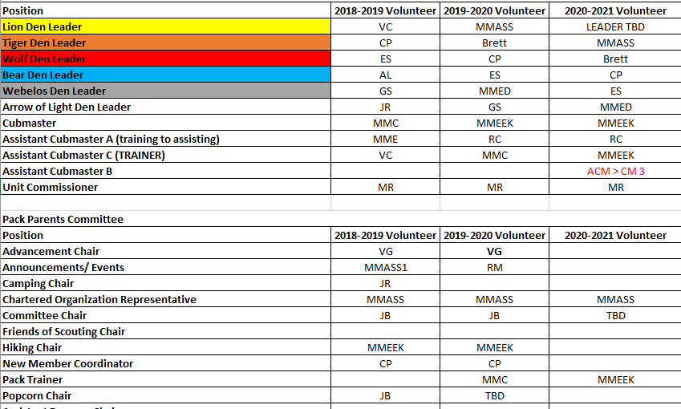
Preliminary Steps:
Succession Planning:
Making the decision on how often Key Positions Rotate
Ensuring that all positions are represented
Outlining that Rotation
Training progressions and position durations

Slide 4
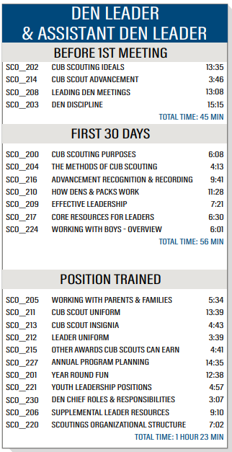
Training and Recognition
Keep a page dedicated to training (Calendar, Requirements, and Estimated Time Required on the Pack website.
Provide detailed information about Position training requirement: (https://filestore.scouting.org/filestore/training/pdf/TrainedLeader_Requirements.pdf )
Start early, provide support. Do a Class together.
Encourage ALL ADULTS to be YPT Trained (this gets them on Scoutbook)!

Slide 5
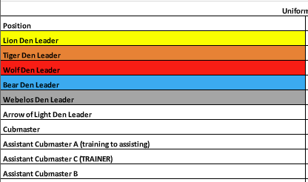
Training and Recognition
Gradual increase in responsibility: This goes back to the Succession Planning (i.e. Cubmaster)
Identify Possible Volunteers. If they are AT the meeting, they are open to helping in some small way.
Hear the Volunteers objections and work to overcome the objections WITH them.
Encourage recognition when possible (at Multiple levels) to reward the efforts

Slide 6
Training and Recognition
FIND TRAINING THAT
ENCOURAGES GROUP PARTICIPATION
BALOO
IOLS
Wood Badge
University of Scouting
Special Interests Training
(Such as Interpreter, Recruiter, Trained)
Training Patch Program:
Working as a team to complete a row

Slide 7
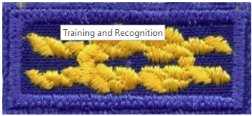
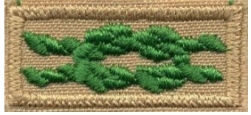
Training and Recognition
Encourage recognition when possible.
Den: Den Leader Presents or “Awards” to remember Camp etc FROM the Den.
Pack: Make certificates and present awards at Pack Meetings
District: Actively work to help Uniformed Leaders achieve Training and Leadership Awards. Encourage participation in Recognition Dinners etc.
Identify Special Interests (Interpreter, Ham Radio Operator) Recognition and Skills.
Make a big deal about Years of Service, Recruiter and Trained Awards

Slide 8
Honoring Commitments
Have Current Leadership estimate amount of time spent on their duties
Look to have “Assistants” to positions. Lower level or responsibility, but being trained
Encourage Uniformed Leaders to delegate if need be.
SET ACHIVEABLE EXPECATIONS OF TIME NEEDED AND WORK TO MEET THESE COMMITMENTS

Slide 9
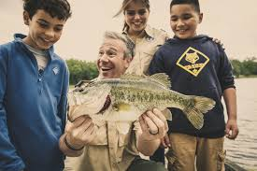
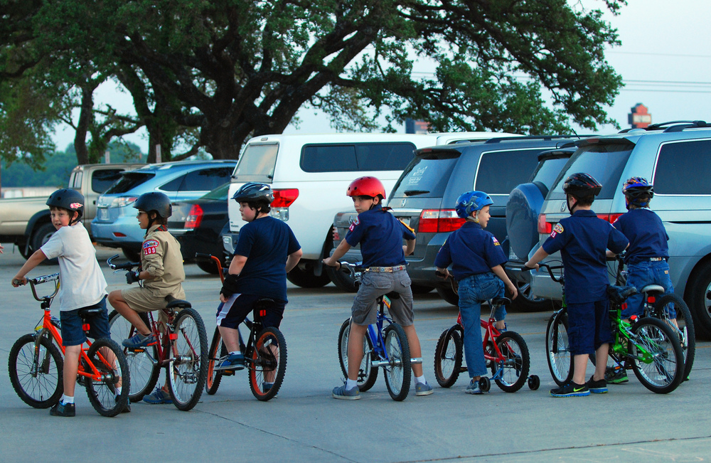
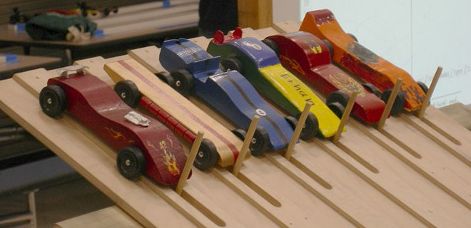
Recruiting
Look For:
Then:
Pack Members Interests
Special Skills
Planning
Hobbies / Talents
An interest someone would LIKE to try
Ask for advice and/or help
Recognize their talent and ask for a demonstration
Encourage them to try that new activity out

Slide 10
Working as a Pack Be Proactive Find Opportunities Include
Succession Planning
Training and Recognition
Honoring Commitments
Recruiting

Slide 11
Working as a Pack Be Proactive Find Opportunities Include
Succession Planning
Training and Recognition
Honoring Commitments
Recruiting

Slide 12
Resources
TRAINING PATCH: http://www.sfbac.org/training/the-training-patch-program/63600
AWARDS: https://www.scouting.org/programs/cub-scouts/what-cub-scouts-earn/adult-awards-and-recognition/
Getting Started on it all and need help or to talk it out?
Michael McClung michaelemcclung@gmail.com Pack 915, AOL Den

