Slide 1
General Discussion Topics

Slide 2
Next Roundtable: December 12th

Slide 3
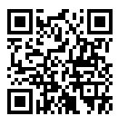
Council Scouters Nominations
Due by November 25, 2019
Contact: Skip Phair jfphair@yahoo.com
Awards
Silver Beaver ~ highest honor a council can present
¡Scouting…Vale la Pena! ~ outstanding service for Hispanic/Latino youth
Asian American Spirit of Scouting ~ outstanding service for Asian American youth
Whitney M. Young Jr. ~ outstanding service youth from rural or low-income backgrounds
Torch of Gold ~ exceptional service in working with Scouts who have disabilities
Venturing Leadership ~ To recognize Venturers and Venturing Advisors who have made exceptional contributions to Venturing and who exemplify the Scout Oath and Law. (Youth nominations may be submitted up to one year past the youth's 21st birthday).
William H. Spurgeon III ~ outstanding leadership for the Exploring program

Slide 4
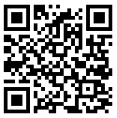
Twin Valley District Dinner
May 9, 2020
Veterans Memorial Hall
301 Main Street, Pleasanton
5:30 PM Chili Cook-off & Fellowship
6:30-9:00 PM Dinner & Recognition
Email: tvdistrictdinner@yahoo.com

Slide 5
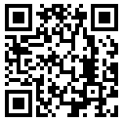
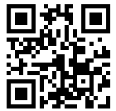
Training
Upcoming training
Merit Badge Counselor (Nov. Roundtable)
Youth Protection (Dec. Roundtable)
Fundamentals of Training & Trainer's EDGE ~1/11
Training Chair
Mike Lennox

Slide 6
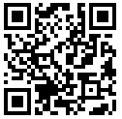
Leave no Trace Unit Guide
Will Be held during BALOO Training ~ 3/27-29
Two-day course @ Rancho Los Mochos
If you are interested, contact Shannon Carroll
Shannon Carroll
mrsshannonpack901@gmail.com

Slide 7
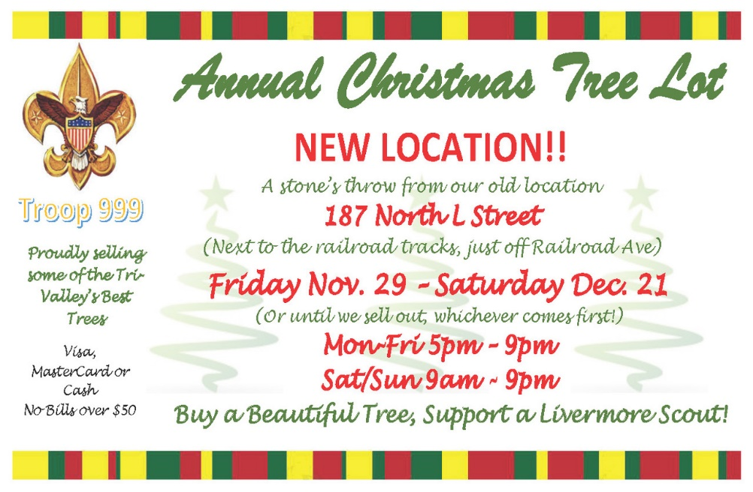
Unit Fundraising
Any unit can advertise their fundraising activity here!
Troop 900 Christmas Tree Lot
Location: Corner of Hillcrest and East Ave. in Livermore
Opens: Nov 29th
Ends: ~ Dec 21st
Hours:
Mon-Fri 5:00-9:00
Sat & Sun 9:00-9:00

Slide 8
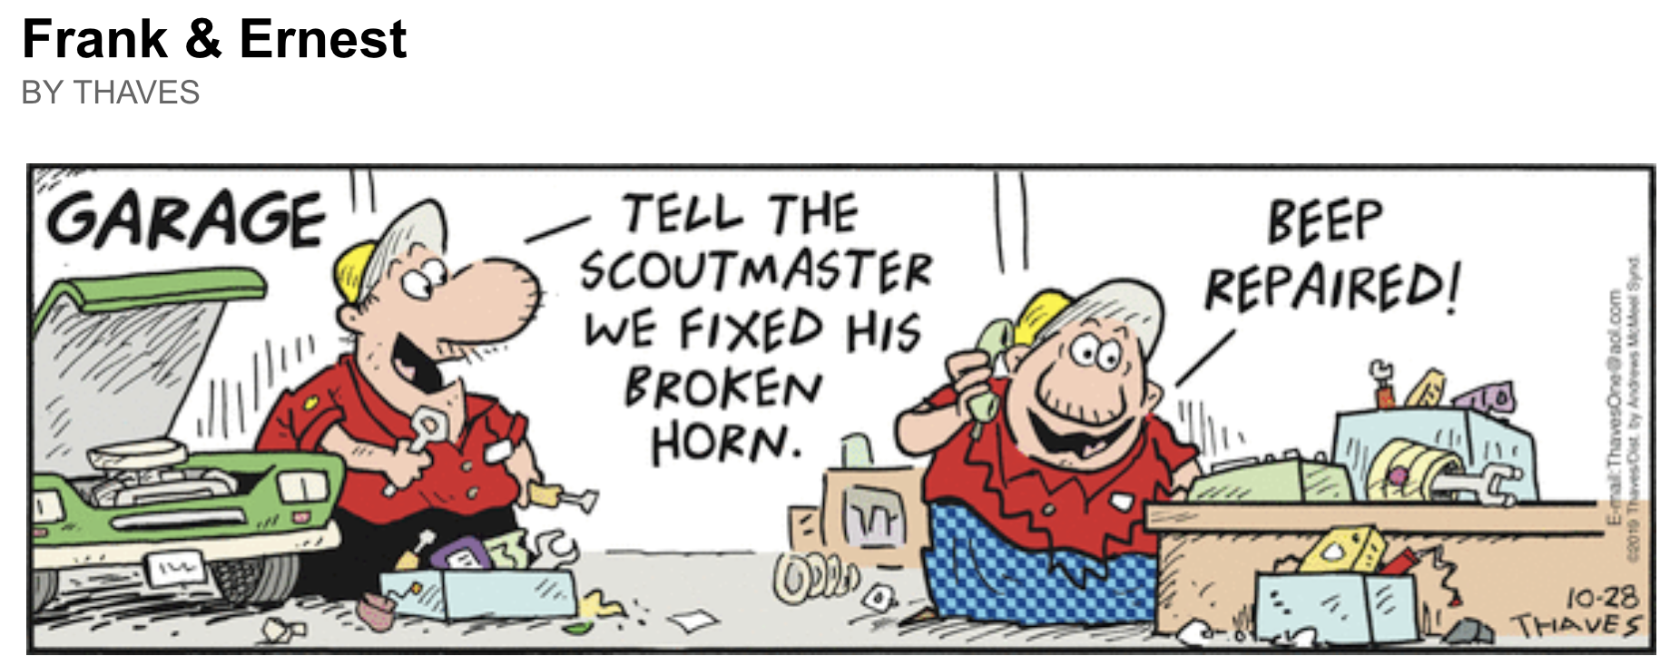
Breakout Sessions
Merit Badge Counselor Training
Follow Mike Lennox
Cub Scouts
Follow Jeff Biehl
Scouts BSA
Right Here

Slide 9
Mark Your Calendar
SM/ASM Position Specific ~ 1/25
Introduction to Outdoor Leadership Skills (IOLS) ~3/4
Basic Adult Leader Outdoor Orientation (BALOO) ~3/27-29
Training Chair
Mike Lennox

Slide 10
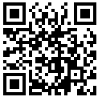
Winter Camp Awareness
http://achewonnimat.org/wca.htm
When:
January 18, 2020
Check-in 8:00 to 8:45
Course begin promptly at 9:00
Ending around 2:45
Where: U.S.S. Hornet
Cost:
$15.00 for scouts
$18.00 for adults
after January 8th subjected to an additional $5.00 late fee.
Contact: wcachair@achewonnimat.org

Slide 11
High Adventure Signups
Philmont Scout Ranch (reg open for 2021)
Florida Sea Base
Northern Tier High Adventure Base
Summit Bechtel Reserve
Louisiana Swamp Base
Chilkoot High Adventure Base

Slide 12
Level 1 USA Archery Instructor Training
When: December 14, 2019
Where: Rancho Los Mochos
Course Includes: all USA Archery Fees, handbook & certification.
Who: Youth/Adults age 16 or older. All Youth must be accompanied by a paying adult.
Cost: $100.00 per Participant
Late fee: $25.00 (after 12/1/2019)
Course Questions: Gene Hertal (unit83@gmail.com)
Registration questions: James Ewing (james.ewing@scouting.org)

Slide 13
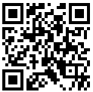
Swimming Merit Badge Day
Date:
November 23, 2019 1:30 pm - 5:30 pm (Check-in at 1:15 PM)
November 24, 8:30 am-12:30 pm (Check-in at 8:15 AM)
November 24, 1:30 pm - 5:30 pm (Check-in at 1:15 PM)
Where:
Southgate Swim Club
24900 Magnolia St
Hayward, CA 94545
Cost:
$50 per scout. Snack included. ($5 Late fee after 11/4)
Bring a signed blue card

Slide 14
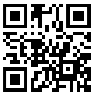
Eagle Scout Board of Reviews
Eagle Coordinators
Jay Johnson (Livermore)
johnson-tveagle@sbcglobal.net
Dean Buchenauer (Pleasanton/Dublin)
sfbac.tv.eaglescouts@gmail.com
Eagle Board Coordinator
Jill Zollinger
tveagleboard@gmail.com
All boards are start at 5:45pm
Livermore Police Station (1110 South Livermore Avenue)
Dec 18th - Need 1 more person

